Slide 1
Ppe program Administration
Requirements for Flotilla and Division Leadership

Slide 2
References
Rescue and Survival Systems Manual, CIM 1047.10 (series)
Auxiliary Operations Policy Manual, CIM 16798.3 (series)
Auxiliary Manual, CIM 16790.1 (series)
Auxiliary Training Boat Crew Hand Book, ATH 1679.51 (series)
D11N Personal Protective Equipment Policy

Slide 3
PROGRAM GOALS
Ensure Auxiliary Surface Operators are properly equipped to safely and effectively execute operations in multiple environments through out D11 North.
Comply with policies for issuance, maintenance, and administration as directed by the Commandant.
Properly record data in ADII to capture funding to justify request for more funds
Model Proficient operations as the Professional Volunteer Service towards Safe mission execution as an example to the public and other safety organizations.
The publics trust is earned in drips and lost in buckets

Slide 4
responsibilities
PPE Program Administration

Slide 5
Director of auxiliary
DIRAUX, “pursuant to current directives”, ensures Auxiliary is provided PPE for assigned duties.
Appropriated funds may be used to purchase PPE. CG-731 (Office of Boat Forces) Office of Boat Forces (CG-731) - RSS Information (uscg.mil) oversees the budget build process and distributes the funds to the District Budget Officer.

Slide 6
Diraux (CONT)
CG-731 runs an ADII report early in Fiscal Year (FY) to determine funding for next FY. The number of currently certified Coxswains, PWC Operators, and Boat Crewmembers is multiplied by a set dollar amount, , then divided by five (assuming a need to replace gear every five years) to determine funding. Additional funding provided for a smaller number of crew that operate in cold weather.
Example: $950 x 294/5 = $ 56,330
Multiple assigned by CG 751 # of certified crew Total funding for basic ensemble

Slide 7
Diraux (cont)
The AUXOPS manual specifies that the OIA is responsible for ensuring crews are outfitted in proper uniform or PPE prior to authorizing patrol. DIRAUX could simply transfer the money to each Sector and require them to manage issuance and administration.
We feel the Sectors are not appropriately staffed and resourced to manage that burden and that Auxiliary operations may be curbed or otherwise impacted if we made that change.

Slide 8
OPERATIONS TRAINING OFFICER (OTO)
Per Part 2, Chapter 1, Article A.6, the OTO is designated as the Rescue and Survival Systems Officer for D11N.
Leverages experience in active-duty program to administer and provide oversite and guidance on Rescue and Survival Systems Program, to include quality assurance efforts.
Subject Matter Expert (SME) on RSS program available to train field units

Slide 9
Flotilla leadership
At the district level, we have near 300 members that have been issued PPE. Managing individual maintenance and record-keeping at this level is beyond the capabilities of the DIRAUX staff.
However, at the Flotilla level, the number of operators is more realistic, and the span of control allows for simplified administration and maintenance.
How much PPE is currently unaccounted for or being utilized outside of policy which makes it a hazard and creates a false sense of safe operation.

Slide 10
Flotilla leadership (cont)
Per Chapter 1, Section K of AUXOPS, Elected leaders have the “responsibility and obligation: to ensure operators comply with established directives.
Flotilla Commanders must know the status of the issued equipment within their unit.
Flotilla Commanders must also exercise the necessary leadership to ensure members who are not in compliance with the PPE policies are notified and instructed not to get underway until the discrepancy has been resolved.

Slide 11
Risk vs gain
PPE that is not serviceable may not perform as designed when the member needs it most. It jeopardizes safety.
Knowingly operating with non-serviceable PPE constitutes a willing departure from established policy and procedure and is negligent operations. In the event of a damage claim, personnel injury, or third-party claim; this departure will be noted and may have a negative impact on claim determination.
EXPOSES THE MEMBER TO FINANCIAL RISK
Increases the administrative burden on DIRAUX and OIA staffs to conduct quality assurance reviews.

Slide 12
Risk vs gain (cont)
To operate in a nonprofessional manner, the gain achieved by continuing to operate with unserviceable PPE doesn’t outweigh the risk.
Auxiliary missions, while very important, are typically non-emergent, Urgent SAR.
ALL COAST GUARD Small Boats and Cutters are not authorized to get underway without conducting risk assessment and proper PPE for the expected environmental conditions.

Slide 13
ADMINISTRATION

Slide 14
SHARED FLOTILLA RESPONSIBILITY
FLOTILLA COMMANDER
ADMIN OVERSITE
FSO-MA
ISSUANCE
FSO-OP
MAINTENANCE

Slide 15
FSO-MA
Coordinates with DIRAUX to obtain equipment for flotilla members
Equipment being shipped will typically be sent to FSO-MA vice individual member to ensure proper documentation is completed.
Completes the DD-1149 and AF-538, sends copies back to DIRAUX.
Ensures gear fits properly and marks IAW guidance.
Returns gear to DIRAUX when turned in.

Slide 16
Fso-op
Reports monthly to FC on status of PPE maintenance example
Number of members with PPE | 10
Members with current inspections | 8
Members not current | 2
Actions taken to get members current | Xxxxxx xxxxx xxxxx xxxxx

Slide 17
Fso-op (cont)
Coordinates semi-annual inspections of PFD’S, Anti-Exposure Coveralls, Boat Crew Survival Vests, Float Coats…..
Takes reports of satisfactory or unsatisfactory monthly PLB battery tests from coxswain or facility owners.
Maintains Rescue and Survival Systems Logs (Rescue and Survival Appendix C CIM 104710)
Updates ADII to reflect accountability and satisfactory inspection.

Slide 18
inspections
Although the FSO-OP is responsible for coordinating, they are not the sole member responsible for conducting the inspection.
Ideally, during meetings and collectively inspect each others PPE. Alternatively, one member may inspect another’s gear if they cannot make a meeting.
It is essential to have Two-person integrity (TPI) this is a means of error trapping.
One-member self-reporting completion of their own inspection is not acceptable.

Slide 19
Inspections
Members conducting inspections shall use the inspection job aids/ maintenance procedure cards located at:
https://uscg.experience.crmforce.mil/auxcommunity/s/contentdocument/ContentDocument/All
[Aux Data // More //Files//Libraries//Rescue & Survivals Systems Maintenance Procedure Cards (MPC) ]
District 11NR Operations Training Officer (uscgaux.info)
wow.uscgaux.info/content.php?unit=113&category=forms-downloads
Log entries must be made. This is redundant and time consuming, but it is vital to proper program administration. “If it ain’t logged it ain’t done”
The OTO is always available to assist on scene or remotely with inspections.

Slide 20
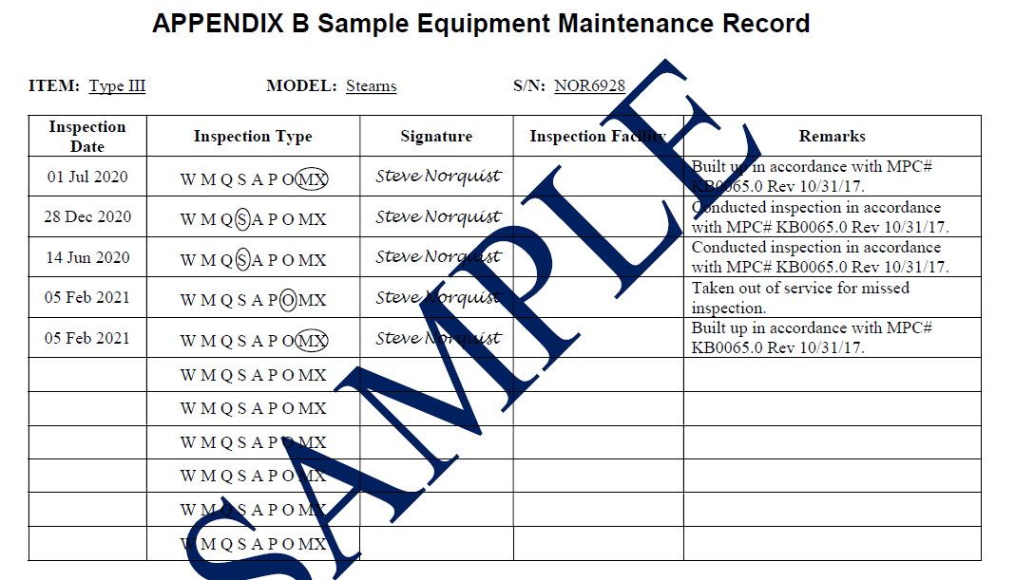
Log keeping
The log serves as the basis for determining “serviceability”

Slide 21
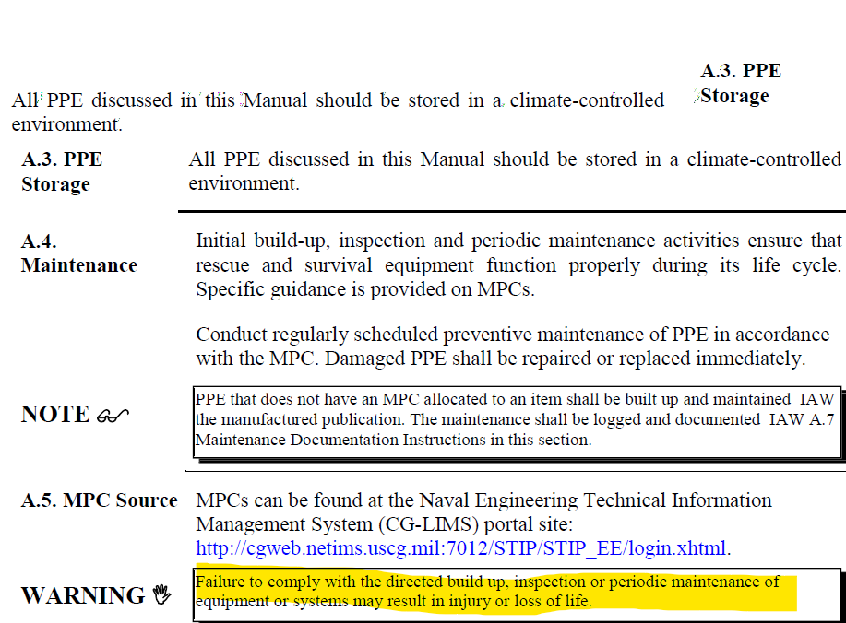
MAINTENANCE
CG-BSX shall ensure up-to-date MPCs are available to help facilitate to complete PM & build up procedures.
Electronic Maintenance Records are required to be maintained for each piece of equipment.
Appendix A contains the only maintenance records that are authorized.

Slide 22
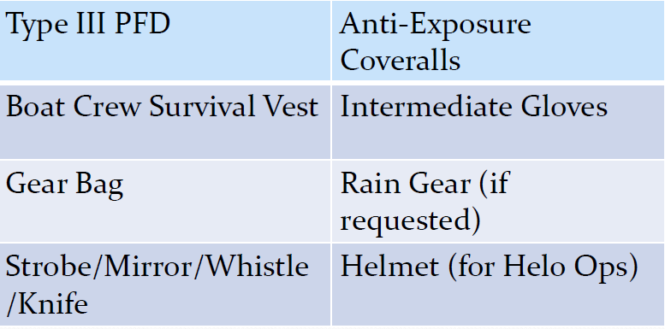
issuance
The “Basic Ensemble” to all Boat Crew, PWC, Coxswains and trainees
Total Cost: $958 (as of 2023)

Slide 23
Cold wx issuance
Will only be issued to those members deemed necessary by the OIA. Cold WX PPE cost over $1,800 per person and is maintenance/admin intensive.
DIRAUX will typically transfer funds to Active Duty unit for them to purchase gear for supporting members. Their RSS Petty Officer will maintain records and conduct inspections, unless otherwise agreed with OTO.

Slide 24
Personally procured equipment
If members purchase equipment with their own money. It’s recommended to contact OTO prior to making any purchase to confirm the equipment is authorized IAW RSSM.
PPE must still annotated on the AF-538 form and maintained/inspected per applicable directives to be considered serviceable.

Slide 25
Inflatable pfd’s
Inflatable PFDs are not authorized to be worn with anti-exposure coveralls because it creates too much buoyancy to safely egress out of a capsized boat.

Slide 26
Non-coast guard approved pfd

Slide 28
Inflatable pfd’s (cont)
Per RSSM, completion of an individual personal qualification standard (PQS) for the model of inflatable PFD you wear is required.
OTO will offer training sessions on each PFD with the goal of “Train the Trainer”
The Aux Liaison will work with the RSS Petty Officer at CG STATIONS to obtain training to assist other members within their flotilla.
DIRAUX has no plans to purchase inflatable PFD’s

Slide 29
Personal locator beacon (plb)

Slide 30
PERSONAL LOCATOR BEACON (cont)
Best Practice: include verbiage in your monthly meeting agendas reminding operators to conduct monthly test. They must notify FSO-OP via email if the test fails.

Slide 31
Flotilla leadership & unused ppe
D11 is currently resourced to issue the basic PPE to all personnel interested in participating in surface & air operation programs.
Flotilla Commander visibility on PPE issuance is critical. FC’s should have the best gauge of how active a member is. If they don’t feel the member will follow through with completing the certification, or meeting the inspection/currency requirements, they should say so

Slide 32
Flotilla leadership & unused ppe (cont)
FC’s are in the best position to determine when a member’s participation in the surface/air operations program may fall below desired levels. In those cases, FC’s are empowered to contact individual members and request that they turn in unused PPE.
REYR for more than one year would be an indication to start that conversation.

Slide 33
Diraux quality assurance
As the designated Rescue and Survival Systems Officer for D11N, the OTO provides oversight on the PPE program.
Short-notice quality assurance visits will be scheduled by the OTO to review logs for currency and accuracy.
Spot checks will be conducted on a sample of equipment to assess material condition.

Slide 34
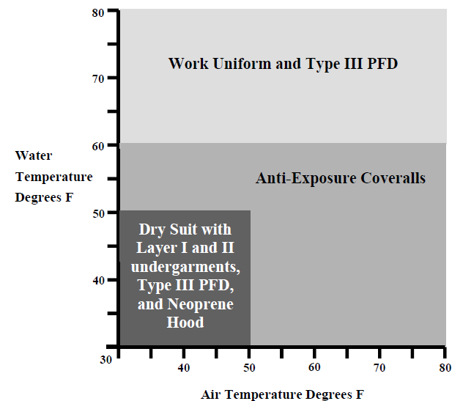
Diraux quality assurance
EVERYONE is required to suspend operations if safety issues arise.
Please ensure your crew is properly equipped and reflect the PROFESSIONAL VOLUNTEER SERVICE that we are.

