Slide 1
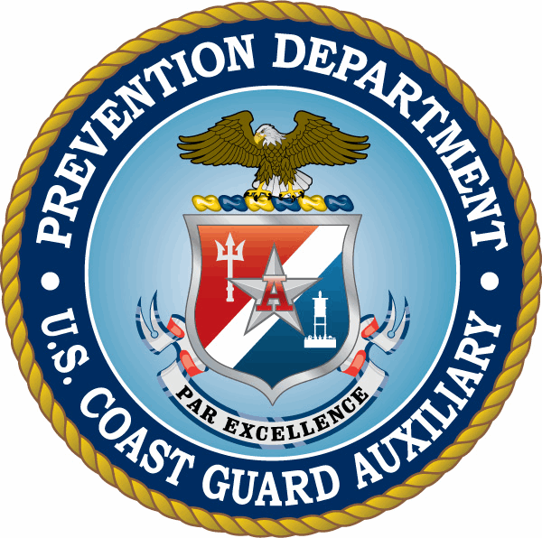
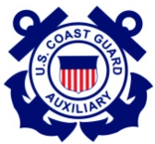

District 11: Northern Region
Marine Safety Overview
Notes:
----- Meeting Notes (4/11/11 16:27) -----
Program is a work in progress. We started with a very basic program and have grown as interest has grown. Interest in the different areas changes over time and CG requirements change over time.

Slide 2
Overview
This presentation covers the MEP Outreach Programs and the MS Prevention and Response activities in District 11 NR Marine Safety/Prevention programs for Aux members.
Notes:
----- Meeting Notes (4/11/11 16:27) -----
The ADSO-MS/AWW has reworked the program to combine two features, the original AWW program and the Marine Safety Observation MIssion, the latter being terminated last year because Aux cannot supplant the AD OFL Mission.
Reference to America's Cup is with the thought that Auxiliarists can provide assistance in delivering informational materials about America's Cup and AWW to viewers at Marina's, Docks, Ramps, Clubs and other groups building up to the 2012 and 2013 events.

Slide 3
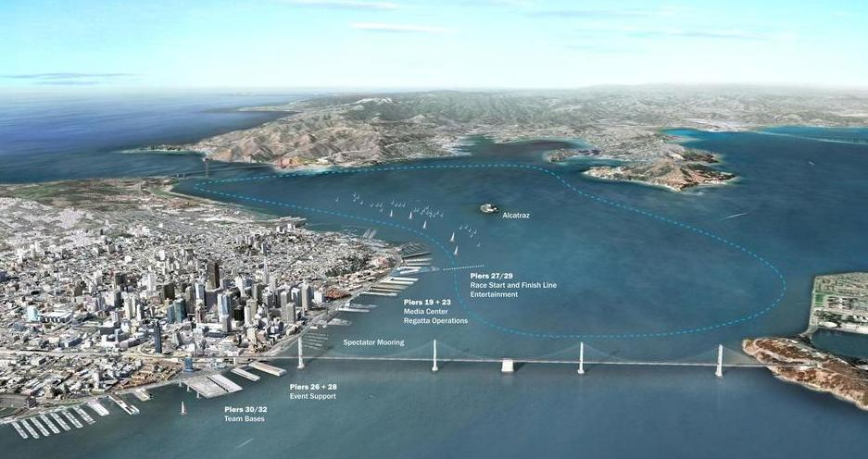
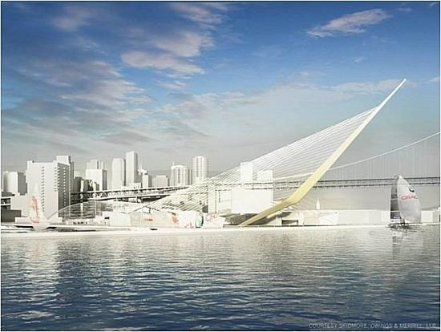
MEP Outreach Programs
America’s Waterways Watch
Continue to merge this program with Public Education, Vessel Exams, Dockwalkers, Info Booths and Program Visitor Missions.
.
Notes:
----- Meeting Notes (4/11/11 16:27) -----
As stated in the previous slide the Outreach Mission will combine 2 Aux members, an AWW Outreach Mission Specialist and a Land Mobile operator in a "cross mission" approach to area familiarization and viewer awareness of the importance of Marine Safety and Environmental Protection.
Training in pollution awareness and laws that pertain to such things as the FWPCA (clean water act adm by EPA), CERCLA (comprehensive environmental response, compensation and liability act of 1980 implemented by EPA 's office of Solid Waste and Emergency Response) and OPA (1990) following Exxon Valdez established Oil spill Liability Trust Fund and provides up to 1 billion per spill incident.
Overall the NCP provides guidance on priorities to protect the nation's clean waters and environment.

Slide 4
AWW Outreach Mission
Outgrowth of the Marine Safety Observation Mission
Shoreside mission
  Teams of 2 trained Auxiliary members are encouraged
  Classes, Info booths, Marinas, Clubs, Boat Docks
  Pass out brochures/cards with contact information on:
    Observed suspicious or unusual activities
    Hazardous substance discharge/debris in the water
    Record when, where and how many people you contact.
    Send to ADSO-AWW Form 7030 Mission 70V Neil Nevesny
    neilanevesny@yahoo.com
Notes:
----- Meeting Notes (4/11/11 16:27) -----
The Auxiliary provides the eyes and ears for helping to make these vessels safer for the public. Each auditor is a trained observer for such things as numbers of passengers on board, proper safety announcements, locked doors, accessible PFD's, security signage,

Slide 5
Dock Walker, Outreach Mission
Mission focused on boating pollution prevention
Shoreside mission (Sea Partners)
  Teams of 2 trained Auxiliary members are encouraged
  Educational Surveys conducted in Classes, Info booths, Marinas, Clubs, Boat Docks
  Survey boat owners, and interested mariners
    Covers boating sources of marine pollution
    Covers boating pollution laws from fuel, sewage and trash
    Training provided by Vivian Matuuk, CDBW, see schedule
    Send to ADSO-MEES Form 7030 Mission 70N Sue Fry
Notes:
----- Meeting Notes (4/11/11 16:27) -----
The Auxiliary provides the eyes and ears for helping to make these vessels safer for the public. Each auditor is a trained observer for such things as numbers of passengers on board, proper safety announcements, locked doors, accessible PFD's, security signage,

Slide 6
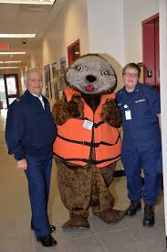
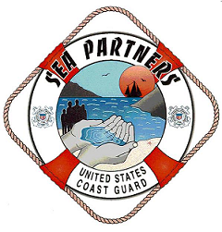
Sea Partner, Outreach Mission
Mission focused on Shore Side Cleanup and Prevention
Shoreside mission (Sea Partners)
  Partner with local Environmental Group clean up projects such as National Coastal Clean Up Day (Sept 21), or National Marina Day (August 6). Or Lake Sonoma Clean Up day, Discovery Park Clean UP Day, Friends of the Petaluma River clean up day.
  Sea Partner PA events during other marine events using “Sammy the Sea Otter”
    Send to ADSO-MEES Form 7030 Mission 70N Sue Fry
Notes:
----- Meeting Notes (4/11/11 16:27) -----
The Auxiliary provides the eyes and ears for helping to make these vessels safer for the public. Each auditor is a trained observer for such things as numbers of passengers on board, proper safety announcements, locked doors, accessible PFD's, security signage,

Slide 7
Marine Safety Programs
Support for CG Sector San Francisco Prevention & Response (each require a PQS).
  Ferry Boat Exams
  Commercial Fishing Vessel Exams
  Uninspected Passenger Vessel Exams (charter boats)
  Facility and Container Exams
  Uninspected Towing Vessel Exams
  Pacific Strike Team
  Incident Management Division (ADV and HAXWOPER)
  Regional Exam Centers
  Domestic Inspections
  Life Raft Inspections

Slide 8
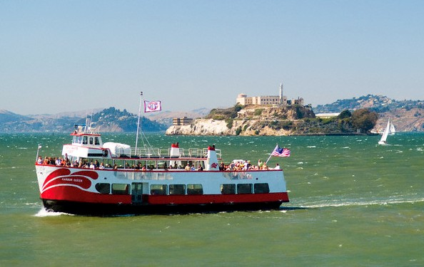
Ferry Boat Vessel Exams
Great opportunity
  New members can make a difference in Ferry Safety.
  Assist the CG in making riding Ferry boats safer.
Activity
  2010: 163 audits
  2011: 358 audits
  2012: 320 audits
  2013: 330 audits
  2014: 200 audits
  2015: 150 audits
  2016: 50 audits
  2017: 35 audits
  2018: 45 Audits
POC: ADSO Steve Johnson
Email: smjsk35@comcast.net
Notes:
Great opportunity for new members to get right to work assisting the CG in making riding Ferry boats safer.
We had a total of 163 Ferry Vessel audits in 2010 with a goal of 200 for 2011.
ADSO:
Planning a training session at PCA in January and August 2016.

Slide 9
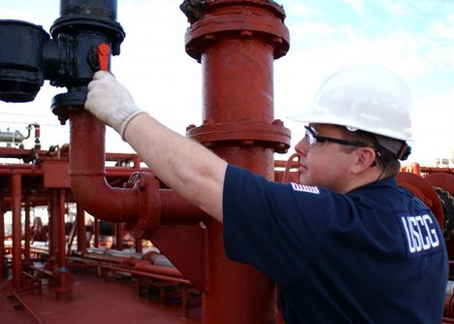
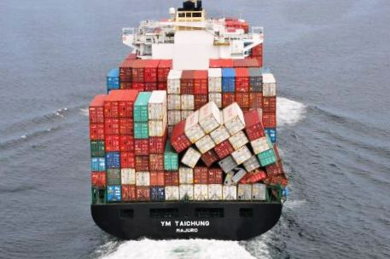
Facilities and Containers
Both Departments can:
  Take interested Auxiliarists on inspections.
  Provide training opportunities.
  Allow participation with the Reserves on the weekends.
The CG liaison conducts training for the Auxiliary
POC: ADSO Michael Mitchell
Email: michaelmitchell717@msn.com

Slide 10
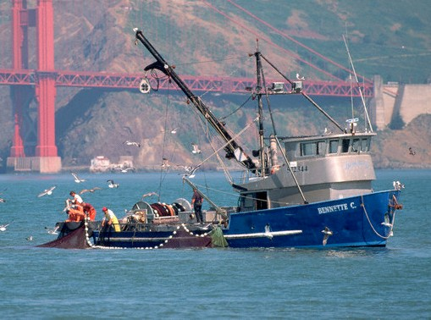
Commercial Fishing Vessel Safety
Commercial Fishing Vessel Exams
  Are mandatory as of 15 Oct 2015 for vessels fishing beyond 3NM
  1,400 Fishing Vessels in District 11
  Exams: 2 hours on average
  Refresher training semi annually
Dockside Exams
  45% done by Auxiliary members
  Dockside Exams completed at 9 ports
  from Monterey to Crescent City and SF Bay
Training
  Spring before the Salmon season
  Fall before the Crab season
POC’s: Manny Ramirez, David Cripe, JP Giles
Email: eustascio.m.ramirez@uscg.mil
ADSO-CFVS Dan Swett or Wil Sumner
scafurniture@yahoo.com
Notes:
Our District’s qualified members provide a substantial number of Dockside Exams for the Industry. Close to 85% of exams done in D11NR are completed by our members. Our members also provide training to the Active Duty, Reserves, VTS and civilian CG employees.
Because Commercial Fishing Vessel Exams will become Mandatory Inspections we are anticipating an increased demand for Inspections . We will also need to have an increased number of Examiners. Training will be held in the Spring before the Salmon season opener and again in the Fall before the Crab season.
Approximately 70-100 Dockside Exams are performed by 14 Auxiliary members from Crescent City to Monterey including Bodega Bay, San Francisco Bay, Pillar Point and Moss Landing. We have about 1400 Fishing Vessels in the District and that will prove to be a challenge. Each exam takes about 2 hours on average and is a big time resource for the Coast Guard. The CG Civilian, Manny Ramirez is the POC.

Slide 11
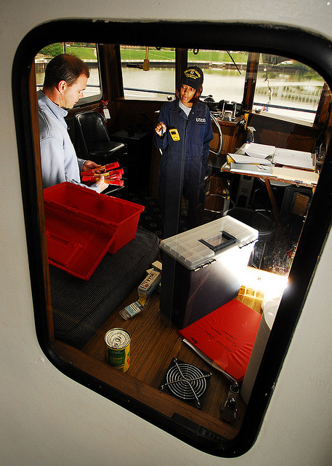
Uninspected Passenger Vessels
Primarily 6 pack fishing charter boats in coastal waters. 128 audits in 2018
Increase UPV inspections to inland fishing charters, small passenger charters, and 200 ton charters.
Education Priorities
  Vessel passenger safety
  Sailing school vessel safety
  Small Tour vessel safety
POC: ADSO Michael Mitchell
Email: mmitchell.uscgaux@gmail.com

Slide 12
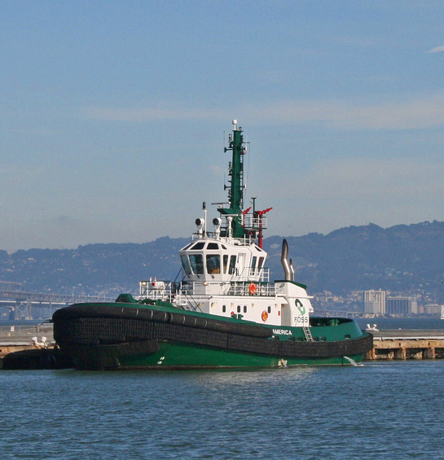
Uninspected Towing Vessels
Current Status
  Tug boat operators are in a program of Bridging Inspections awaiting Subchapter M
  Limited number of vessels each year
Opportunity
  Ideal for Auxiliarists who have a keen interest in Marine Inspection
  Requires working with Active duty personnel and the completion of a Coast Guard PQS
Qualification
  The Department is always working toward qualification of its members
  Will take one Auxiliarist at a time to train.
  Requires at least 10 inspections
  With few vessels it may take a year to get the qualification.
  One member is qualified at this time in D11N
  POC: ADSO Sue Fry
  Email: Sue.Fry@sbcglobal.net
Notes:
The tug boat operators are in a bridging program leading toward a Mandatory Inspection. Many vessels are still not fully prepared for this inspection.
This area is open to Auxiliarists who have a keen interest in Marine Inspection. It requires working with Active duty personnel and the completion of a PQS. The Department is working toward qualification of their members and so will be willing to take one Auxiliarist at a time to train. It takes doing 10 inspections that are approximately 3 hours in length, so with few vessels available it takes about a year to get the qualification. One Auxiliary member is qualified at this time.

Slide 13
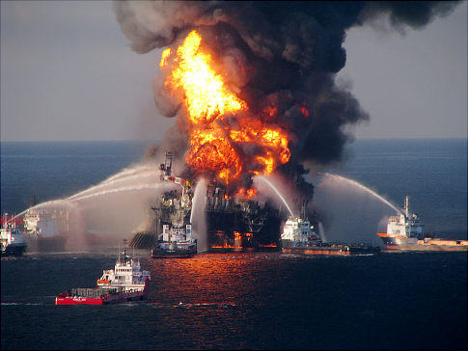
Pacific Strike Team
Responds to major incidents inside and outside our area (e.g., Olympics, Deepwater Horizon).
  Handle hazardous accidents that require full suits/equipment, etc.
Auxiliarists assist with office, phone and watchstanding activities.
  Auxiliary Volunteers
SCAT (Shoreline Cleanup Assessment)
POC: ADSO Wil Sumner
Email: wilsumner_cgaux@yahoo.com

Slide 14
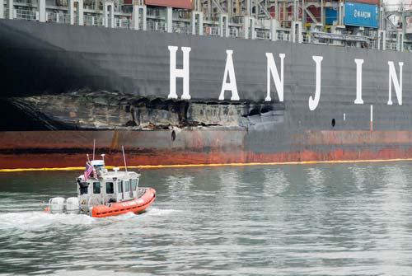
Incident Management Division
Responds to oil or hazardous material spills in D11N (i.e., Santa Cruz, Delta, Bay, or Coast ).
Located on Yerba Buena Island
Training
  Pollution Training at IMD
  ICS 300/400 or 300a
  Pollution Responder PQS
  Harbor Patrols by land
  Hazwoper course (24hour)
  Oral Board completes the process.
8 Auxiliarists in D11N have been designated as Pollution Investigators/Responders
POC: ADSO-IMD: Wil Sumner
Email: wilsumner_cgaux@yahoo.com

Slide 15
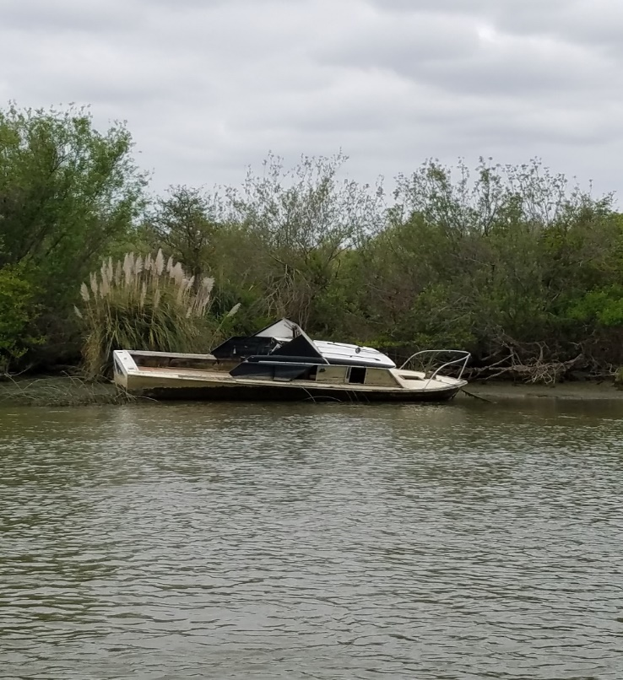
Incident Management Division
Abandoned Derelict Vessel Surveys
Aux is tasked to perform surveys of abandoned vessels in the Delta, Bay Area and Coastal areas.
These surveys are performed by:
Aux Air and Aux Surface fleet.
Data is entered into Cal State Lands Database.
Surveys support clean up efforts of ADV vessels
Requirements
  ADV Training and Orientation
  Hazwoper course (4 hour)
POC: ADSO-IMD: Wil Sumner
Email: wilsumner_cgaux@yahoo.com

Slide 16

Marine Safety Training Ribbon
Excellent opportunity for New Members.
Great introduction to Marine Environmental Information
Fits well with Public Education, Vessel Safety Checks, PV, Dockwalkers, Information Booths
Five ICS courses are required for Marine Safety, Surface Operations, and elected leader status.
One Personal Qualification Standard is required –MSAM is recommended for overall organizational understanding or MEES for Environmental Awareness.
For more information check with your FSO-MS or SO-MS

Slide 17
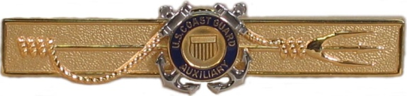
CGAUX Marine Safety Device
In addition to the Marine Safety Ribbon, you can earn the coveted Aux MS Device or TRIDENT
You will need the MST Ribbon plus 4 Personal Qualification Standards (PQS) and
  5 years participation with 96 hours per year is required for AUX MS device. Approval may be requested of Sector for Conditional status after 4 years high level participation and continuing involvement.

Slide 18
Conclusion: Integration with CG
For more information you can go to the D11NR Marine Safety Website for local news
www.d11nuscgaux.info
National Auxiliary Website for latest Directorate news and updates on requirements
www.cgaux.org
Application for Ribbon or Trident Device is found on
National Prevention Department Website inside the Members login
Additional questions, please contact:
  DSO-MS: Wil Sumner: wilsumner@gmail.com
  Deputy-MS: Sue Fry: sue.fry@sbcglobal.net

