Slide 1

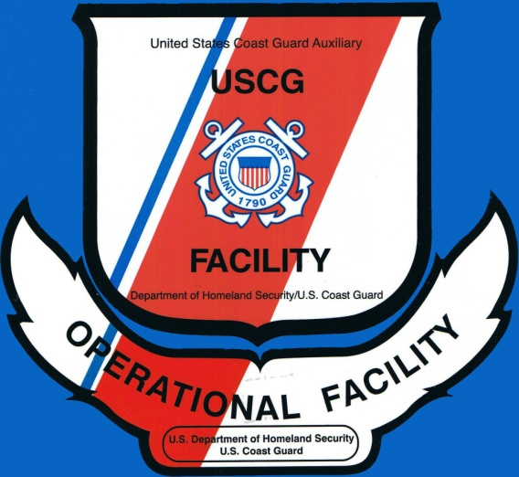
Operational
Facility Review
Prepared by
Mike Lauro DSO-VE 11NR
The D11NR Vessel Examiners Save Lives!

Slide 2

Operational Facility Decal

Slide 3

VSC Decal

Slide 4
Introduction
This module will present you with the forms and tips necessary to conduct an Auxiliary OPFAC (Operational Facility) inspection, the 1st step to be able to apply for Coast Guard patrol orders.
This module will also highlight the important items while doing the inspection.

Slide 5
Topics of Discussion
FORMS- the ANSC 7003 for boats & ANSC 7008 for PWC’s.
Highlight important items within each section on the ANSC forms.
Disciplinary action for “coffee table” inspection!
Notes:
Be sure to hand out copies of the ANSC 7003 & 7008 to the students.

Slide 6


OPFAC Inspections-
(Operational Facility)
Operational Facility Inspections must be performed by a currently certified USCG Auxiliary Vessel Examiner and accepted by DIRAUX.
A member many fly the BLUE ensign after being examined for a VSC or after an OPFAC facility inspection.
The orange and white operational ensign may only be flown by a facility which is under CG orders
Since April 1st 2009, there are no more NON-OPERATION facility inspections.

Slide 7
OPFAC Inspection Forms
(Operational Facility)
ANSC form 7003 outlines requirements for an OPFAC inspections on motorboats and motor vessels.
It’s a 5 page multi-section form (containing instructions)
It requires the signatures of the Owner, VE, & DIRAUX
Upon successful completion of inspection no decal is affixed to facility. Decal will be sent from DIRAUX after final approval.
The Coast Guard MUST inspect commercial motor vessels OVER 65 feet in length
Notes:
PWC’s can not be a Vessel Facility because they are less than 14’ in length. They must be offered for use as an Operational Facility.

Slide 8
OPFAC Inspection Forms-continued
ANSC Form 7008 outlines requirements for PWC OPFAC (PWC’s can only be offered for use)
It is a 4 page multi-section form (containing instructions)
It also requires the signatures of the Owner, VE, & DIRAUX
Upon successful completion of inspection no decal is affixed to facility. Decal will be sent from DIRAUX after final approval.

Slide 9
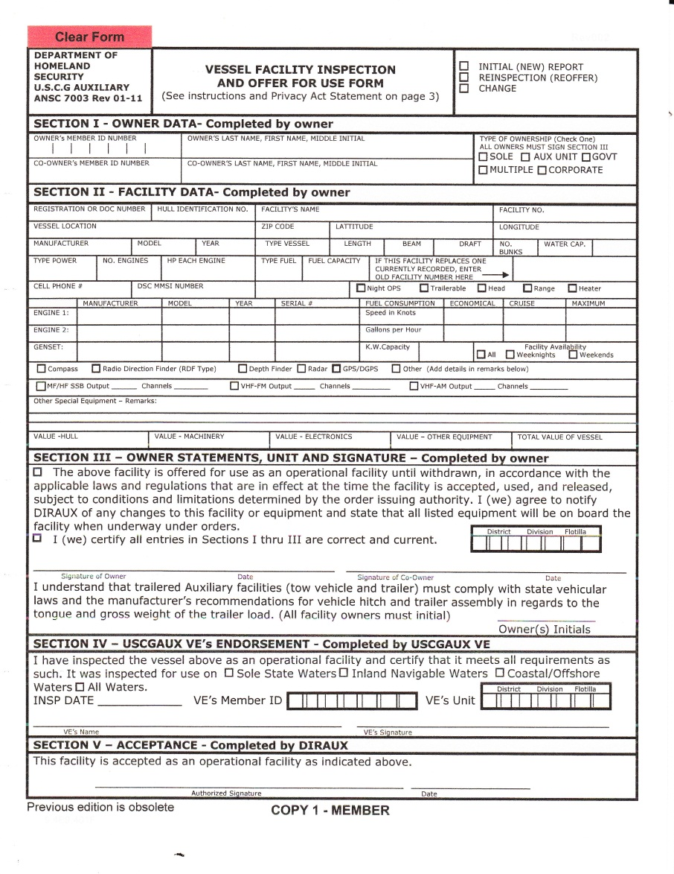
7003 –Page 1
This form used for facility and Operational facility inspections on Motorboats and Pleasure motor vessels.
This page may be filled out by the owner on the computer prior to the inspection.

Slide 10
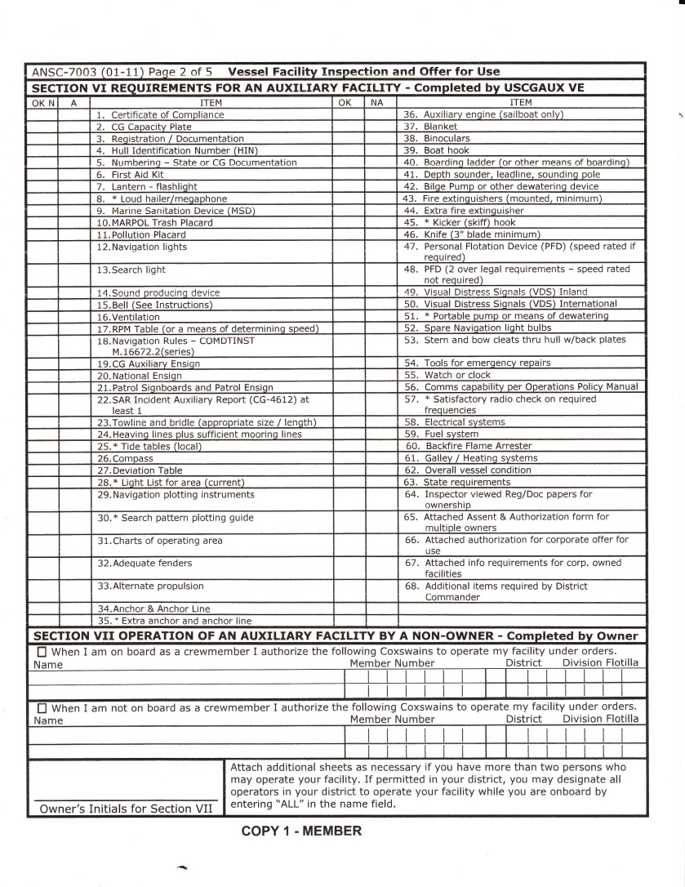
7003-Page 2
This form used to check off items as they are inspected.
This MUST be filled out during the inspection while on site!

Slide 11
Section I- 7003
To be completed by the Owner
Owner’s and Co-Owner’s Member Number
Type of Ownership-husband and wife are placed in the “SOLE” box
Notes:
If the owner is not an Auxiliarist then enter “NON AUX”. If the facility is corporate owned, enter the corporation name

Slide 12
Section II- 7003
Completed by Owner
Blue wedge, get information from website or drop down menu.
Be sure to enter all information about the facility-DO NOT LEAVE BLANK BOXES! Use N/A as necessary.
Important items: Registration number, HID, Latitude, Longitude
Enter the city and state where vessel is located or berthed.
Notes:
Enter state registration number without hyphens or spacing (I.e.MU185NA). Facility No. enter the district assigned CALL SIGN for the facility being inspected. Leave blank if none is currently assigned.Beam,draft state in feet and inches

Slide 13
Section III- 7003
Completed by Owner
Owner Statements, Unit & Signature
Be sure to sign
Be sure to initial if trailerable
Indicate District, Division & Flotilla
On Form 7003 in Section III & Section VII you need to make sure the owners put their initials on the form on the initial line.
Notes:
Be sure you understand owner’s intentions on the OFFER FOR USE. Remember, before any facility can be accepted for use, ALL appropriate information must be provided to and approved by the Director.

Slide 14
Section IV- 7003
Completed by VE after the inspection has been done.
Date, VE member number, VE Unit (District, Division, Flotilla)
Op Facility 7003/7008 is mailed to DIRAUX
Record mission on ANSC-7038
include member name in COMMENTS section.
Completed by DIRAUX
Notes:
If facility does not meet requirements, return VE-signed form to owner-don’t forward to Director or DCO for signature. Give copy 2 to owner and forward remaining copies to Director or DCO. If facility meets requirements count as Vessel Facility Inspection. If failing, count as VSC.

Slide 15
Section VI - 7003
Requirements for an Auxiliary facility.
Same as required for a VSC with some additional items required:
Mounted fire extinguisher(s), Anchor & Anchor line, RPM table
National Ensign plus items 32-39
Notes:
Check the appropriate boxes. Items marked by an (*) are recommended but may be waived by the District Commander.

Slide 16
Section VII - 7003
Complete this section for an Operational facility
Extra fire extinguisher does not have to be mounted.
Be sure to check for items required for Operational facility.
Notes:
Check the appropriate boxes. Items marked by an (*) are recommended but may be waived by the District Commander. Make sure required documents are attached. See Section I instructions.

Slide 17
Section VIII - 7003
Fill this section out if the facility is going to be operated by a non-owner of the facility.
Attach an extra sheet to add to the list of names if necessary.
Be sure owner initials.
Remind member that (2) photos are required to accompany the form to DIRAUX.
Notes:
You many substitute a unit number instead of names:ie: any coxswain in a flotilla, division, or district. In the NAME field, enter “ALL” then applicable unit numbers.

Slide 18
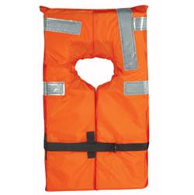
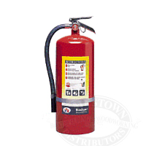
Reminders
Operational Facilities must have two Life Jackets over the legal requirement, and one extra fire extinguisher

Slide 19
PWC FACILITY INSPECTION
You will use ANSC 7008 for the inspection on a PWC
A PWC can only be offered for use.
It can only be an Operational facility and will fly the Operational Ensign while under orders.
It may also be examined for a VSC and fly the BLUE ensign.
Section I thru V on 7008 is the same as I thru V on 7003
Notes:
PWC’s are not at least 14’ in length. Therefore, they must be offered for use as an Operational Facility. Any Facility less than 14’ in length can not be designated as a Vessel Facility.

Slide 20
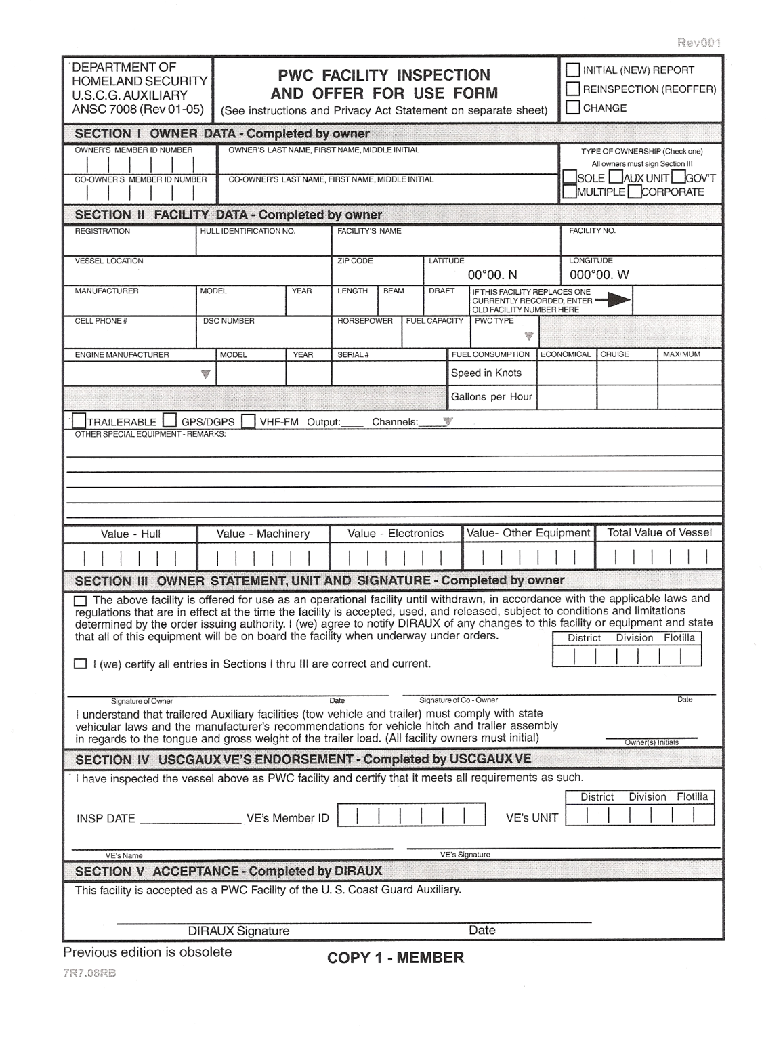
7008-Page 1
This form is used to do a facility inspection on a PWC.
It has to be offered for use
Do not leave blank spaces! Use N/A as necessary.
Notes:
It is important to remember that a PWC MUST be offered for use as an Operational Facility

Slide 21
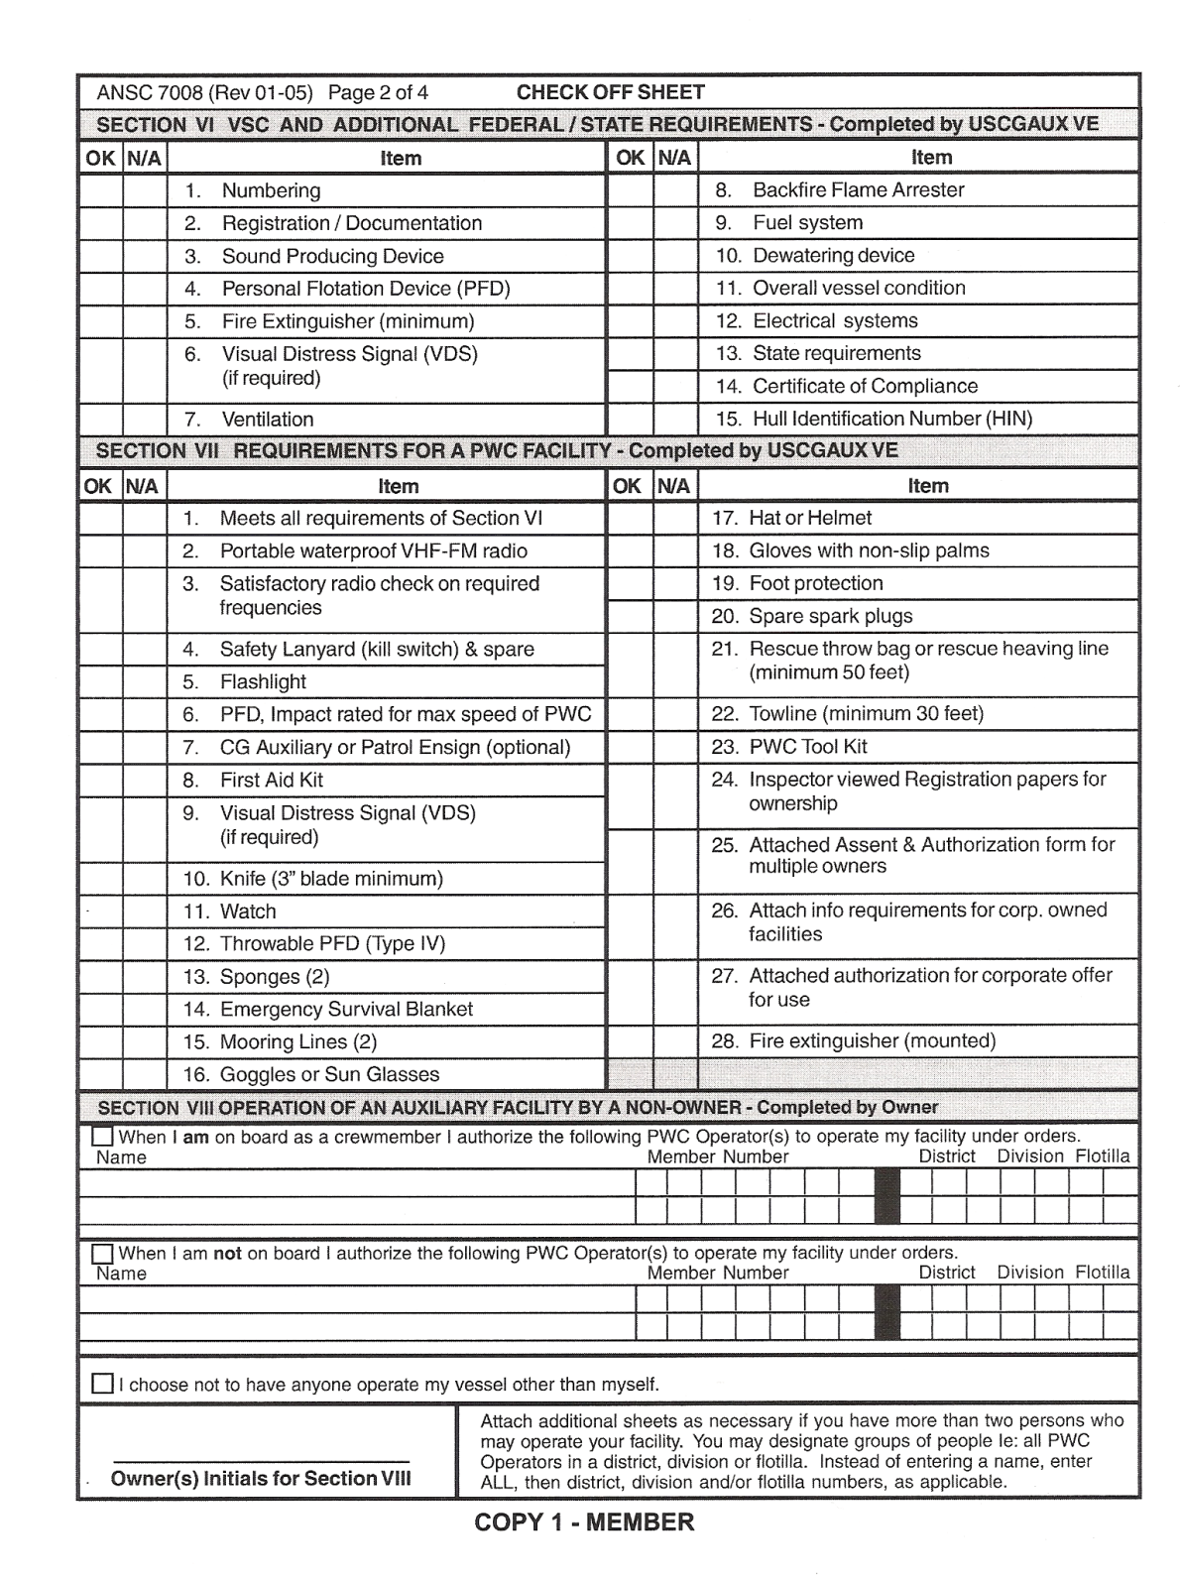
7008-Page 2
This page used to check off items as they are inspected

Slide 22
Section VI
This section is almost the same as you would do for a VSC on any vessel.
Exceptions=Dewatering device and fire extinguisher are required.
Item 6 – Visual Distress Signals: Federal requirement
Notes:
One electric distress light or 3 combination (day/night) red flares. Required to be carried when operating between sunset and sunrise only.

Slide 23
Section VII
Must meet all the requirements of Section VI including:
As of 2/09, item #12 a throw-able PFD is not required.
VHF-FM radio, VDS, Sponges, First Aid Kit, Hat, gloves, foot protection
As of 2/09, item # 20 a spare spark plug is required for only for 2-stroke engines, 50’ heaving line, Towline (minimum 30’),
Goggles or Sun Glasses
Notes:
Item 9-Auxiliary Operations Policy Manual, requires CG approved combination VDS attached to PFD if operated over 3 miles from land. Make sure required documents are attached. See SECTION I instructions.

Slide 24
Section VIII
Operation of an Auxiliary Facility by a Non-Owner.
Same as required on ANSC 7003
Attach an extra sheet to add to the list of names if necessary.
Be sure owner(s) initial
Must be a qualified PWC Operator
Notes:
You may substitute a unit number instead of names; ie: any PWC Operator in a flotilla, division, or district. In the “NAME” field, enter “ALL”, then applicable unit numbers.

Slide 25
Auxiliary Operational Facility & PWC/Facility
These vessels must be some of the safest vessels afloat.
Our Auxiliary facilities need to set the example for safety standards on a vessel.
It is up to you, as a Vessel Examiner to be sure to take the extra time necessary to be sure that ALL Auxiliary facilities are the safest they can be.
Disciplinary action for “coffee table” inspection!
Notes:
Stress this slide. The Auxiliary Operations Manual makes a big statement about Auxiliary facilities being the SAFETY vessels afloat. REVIEW ALL SLIDES, IF NECESSARY, to be sure students understand what is required to do Facility Inspections.

Slide 26

End rev 1/2021

