Slide 1

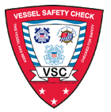
Vessel Safety Check Review
Prepared by:
Mike Lauro
DSO-VE 11NR

Slide 2
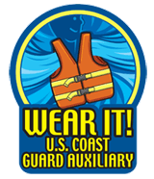
D11NR V-Department For 22+ years:
1-Is the ONLY District to offer a 2-day Vessel Examiner class TWICE a year.
2-Offers 2 levels of recognition for VSC production!
3-All Examiners receive a copy of the DSO-VE report to the District board.
4-Vessel Examiner recognition website.
And MORE!
The D11NR V-DEPT.-------WE SAVE LIVES!

Slide 3
D11NR Vessel Examiner Website: http://rbsafety.d11nuscgaux.info/ve/ve.html
Designed exclusively for Vessel Examiners
Complete with EVERY form needed and LOADED with information!
Updated several times a month
This ONLY one of it’s kind in the Nation!

Slide 4
D11NR Public
Vessel Safety Check Website: http://resource.d11nuscgaux.info/public/ve.html
Designed exclusively for the public with a power-point VSC presentations for both boats, kayak and canoes.
The site is LOADED with information!
This ONLY one of it’s kind in the Nation!

Slide 5
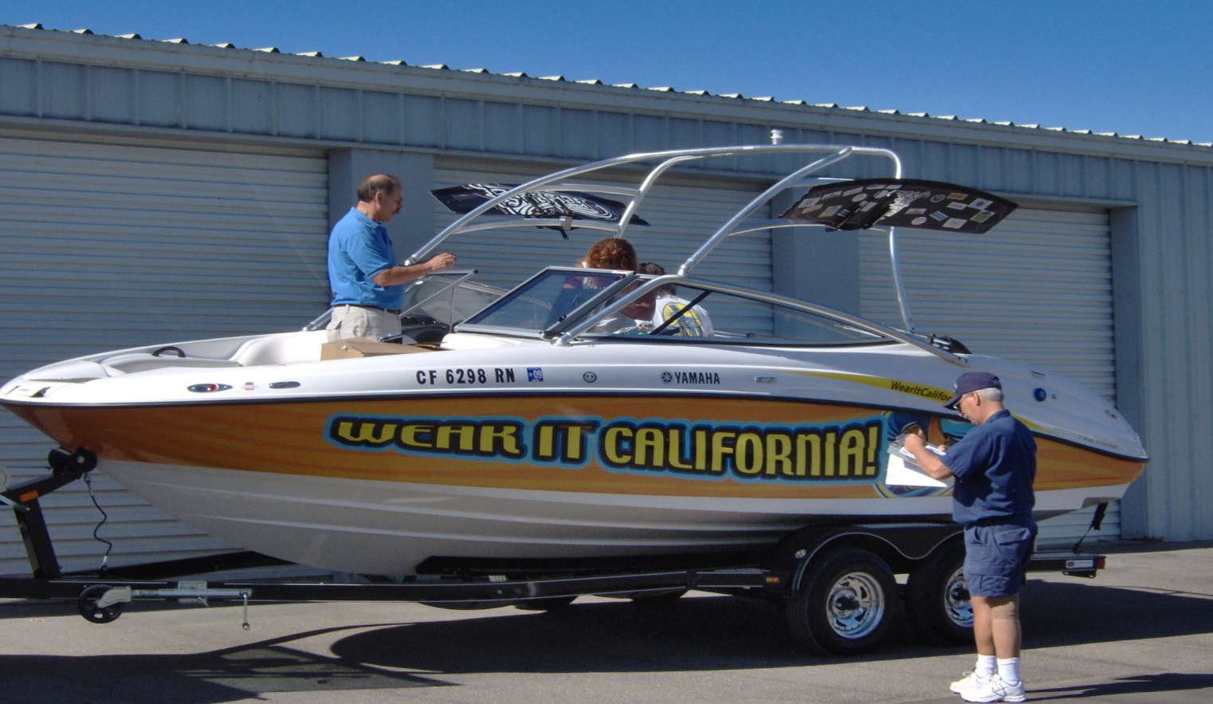
The Vessel Safety Check

Slide 6
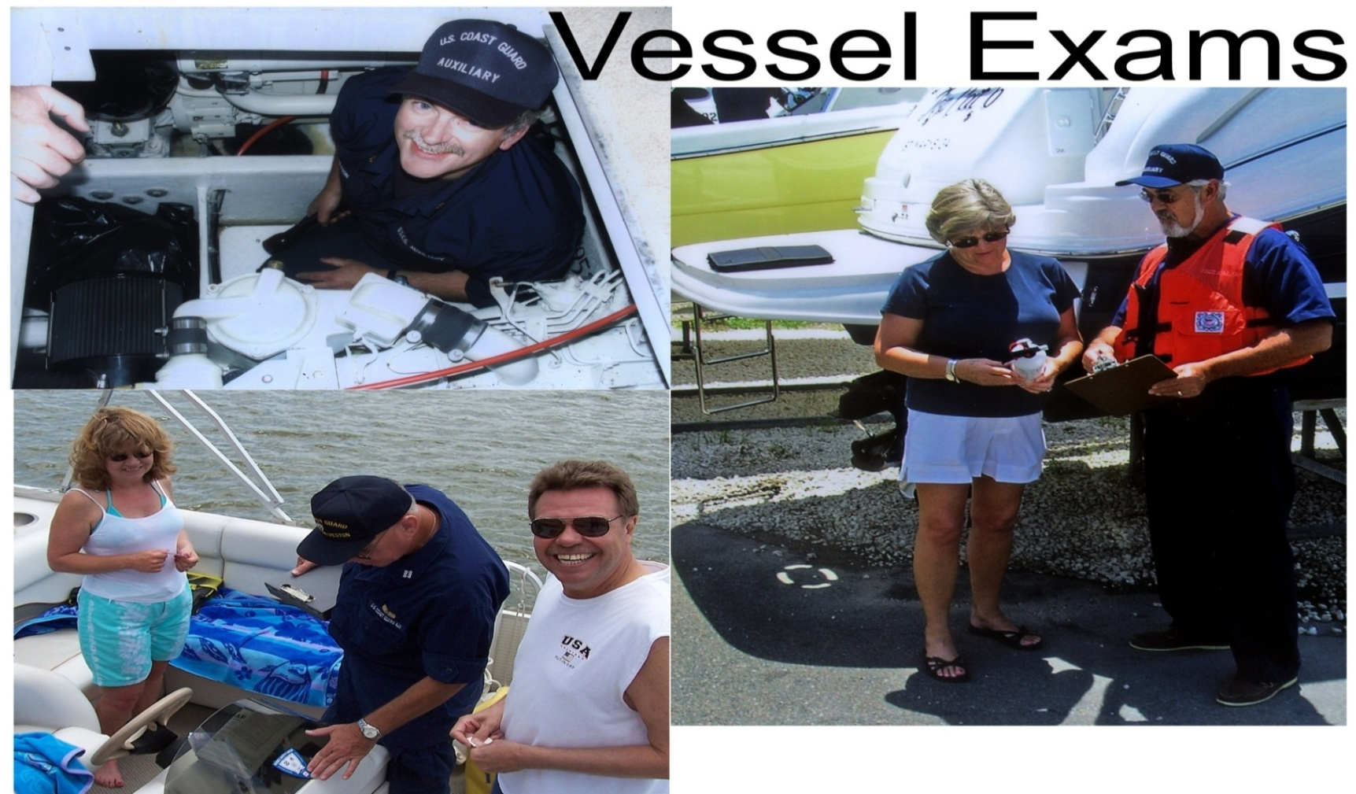
The Vessel Safety Check-
One-on-One Education!

Slide 7
Vessel Safety Check
The History
USCG AUX developed the Courtesy Motorboat
Examination program in 1947 to provide recreational
boaters an advisory review of their vessel’s legally
required equipment and additional recommended
equipment essential for safe boating.
It also serves to provide one-on-one education of
recreational boaters regarding the use of safety
equipment, legal requirements and regulations, etc.

Slide 8
Vessel Safety Check
The History-continued
The program evolved with the addition of
sailboats and the name was changed to
Courtesy Marine Examination, then in 2000 changed to become the Vessel Safety Check (VSC). The VSC program now includes PWC’s, canoes and kayaks. 2007 was the 60th anniversary of the program that now includes the U.S. Power Squadron.
Notes:
In concert with these outreach efforts in safety education, this program provides significant benefits to recreational boaters. The United States Coast Guard (USCG) is interested in seeing this program grow by increasing the number of trained vessel examiners (VE) and increasing the number of VSCs, particularly in the PWC and SUB areas.

Slide 9
The Vessel Safety Check
Vessel Examiners may examine Powerboats,
Sailboats, Personal Water Craft (PWC), and
kayaks and canoes. Sailboards do also qualify for a VSC.
Requests for VSCs on boats larger than 65ft
in length should be referred to the DSO-VE.
Notes:
Coast Guard Auxiliarists who would like to augment MSOs and do such inspections need to pass a series of PQS courses on inspecting lifeboats, etc. The requirements are spelled out in detail as part of the Trident Program. See the Coast Guard Auxiliary National website for details.

Slide 10
The Vessel Safety Check
Unless participating in an organized VSC station, for insurance purposes when performing a one-on-one VSC at a marina or a home, it is necessary to notify your FC, VFC, or FSO-VE and wear your uniform.
When working at an organized VSC station, it is important to wear the prescribed uniform by the station organizer, generally the FSO-VE. In addition, for a one-on-one VSC for insurance purposes, a uniform should be worn.
Prior to boarding a vessel, ask permission from the owner and ask if necessary to remove your shoes or wear shoe covers.
When working around a dock, always wear a pfd-float coat, and inflatable, or a type III. An Auxiliary pfd is preferred.
Notes:
Coast Guard Auxiliarists who would like to augment MSOs and do such inspections need to pass a series of PQS courses on inspecting lifeboats, etc. The requirements are spelled out in detail as part of the Trident Program. See the Coast Guard Auxiliary National website for details.

Slide 11
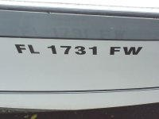
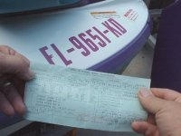
Item 1 - Display of Numbers:
The boat’s registration numbers must
be permanently attached to each
side of the forward half of the boat.
They must be plain, vertical, block
characters, not less than three (3)
inches high-the same height as the state
decal, and in a color contrasting with the
background.
A space or hyphen must separate
the letters from the numbers. The
state decal should be on stern of the
numbers.

Slide 12
Boat Numbers
PLACEMENT
Painted or Attached
to Each Side of Bow
Always Read Left to Right
Block not less than
3 inches high CHARACTERS
CF 1234 AB
COLOR
Must be of a Color
Contrasting to the
Background
SPACING
Hyphen or Equivalent Space
Between 3 Parts of Number
CF 1234 AB
or
CF-1234-AB
CF1234AB
CF 1234 AB
12

Slide 13
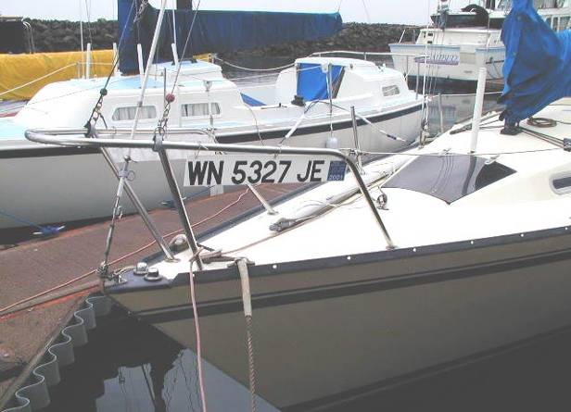
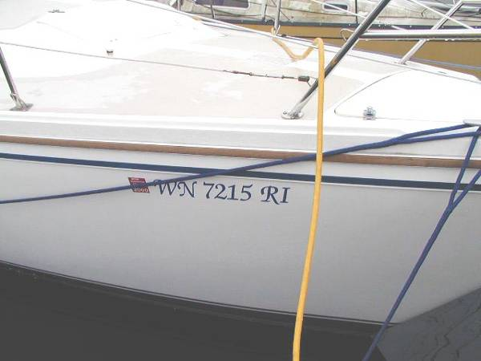
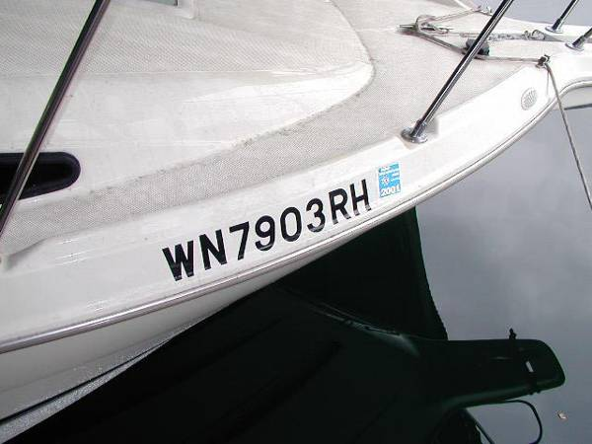
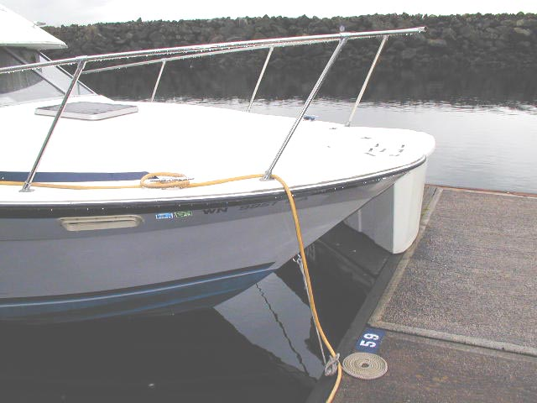
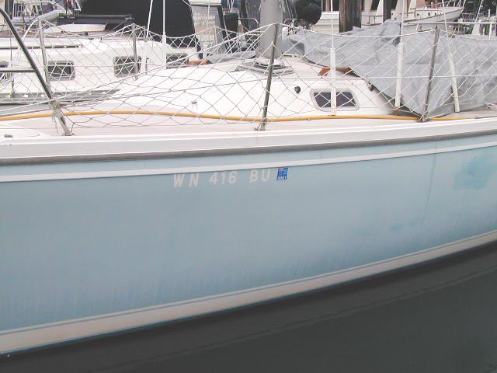
Incorrect numbers
Not permanently attached
Not block
No spaces
Under overhang
Not contrasting color
Notes:
VSC decals can not be given to vessel that look like this…. VE’s need to know what to look for….

Slide 14
Item 2 - Registration and Documentation:
Registration or Documentation papers must be on board and available. Documentation numbers must be permanently marked on a visible part of the interior structure. Original registration and documentation must be on board.
The documented boat’s name and hailing port must be displayed on the exterior hull in letters not less than 4 inches in height. To be documented a boat must be 5 net tons or greater.

Slide 15
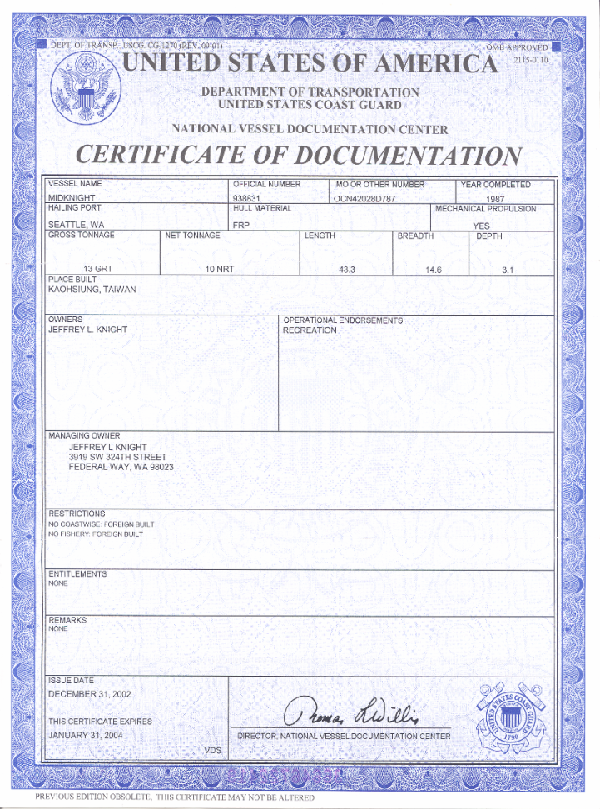
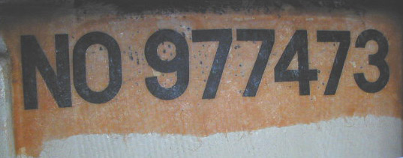
How to read a “Certificate of Documentation” for a documented vessel
Official Number
Hull Id Number
Vessel Name
Length
feet
Hailing Port
Owner / Operator
Expiration Date
Notes:
This is what you need to look for when doing a VSC on a Documented Vessel.

Slide 16
Hull Identification Number
(HIN)
MUST be permanent
Usually on Starboard Side of Transom Maybe on Portside prior 1984
Must be on hull not top structure except on a PWC. May be also be on a pontoon near the waterline
Notes:
16

Slide 17
Item 3 Flotation Devices (PFD)

Slide 18
Item 3 Flotation Devices (PFD):
Wearable PFDs shall be "readily
accessible.“ Throwable devices for 16’+ vessels shall be “immediately available.” PFDs and throwables should NOT be stored in unopened plastic packaging.

Slide 19
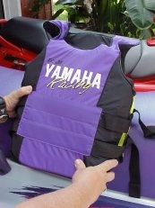
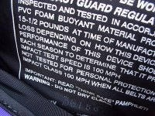
Item 3 Flotation Devices (PFD):
Acceptable PFDs (Life Jackets) Must be U.S. Coast Guard approved, in good serviceable condition, and of suitable size for the each person on the boat. Children must have properly fitted PFDs designed for children based upon their weight.
Notes:
All recreational boats must carry one wearable PFD (Type I, II, III or Type V PFD) for each person aboard.
A Type V PFD provides performance of either a Type I, II, or III PFD (as marked on its label) and must be used according to the label requirements.
Any boat 16ft and longer (except canoes and kayaks) must also carry one Throwable PFD (Type IV PFD).

Slide 20
Item 3 Flotation Devices (impact rated PFD):
WARNING:
Impact rated Life-jackets do not protect
wearers from traumatic injury in a high
speed crash.
The impact rating means that the PFD still
  be buoyant following an impact.
Notes:
100 MPH rated Life-jackets do not protect wearers from traumatic injury in a high speed crash.
The impact rating means that the PFD still be buoyant following a 100 MPH impact.

Slide 21
Item 3 Flotation Devices
Non-Serviceable and Substandard Type I Unicellular Plastic Foam Life Preservers
The US Coast Guard strongly recommends
that owners and operators carefully inspect
all of their older Type I unicellular plastic
foam PFDs.
Potential indications that a Type I unicellular
plastic foam PFD may no longer be serviceable
include:
Notes:
The US Coast Guard strongly recommends
That owners and operators carefully inspect
all of their older Type I unicellular plastic
foam PFDs.

Slide 22
Item 3 Flotation Devices
Compression: The PFD may be compressed from many years of stowage.
Loss of resiliency: The PFD is excessively hard, stiff or its foam is brittle. Normally after compressing the PFD to about half its initial thickness, the foam should expand to its original dimension in a short period of time.

Slide 23
Item 3 continued
Flotation Devices
3. Shrinkage: A physical reduction in size may be indicated by “wrinkling” of the coating on vinyl dipped type or by a loose fitting shell on a fabric-covered PFD.

Slide 24
Item 3 Flotation Devices
PFD INFLATION FAILURE DUE TO FALSE
POSITIVE SERVICE INDICATORS AND
INCORRECT CO2 CYLINDER INSTALLATION
There is a potential problem when installing CO2
cylinders that have bayonet tips on older inflatable PFDs.
If a cylinder is not properly installed, the PFD will not
inflate with CO2. The problem may affect several
thousand PFDs, but the Coast Guard is only aware of
one incident to date.
Notes:
Some Mustang, Protexion, and Stearns/SOSpenders PFDs using Halkey-Roberts’ inflators can indicate a green “Ready” status when the CO₂ cylinder is not properly installed. This false positive green indication occurs when the cylinder-bayonet assembly is inserted in the inflator, not turned, and the cylinder is not ejected.
Cylinders with bayonet tips are designed to be pushed in and turned 1/8th turn clockwise to a full stop to secure the cylinder. When the cylinder is not turned to secure it in place, the PFD will not inflate with CO₂. The PFD may still be inflated orally.
If the CO₂ cylinder is not turned, the mechanism is supposed to eject it. In some production units a false positive green indication can be achieved by simply pushing the cylinder into the mechanism without turning it 1/8th turn to a full stop. According to the consumer report, a user was led to believe the cylinder-bayonet was properly engaged without turning it due to the firm seating of the cylinder-bayonet, which also prevented the cylinder-bayonet from ejecting as designed.

Slide 25
Item 3 Flotation Devices (PFD):
For Personal Watercraft riders, California, Nevada, and Utah require that a PFD with an impact rating(recommend a type III) be worn.
Boats 16 Feet or longer, except kayaks and canoes must also have one Type IV.

Slide 26
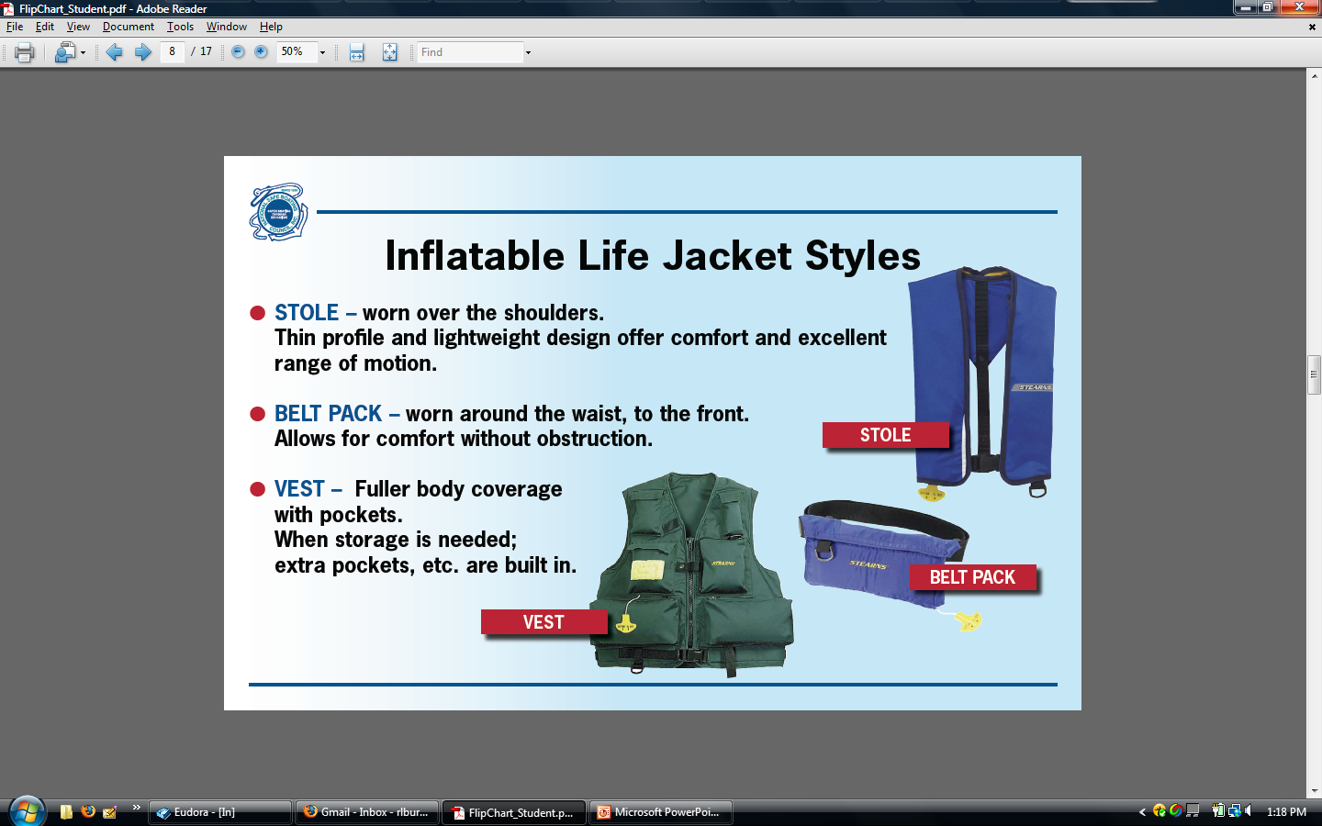

Slide 27
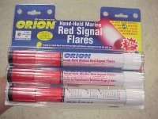
Item 4 - Visual Distress Signals (VDS):
Do NOT accept expired flares or demo them!

Slide 28
Item 4 - Visual Distress Signals (VDS):
Recreational boats 16 feet and over used on coastal
waters or the Great Lakes require a minimum of
either:
3 day (orange) and 3 (red) night pyrotechnic devices, or 3 (RED) Combination day/night devices.
Non-pyrotechnic devices day(flag) and one night (auto SOS light) or
A combination of 1) and 2). Recreational boats less than 16 feet on coastal waters or the Great Lakes need only carry night visual distress signals when operating from sunset to sunrise.
Notes:
Mention combination day/night devices here -- Three day and three night pyrotechnic devices, or three day/night devices,

Slide 29
Item 4 - Visual Distress Signals-Continued
It is recommended, but not required, that boats operating on non-coastal (inland) waters should have some means of making a suitable day and
night distress signal.
DAY NIGHT –Flash S O S!

Slide 30


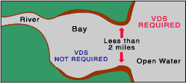
Item 4 - Visual Distress Signals Continued

Slide 31
Item 4 - Visual Distress Signals-Continued
Night Day
Strobe light Signal mirror
Flashlight Red or orange flags
Lantern Hand signals
The number and type of signals is best judged by considering conditions under which the boat will be operating.

Slide 32
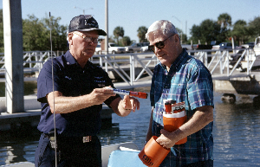
Item 4 - Visual Distress Signals
Flares have a 42 month expiration date

Slide 33
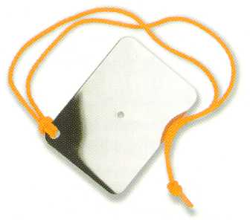
Non Pyrotechnic Visual Distress Signals
Day
Night

Slide 34
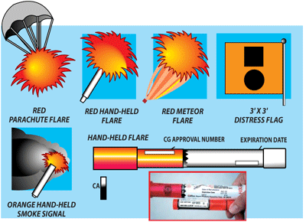
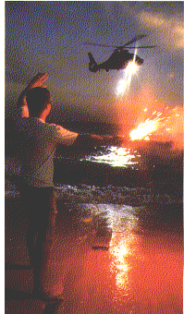
Item 4 - Visual Distress Signals-continued
Notes:
Hand –Held Flare have a expiration date of 42 months from the date they were made.
34

Slide 35
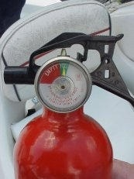
Item 5 - Fire Extinguishers

Slide 36
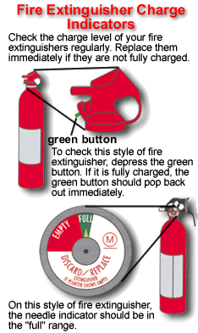
Item 5 - Fire Extinguishers-continued

Slide 37
Item 5 - Fire Extinguishers continued
Fire extinguishers are required if one of the following conditions exists:
Inboard engine(s)
Closed compartments that store
portable fuel tanks
(3) Double bottom hulls not completely
sealed or not completely filled with
flotation material

Slide 38
Item 5 - Fire Extinguishers: Continued
(4) Closed living space
(5) Closed stowage compartments that contain flammable materials or
(6) Permanently installed fuel tanks
NOTE: Portable fire extinguishers must be serviceable, should be less than 10 years old and should be stored or mounted to be easily accessible.

Slide 39
Item 5 - Fire Extinguishers: Continued
Minimum number of extinguishers required
Boat Length No Fixed System With Fixed System
Less than 26’ One B-1 None
26’ to less than 40’ Two B-1 or one B-2 One B-1
40’ to 65’ Three B-1 or Two B-1 or
One B1 & One B-2 One B-2

Slide 40
Item 6 - Ventilation:
Boats with gasoline engines in closed
compartments, built after 1 August
1980 must have a powered ventilation
system.
Those built prior to that date must
have natural or powered ventilation.

Slide 41
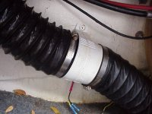
Item 6 - Ventilation:
Boats with closed fuel tank
Compartments built after
August 1, 1978 must meet
requirements by displaying
a "certificate of compliance."
Boats built before that date
must have either natural or
powered ventilation in the
fuel tank compartment.

Slide 42
Required warning Label for Blower Operation at Key:
WARNING
“Gas vapors can explode. Before starting, operate blower for four
minutes and check engine compartment for gas vapors.”

Slide 43
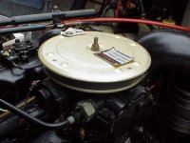
Item 7 - Backfire Flame Control:
All gasoline powered inboard/outboard or inboard motor boats must be equipped with an approved backfire
flame control device.
Notes:
The device will be metal and firmly attached to the air intake with a flame-tight connection so that any backfire flames will be safely dispersed to the atmosphere outside the boat.

Slide 44
Item 8 - Sound Producing Devices / Bell:
To comply with Navigation Rules and for distress signaling purposes all boats including PWC’s, kayaks and canoes, must carry a sound producing device (whistle, horn, siren, etc.) capable of a 4-second blast audible for ½ mile.

Slide 45
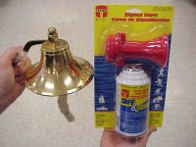
Item 8 - Sound Producing Devices / Bell:
Notes:
Recent changes in the Navigation Rules effectively have changed the requirements for the carriage of a bell on both International, and by default, Inland waters. Boats 20 meters and over are required to carry a bell of 300 mm minimum diameter. Boats from 12 to less than 20 meters are not required to carry a bell but must be able to make the appropriate bell sound when operating under the Inland Navigation Rules.

Slide 46
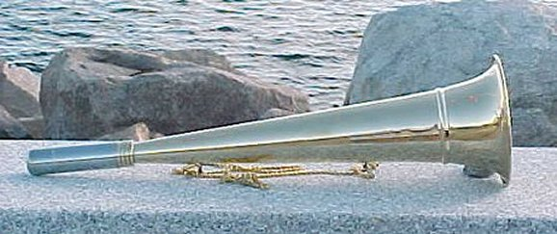
Item 8 - Sound Producing Devices
Recent changes in the Navigation Rules effectively have changed the requirements for the carriage of a bell on both International, and by default, Inland waters-it is NOT required.

Slide 47
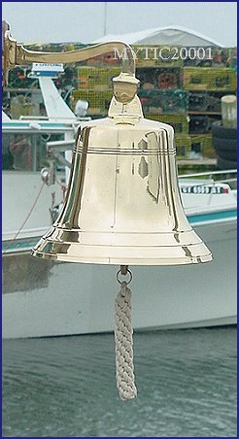
Item 8 –
Sound Producing Devices Bell:
Boats are NOT required to carry a bell.

Slide 48
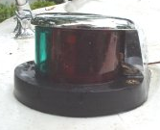
Item 9 - Navigation Lights:

Slide 49
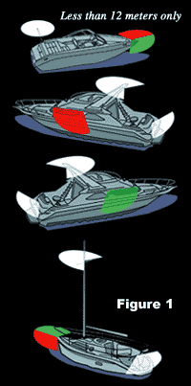
Item 9 - Navigation Lights:

Slide 50
Item 9 - Navigation Lights:
If equipped with lights, all boats must be able to display navigation lights between sunset and sunrise and in conditions of reduced visibility.
Boats 16 feet or more in length must have properly installed, working navigation lights and an all-around anchor light capable of being lit independently from the red/green/white "running" lights. PWC’s must be off the water at sunset

Slide 51
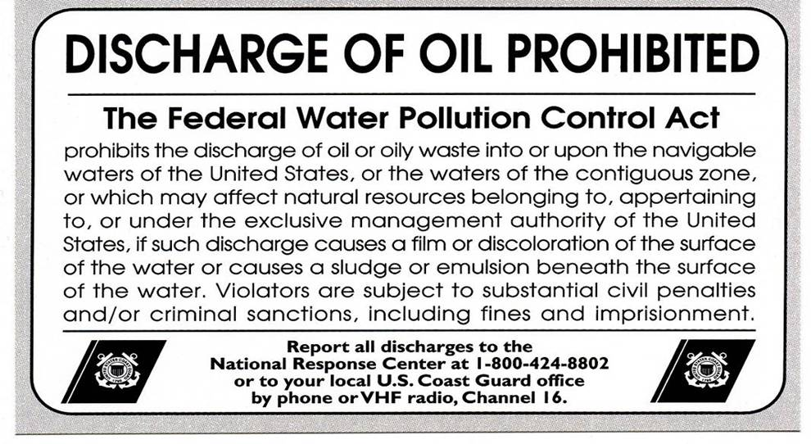
Item 10 - Pollution Placard:
Boats 26 feet and over must
display a 5”x 8” oil waste "pollution" placard.

Slide 52
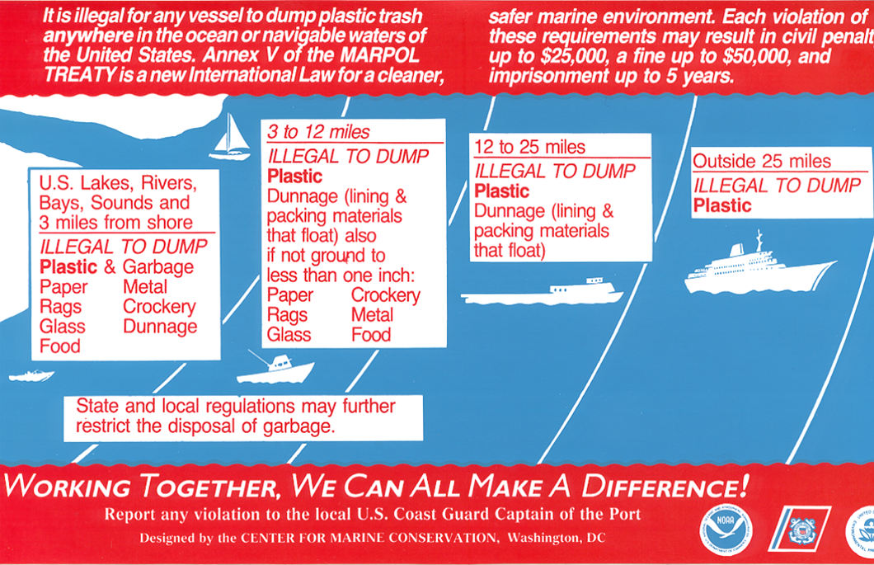
Item 11 - MARPOL Trash Placard:
Boats 26 feet and over in length must display a 4” x 9” "MARPOL" trash placard. This is currently being revised.
Boats 40 feet and over are required to have a written trash disposal plan.

Slide 53
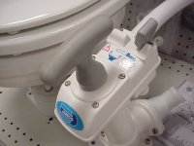
Item 12 - Marine Sanitation Devices:
Any installed toilet
must be a Coast
Guard approved
device.
Overboard discharge
outlets must be
capable of being
sealed.
Notes:
Type I and II MSDs have the ability to discharge overboard.
Type III MSDs re-circulate and store waste for discharge at pump-out stations.
Vessels under 65ft in length can use Types I, II, and III.
Vessels over 65ft in length can only use Types II, and III.

Slide 54
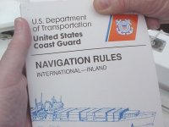
Item 13 - Navigation Rules:
Boats 39.4 feet and over, when operating on Navigable Inland Waters, must have on board a current copy of the Navigation Rules. It may also be an 8x11 copy from the internet. Sole state waters or Inland lakes are NOT exempt. (See page 36 of 2010 Federal Requirements.)
Notes:
Boats 39.4 feet and over, when operating on Inland waters, must have on board a current copy of the Navigation Rules.

Slide 55
Item 14 - State and/ or Local Requirements:
These requirements must be met before the "Vessel Safety Check" decal can be awarded.
A boat must meet the requirements of the state in which it is being examined.In California it includes in 2014+ mussel decal for non-coastal waters. 1/14
We do NOT participate in inspections for Quagga/Zebra mussels EXCEPT to provide information!
Notes:
Instructor should discuss the State and Local requirements for their area.

Slide 56
Item 15 - Overall Vessel Condition:
Deck free of hazards and clean bilge:
The boat must be free from fire hazards, in good overall condition, with bilges reasonably clean and visible hull structure generally sound. The use of automobile parts on boat engines is not acceptable. For outboards, the engine horsepower must not exceed that shown on the capacity plate.

Slide 57
Item 15 - Overall Vessel Condition:
Safe Electrical and Fuel Systems:
The electrical system - Must be protected by
fuses or manual reset circuit breakers.
Switches and fuse panels must be protected
from rain or water spray.
Wiring must be in good condition, properly installed and with no exposed areas or deteriorated insulation.

Slide 58
Item 15 - Overall Vessel Condition:
Safe Electrical and Fuel Systems continued:
Batteries must be secured and terminals and
covered to prevent accidental arcing.
All PWCs require an operating self circling or
kill switch mechanism.

Slide 59

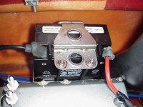
Item 15 - Overall Vessel Condition:

Slide 60
Item 15 - Overall Vessel Condition:
Fuel Systems - Portable fuel tanks (normally 7 gallon capacity or less) must be constructed of non-breakable material and free of corrosion and leaks.
All vents must be capable of being closed. The tank must be secured and have a vapor-tight, leak-proof cap. Each permanent fuel tank must be properly ventilated.

Slide 61
Item 15 - Overall Vessel Condition:
Safe Galley and Heating Systems:
System and fuel tanks must be properly secured with no flammable materials nearby.

Slide 62


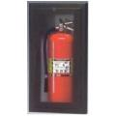
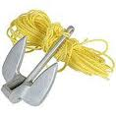
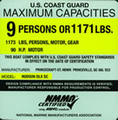
Additional Discussion Items:
We do not fail the boater for missing any of these items nor may each VSC have time to elaborate on each.
Marine Radio
Dewatering Device and Back-up
Mounting Fire Extinguishers
Anchor and Line
Capacity/Certificate
of Compliance
Notes:
A VHF Marine Radio is a key piece of safety equipment in an emergency. An FCC License is required for powered vessels over 65ft in length, commercial vessels, and vessels traveling in International Waters.
Carry a handheld pump and bucket to supplement your bilge pump as backup dewatering devices.
Fire Extinguishers should be mounted for easy access and safety.
Always carry an the proper anchor for your boat and area and enough rode.
Note: Maximum Vertical distance equals the height of the bow from the water surface plus the expected depth of the water, plus an allowance for changing tides.
Rode Length should be 7 to 10 times Maximum Vertical distance.
Maximum Capacity = Boat Width X Boat Length divided by 15.

Slide 63
Additional Discussion Items
Accident Reports/Owner Responsibility
The boat owner is responsible for what
occurs on their boat, even when they are not
present.
Offshore Operations
Boat operators are required by law to safety extend
help to other boaters in distress. Failure to
assist is a felony punishable by fines and/or
prison.
Notes:
The boat owner retains responsibility for what occurs on their boat, even when they are not there.
An Accident Report will be filed immediately if the accident results in a death or disappearance; within 48 hours if there are injuries requiring more than basic first aid; and within 10 days if there is damage greater than $2,000.00.
Any Boat operator is required by law to extend help to other boaters in distress. Failure to assist is a felony punishable by fines and/or prison.
When operating Offshore EPIRBs and Immersion Suits should be carried.

Slide 64
Additional Discussion Items
Fueling/Fuel Management
Refuel portable tanks away from the vessel.
Close all hatches and openings before fueling.
Don’t smoke while fueling.
Turn off engines, electrical systems, and any spark producing items.
Remove all passengers.
Keep the fill nozzle in contact with the tank and clean up any spills.
Notes:
Refuel portable tanks away from the vessel.
Close all hatches and openings before fueling.
Don’t smoke while fueling.
Turn off engines, electrical systems, and any spark producing items.
Remove all passengers.
Keep the fill nozzle in contact with the tank and clean up any spills.

Slide 65
Additional Discussion Items
Fueling/Fuel Management
After Fueling:
Open all hatches and openings
Check bilges and “sniff test” boat for fuel vapor
Run blowers for at least 4 minutes before
starting engine
Always use the One Third Rule
One third of fuel going out
One third of fuel for coming back
One third of fuel as a reserve

Slide 66
Additional Discussion Items-
(time allowing)
Insurance Considerations
Most States require proof of Insurance before you
can register your boat.
Coverage should include:
Loss of, or damage to, boat
Loss of, or damage to, equipment
Liability Coverage; personal injury and property
Medical coverage
Towing; over both land and water
Notes:
Most States require proof of Insurance before you can register your boat.

Slide 67


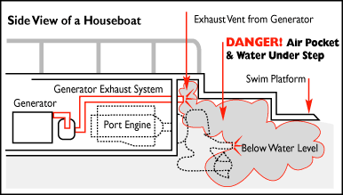
Additional Discussion Items
Notes:
Carbon monoxide (CO) can harm and even kill you inside or outside your boat!

Slide 68
Additional Discussion Items
Carbon Monoxide
CO can affect you whether you're underway, moored, or anchored.
You cannot see, smell, or taste CO.
CO can make you sick in seconds. In high enough concentrations, even a few breaths can be fatal.
CO symptoms are similar to seasickness or alcohol intoxication.
Notes:
What is Carbon Monoxide?
Carbon monoxide (CO) is a colorless, odorless, and tasteless gas. It is produced when a carbon-based fuel-such as gasoline, propane, charcoal, or oil-burns. Sources on your boat may include engines, gas generators, cooking ranges, and space and water heaters
Why is it so dangerous?
Carbon monoxide (CO) enters your bloodstream through the lungs, blocking the oxygen your body needs. Prolonged exposure to low concentrations or very quick exposure to high concentrations can kill you.
Early symptoms of CO poisoning include irritated eyes, headache, nausea, weakness, and dizziness. They are often confused with seasickness or intoxication, so those affected may not receive the medical attention they need.
Altitude, certain health-related problems, and age will increase the effects of CO. Persons who smoke or are exposed to high concentrations of cigarette smoke, consume alcohol, or have lung disorders or heart problems are particularly susceptible to an increase in the effects from CO. However, anyone can be affected. Another factor to consider is that physical exertion accelerates the rate at which the blood absorbs CO.
Emergency Treatment for CO Poisoning
CO poisoning or toxicity is a life-threatening emergency that requires immediate action. The following is a list of things that should be done if CO poisoning is suspected. Proceed with caution. The victim may be in an area of high CO concentration, which means you or others could in danger from exposure to CO.
Evaluate the situation and ventilate the area if possible.
Evacuate the area and move affected person(s) to a fresh air environment.
Observe the victim(s).
Administer oxygen, if available.
Contact medical help. If the victim is not breathing, perform rescue breathing or approved cardiopulmonary resuscitation (CPR), as appropriate, until medical help arrives. Prompt action can mean the difference between life and death.
Shut off potential sources of CO, if possible. Correct ventilation problems and/or repair exhaust problems as appropriate. Investigate the source of CO and take corrective action, such as evacuating and ventilating the area or shutting off the source of the CO, while at the same time evacuating and ventilating the area.

Slide 69
Additional Discussion Items
Carbon Monoxide
Each Time You Go On a Boat Trip
Make sure you know where CO exhaust outlets are located on your vessel.
Educate all passengers about the symptoms of CO poisoning and where CO may accumulate.
When docked, or rafted with another boat, be aware of exhaust emissions from the other boat.
Confirm that water flows from the exhaust outlet when the engines and generator are started.
Listen for any change in exhaust sound, which could indicate an exhaust component failure.
Test the operation of each CO alarm by pressing the test button.
Notes:
Once a Month
Make sure all exhaust clamps are in place and secure.
Look for exhaust leaking from exhaust system components. Signs include rust and/or black streaking, water leaks, or corroded or cracked fittings.
Inspect rubber exhaust hoses for burned, cracked, or deteriorated sections. All rubber hoses should be pliable and free of kinks.
Once a Year
Have a qualified marine technician:
Replace exhaust hoses if cracking, charring, or deterioration is found.
Ensure that your engines and generators are properly tuned, and well maintained.
Inspect each water pump impeller and the water pump housing. Replace if worn. Make sure cooling systems are in working condition.
Inspect all metallic exhaust components for cracking, rusting, leaking, or loosening. Make sure they check the cylinder head, exhaust manifold, water injection elbow, and the threaded adapter nipple between the manifold and the elbow.
Clean, inspect, and confirm proper operation of the generator cooling water anti-siphon valve (if equipped).

Slide 70
Additional Discussion Items
Carbon Monoxide Hazards caused by
Generator Exhaust
Remind Recreational Boaters about Carbon Monoxide Hazards
caused by Generator Exhaust. The Coast Guard advises
owners and operators of boats to turn off gasoline-powered
generators with transom exhaust ports when the swim
platform on the stern is in use. Swimmers should not enter
the cavity of a boat designed with a generator emitting
exhaust into the cavity between the swim platform and the
transom of the vessel.
Notes:
Previous carbon monoxide warnings and educational materials have concentrated on the hazards created by the exhaust of the main propulsion engines while underway. Although these dangers still exist, the Coast Guard will develop new educational materials to emphasize the additional hazards of using a gasoline-powered generator, especially while not underway

Slide 71
FILE A FLOAT PLAN!
A float plan contains information about the operator and the vehicle used to transport the vessel as well as the vessel itself.
The plan also includes the expected route of travel along with a date and time of arrival and departure. Taking a few minutes to post a float plan with the marina operator, friends or loved ones is a great life insurance policy.
Notes:
An overdue SUB is a high search and rescue priority because the effects of cold water and other climatic factors can quickly become life threatening.

Slide 72
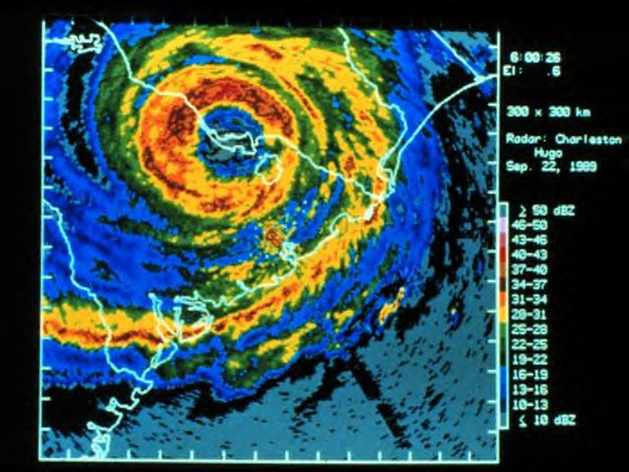
CHECK THE WEATHER
Monitor and evaluate weather conditions.
Purchase a waterproof and portable weather radio or use a VHF radio that has a weather channel.
Check sky and sea conditions and never operate in an environment that exceeds personal capability.
Notes:
There are great website for local weather reports and of course the National Weather Service.

Slide 73
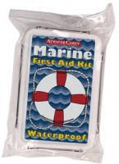
FIRST AID KIT
Pack a waterproof First Aid kit and insure that it is secured to your boat. In addition to the kit consider completing basic first aid training and CPR
Notes:
Paddle sports enthusiasts often operate in remote areas where medical attention is not readily available.

Slide 74
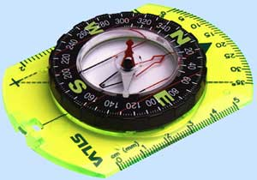
VHF Radio, GPS, Compass
Bring along electronic communication and navigation devices such as a VHF Radio, GPS, and Cellular Phone.
Include a waterproof hand held compass as a back up in case
Notes:
Place VHF radio, GPS and Compass in waterproof bags.
Include a waterproof hand held compass as a back up in case the GPS fails.

Slide 75
CHARTS
When operating in coastal waters or navigable rivers, carry a chart and try to obtain local knowledge of waterway conditions.
Familiarize yourself with basic coastal navigation procedures.
Notes:
Check at the start of each boating season to make sure you have the most up to date charts for the areas you frequent.

Slide 76

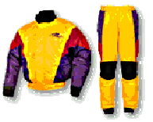
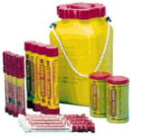
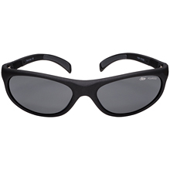

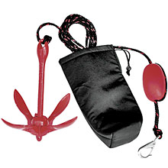

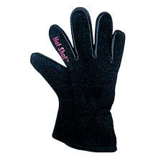
OTHER ITEMS
Notes:
Ask the class to list other items that might be important to bring on your SUB trip.
Don’t forget to secure all items to the boat or your PFD

Slide 77
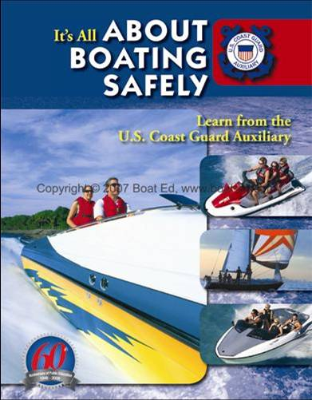
BOATING SAFETY COURSE
All boaters should be encouraged to take a Boating Safety Course such as the “About Boating Safely” Course.
For more D11NR class info, promote: http//public.d11nuscgaux.info/pe-course.html on ALL handout material.
Notes:
Ask the class what other USCG Auxiliary Boating Safety Courses are available to the public.
Ask which one’s might be most useful to SUB operators.

Slide 78
CLEAN UP
Pack a trash bag. Take all refuse away with you.
Leave every stop or campsite cleaner than when you found it.

Slide 79
“ Recreational Boating Safety is the Auxiliary's core competency and core mission. The absolute strongest support to the Recreational Boating Safety mission is needed as never before. “
“Preventive Search and Rescue saves lives and also creates opportunities for our limited active Coast Guard resources to conduct missions other than Search and Rescue, which is extremely valuable within the current maritime security environment... “
Capt. David B. Hill, CHDIRAUX

Slide 80
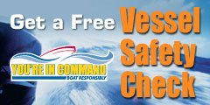

Slide 81

VSC Review
D11NR Vessel Examination Department
The V-DEPT. ----------WE SAVE LIVES!
Prepared by:
Mike Lauro DSO-VE
Rev. 12/21

