Slide 1
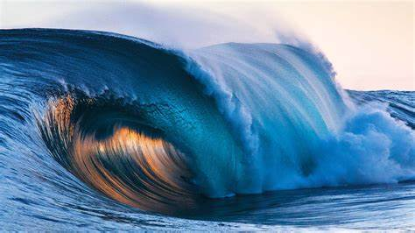
New Handbooks – Qualifications & Night Tasking

Slide 2

Welcome On Board!

Slide 3
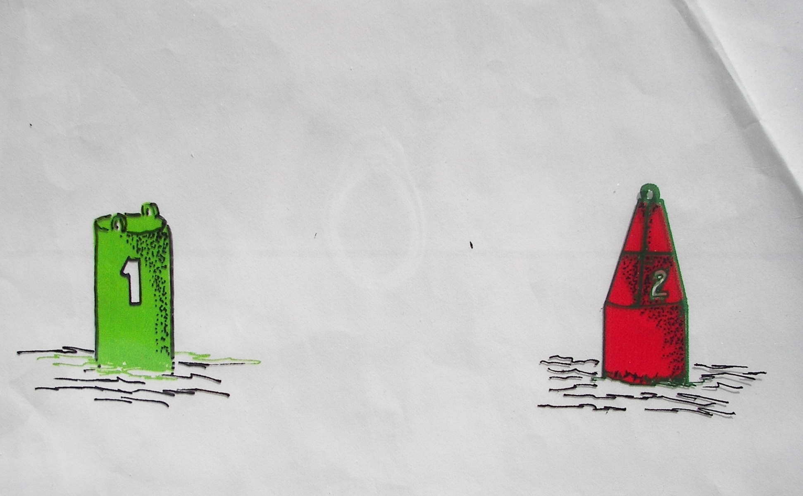

Please ……
You are welcome to ask questions …
BUT … please stay between the buoys!

Slide 4
Today’s Agenda
References:
CG Boat Operations and Training Manual Vol.1 COMDTINST M16114.32 (series)
Auxiliary Training Handbook Boat Crew ATH 16794.51 (series)
Auxiliary Qualification Handbook Boat Crewmember, Coxswain, PWC Operator ABQH 16115.52(series)
Navigation Rules COMDTINST M16672.2(series)
NEW:
Initial Qualification Tasks
Requalification Tasks (3-Year Check Ride)
Annual Task Tracking
“Night Certified” … or not!
NOT NEW
REYR / REWK

Slide 5
TASK COXN-09-06-AUX: Underway Checkride
TASK BCM-08-04-AUX: Underway Check Ride
Initial qualification and requalification (3-year) check rides are very similar to one another.
In response to the QE and as directed by the coxswain, the trainee must answer questions on, and perform the below-listed evolutions as the crewmember. The coxswain/crew along with the QE should supervise the trainee.
For candidates wanting to be “Night Certified”, Performance Criteria include M.O.B. and piloting & navigation exercise and must be part of the check ride conducted at night.
Ref: BCM 08-03 / COXN 09-05 Dockside

Slide 6
Most Tasks To Be Performed in
“Calm Seas and Wind Conditions”
Sea Conditions | Calm | Seas less than 2 FT
 | Moderate | Seas 1 to 4 FT
 | Heavy | Seas 4FT or greater
Wind Conditions | Calm | Less than 2 to 6 knots
 | Moderate | 7 to 19 knots
 | Heavy | 20 knots and above

Slide 7
New Initial Qualification Tasks

Slide 8
Pre-Qualification Tasks - Coxswain
TASK COXN-09-04-AUX: Perform a Navigation and Piloting Exercise (Day and Night)
In response to the mentor, the candidate must perform a navigation and piloting exercise.
For completion of this task, the nighttime exercise must be performed.
After receiving the position (given by the mentor), the candidate should plot a course, determine an estimated time of arrival (ETA), and get the facility underway within 30 minutes of notification.

Slide 9
Pre-Qualification Tasks - Crew
TASK BCM-08-02-AUX: Perform as a Crewmember During a Navigation and Piloting Exercise (Day and Night)
After receiving a position (given by the mentor) the trainee should assist the coxswain in plotting a course and determining an ETA, then perform the duties of a crewmember during a piloting exercise.
For completion of this task, the nighttime exercise must be performed.

Slide 10
Pre-Qualification Tasks
Coxswains and Crew
Members not requesting to be “night certified” must still complete the Navigation & Piloting TASK PQS requirements at night as part of the qualification process to complete the PQS.
This must be done prior to requesting a QE oral board and check ride.

Slide 11
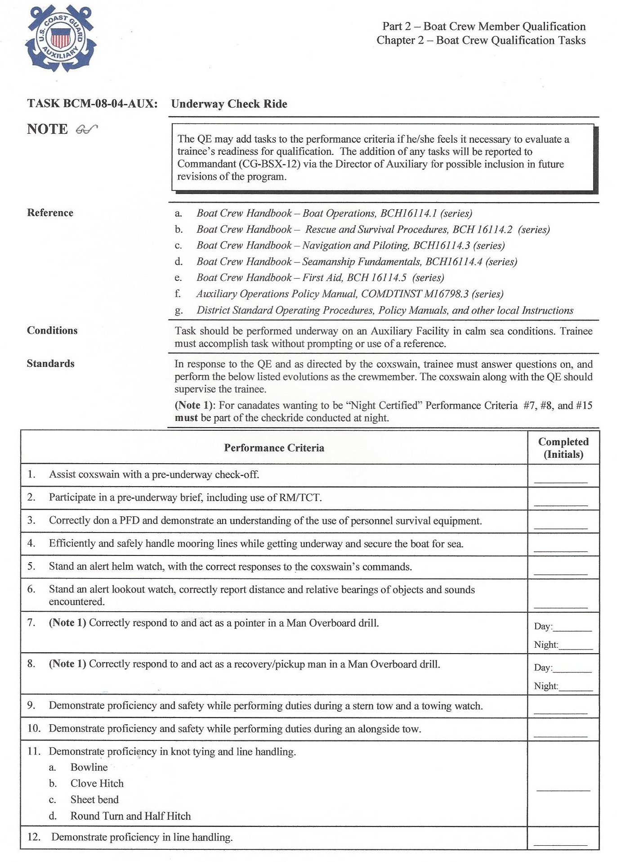
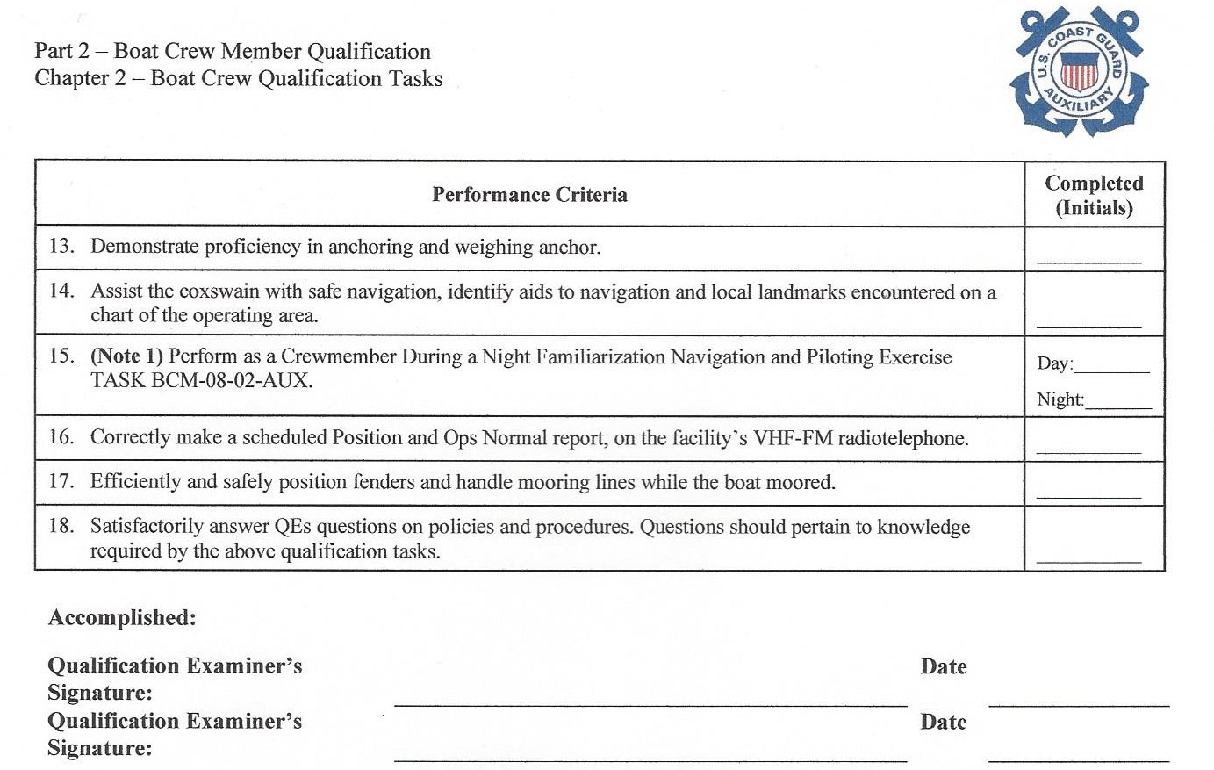



QE Check Ride - Crew
(Note 1): For candidates wanting to be “Night Certified” Performance Criteria #7, #8, and #15 must be part of the check ride conducted at night.

Slide 12
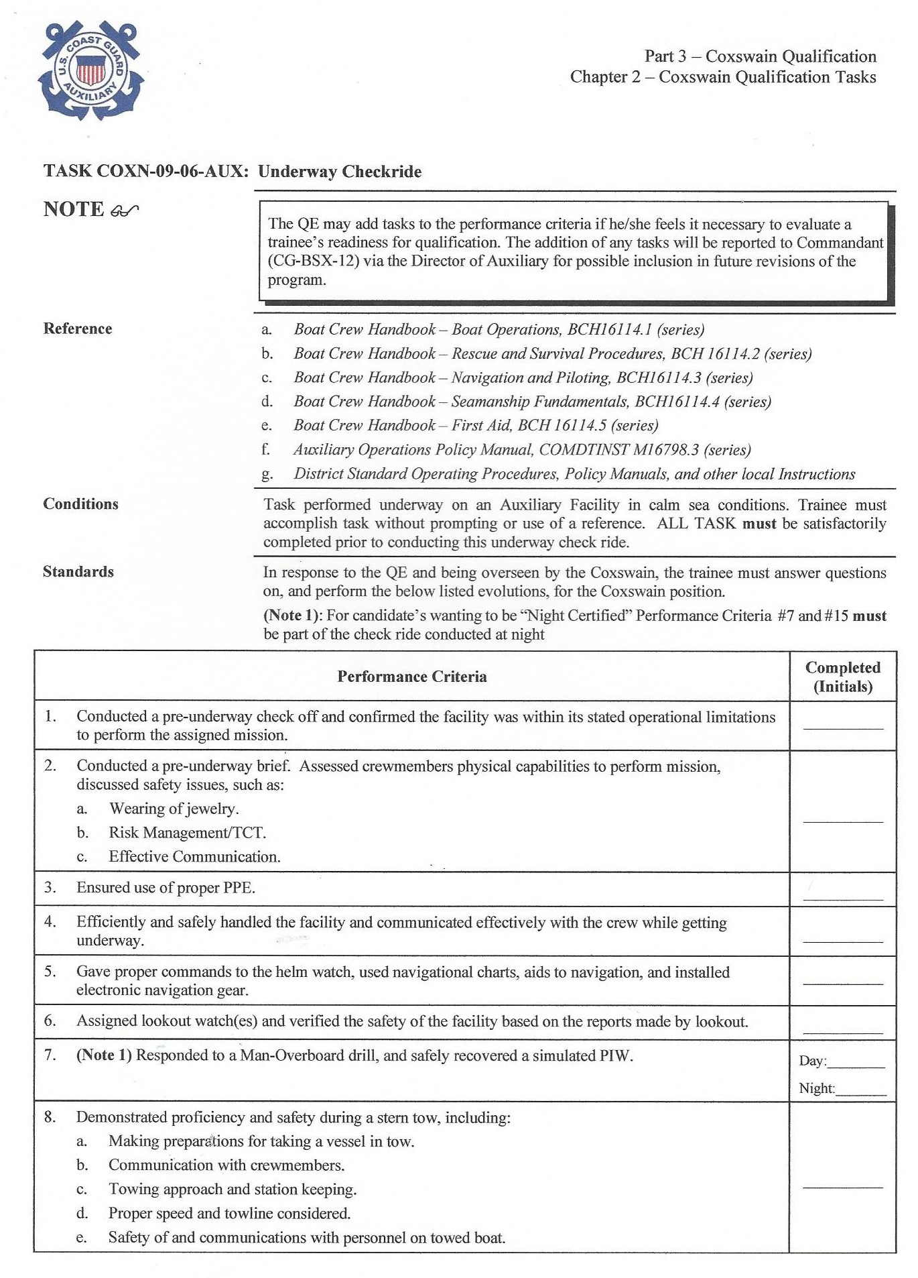
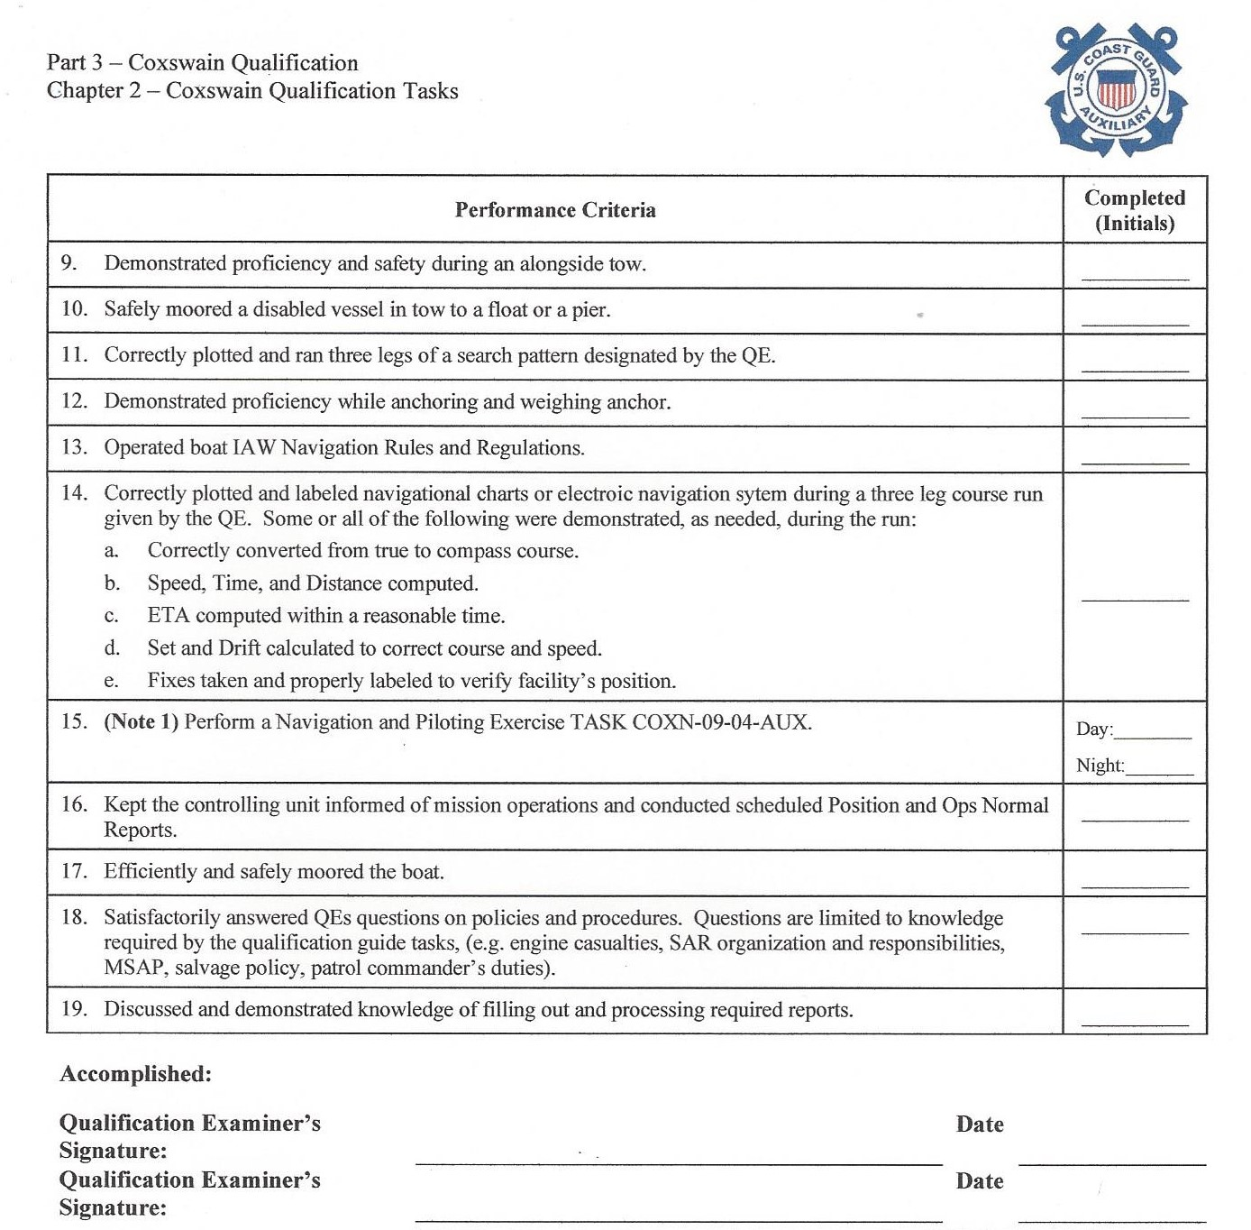

QE Check Ride - Coxswain
(Note 1): For candidates wanting to be “Night Certified” Performance Criteria #7 and #15 must be part of the check ride conducted at night

Slide 13
Three-Year Evaluation Check Ride

Slide 14
Three-Year Evaluation Check Ride (QE)
Annual currency maintenance tasks are not required to be completed prior to the member’s three-year evaluation check ride.
Annual currency maintenance tasks may be completed as part of the check ride and the member will receive credit for those tasks as part of their annual currency maintenance requirements and the QE check ride.
Prior to ALL check rides, a current PPE annual certification will be required and it must be entered in ADII.

Slide 15
Three-Year Evaluation Check Ride (QE)
The member is responsible for making sure they receive credit for completion of any annual currency maintenance tasks on the Annual Currency Maintenance Task Tracker and is reported in AUXDATA II.
The nighttime TASKs are an optional part of the QE three-year evaluation check ride.

Slide 16
QE Check Ride - Crew
(Note 1): For candidates wanting to be “Night Certified” Performance Criteria #7, #8, and #15 must be part of the check ride conducted at night.

Slide 17
QE Check Ride - Coxswain
(Note 1): For candidates wanting to be “Night Certified” Performance Criteria #7 and #15 must be part of the check ride conducted at night

Slide 18
New Currency Maintenance Tasks

Slide 19
Currency Maintenance Tasks
“Annual Currency Maintenance Task Tracker”
Coxswains & crew must complete annual tasks to remain “current” for certification.
Additional tasks are required for night certification.

Slide 20
Currency Maintenance Tasks
Crew Day Tasks:
Navigation & piloting exercise
Man overboard
Towing – Astern & alongside
Boat handling
Anchoring
Knots
Procedure in event of fire
Procedure in event of grounding, sinking, or striking submerged object

Slide 21
Currency Maintenance Tasks
Coxswain Day Tasks:
All the same as crew but add:
Conduct a pre-underway brief
Moor a disabled vessel
Execute three legs of a search pattern (PS, CS, or TSR)

Slide 22
Currency Maintenance Tasks
Recommendation:
Each Coxswain & Crew member carries their “Annual Currency Maintenance Task Tracker” with them on every patrol until completed.
Coxswains: Recommend having several blank forms available on board.

Slide 23
Currency Maintenance Tasks
Sign-offs:
Coxswains may initial crew & coxswain task completions (Note: Coxswains may self-certify)
Crew may initial crew task completions

Slide 24
Currency Maintenance Tasks
For each Task completed, record the following information in the corresponding Task section below:
• The AUXDATA II Patrol # during which the Task was completed (example: PO-123456).
• The date of the Patrol during which the Task was completed.
• The initials of the person authorized to sign off on the Task.
When the Task Tracker is complete, send to DIRAUX (D11AUXNorthern@uscg.mil)

Slide 25
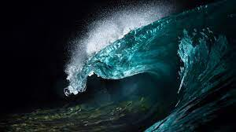
New “Night Certified” Tasks
Nighttime hours begin ½ hour after sunset and end no later than ½ hour before sunrise.

Slide 26
Night Certification
“Night Certified” is an option on an initial check ride depending on whether or not the candidate wants to be night certified.
There is no requirement for a night check-ride for recertification on a third-year QE check-ride.
If the recertification candidate has completed the prior year’s Annual Task Tracker with the optional night exercises signed off, that would certify them for night certification upon successful completion of a “day” check-ride.

Slide 27
Night Certification
If the Annual Task Tracker sign-offs did not include the night exercises, then the candidate would be recertified for “day” operations only.
Important: It is necessary for OPTREX organizers to be notified well in advance if an initial qualification candidate(s) "wants" to be night certified so proper arrangements may be made by the QE(s).

Slide 28
From the Training Handbook
“Coxswains & Crewmembers who are not nighttime certified are not authorized to perform missions at night. To become nighttime certified, a portion of the check ride shall be conducted at night”
To patrol at night, a facility must have minimum crew that is night certified.
Others may be on board at night but, if not night certified, must be recorded as “Trainees” during the night portion.
This allows those not night certified to record hours underway at night to attain “night certification”.

Slide 29
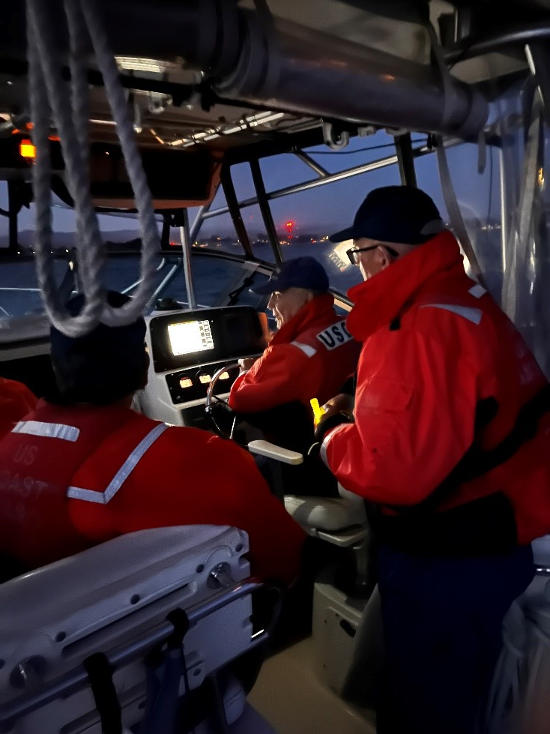
Currency Maintenance Tasks
Additional Crew Night Tasks:
Navigation & piloting exercise
Man overboard
2 hours underway at night

Slide 30
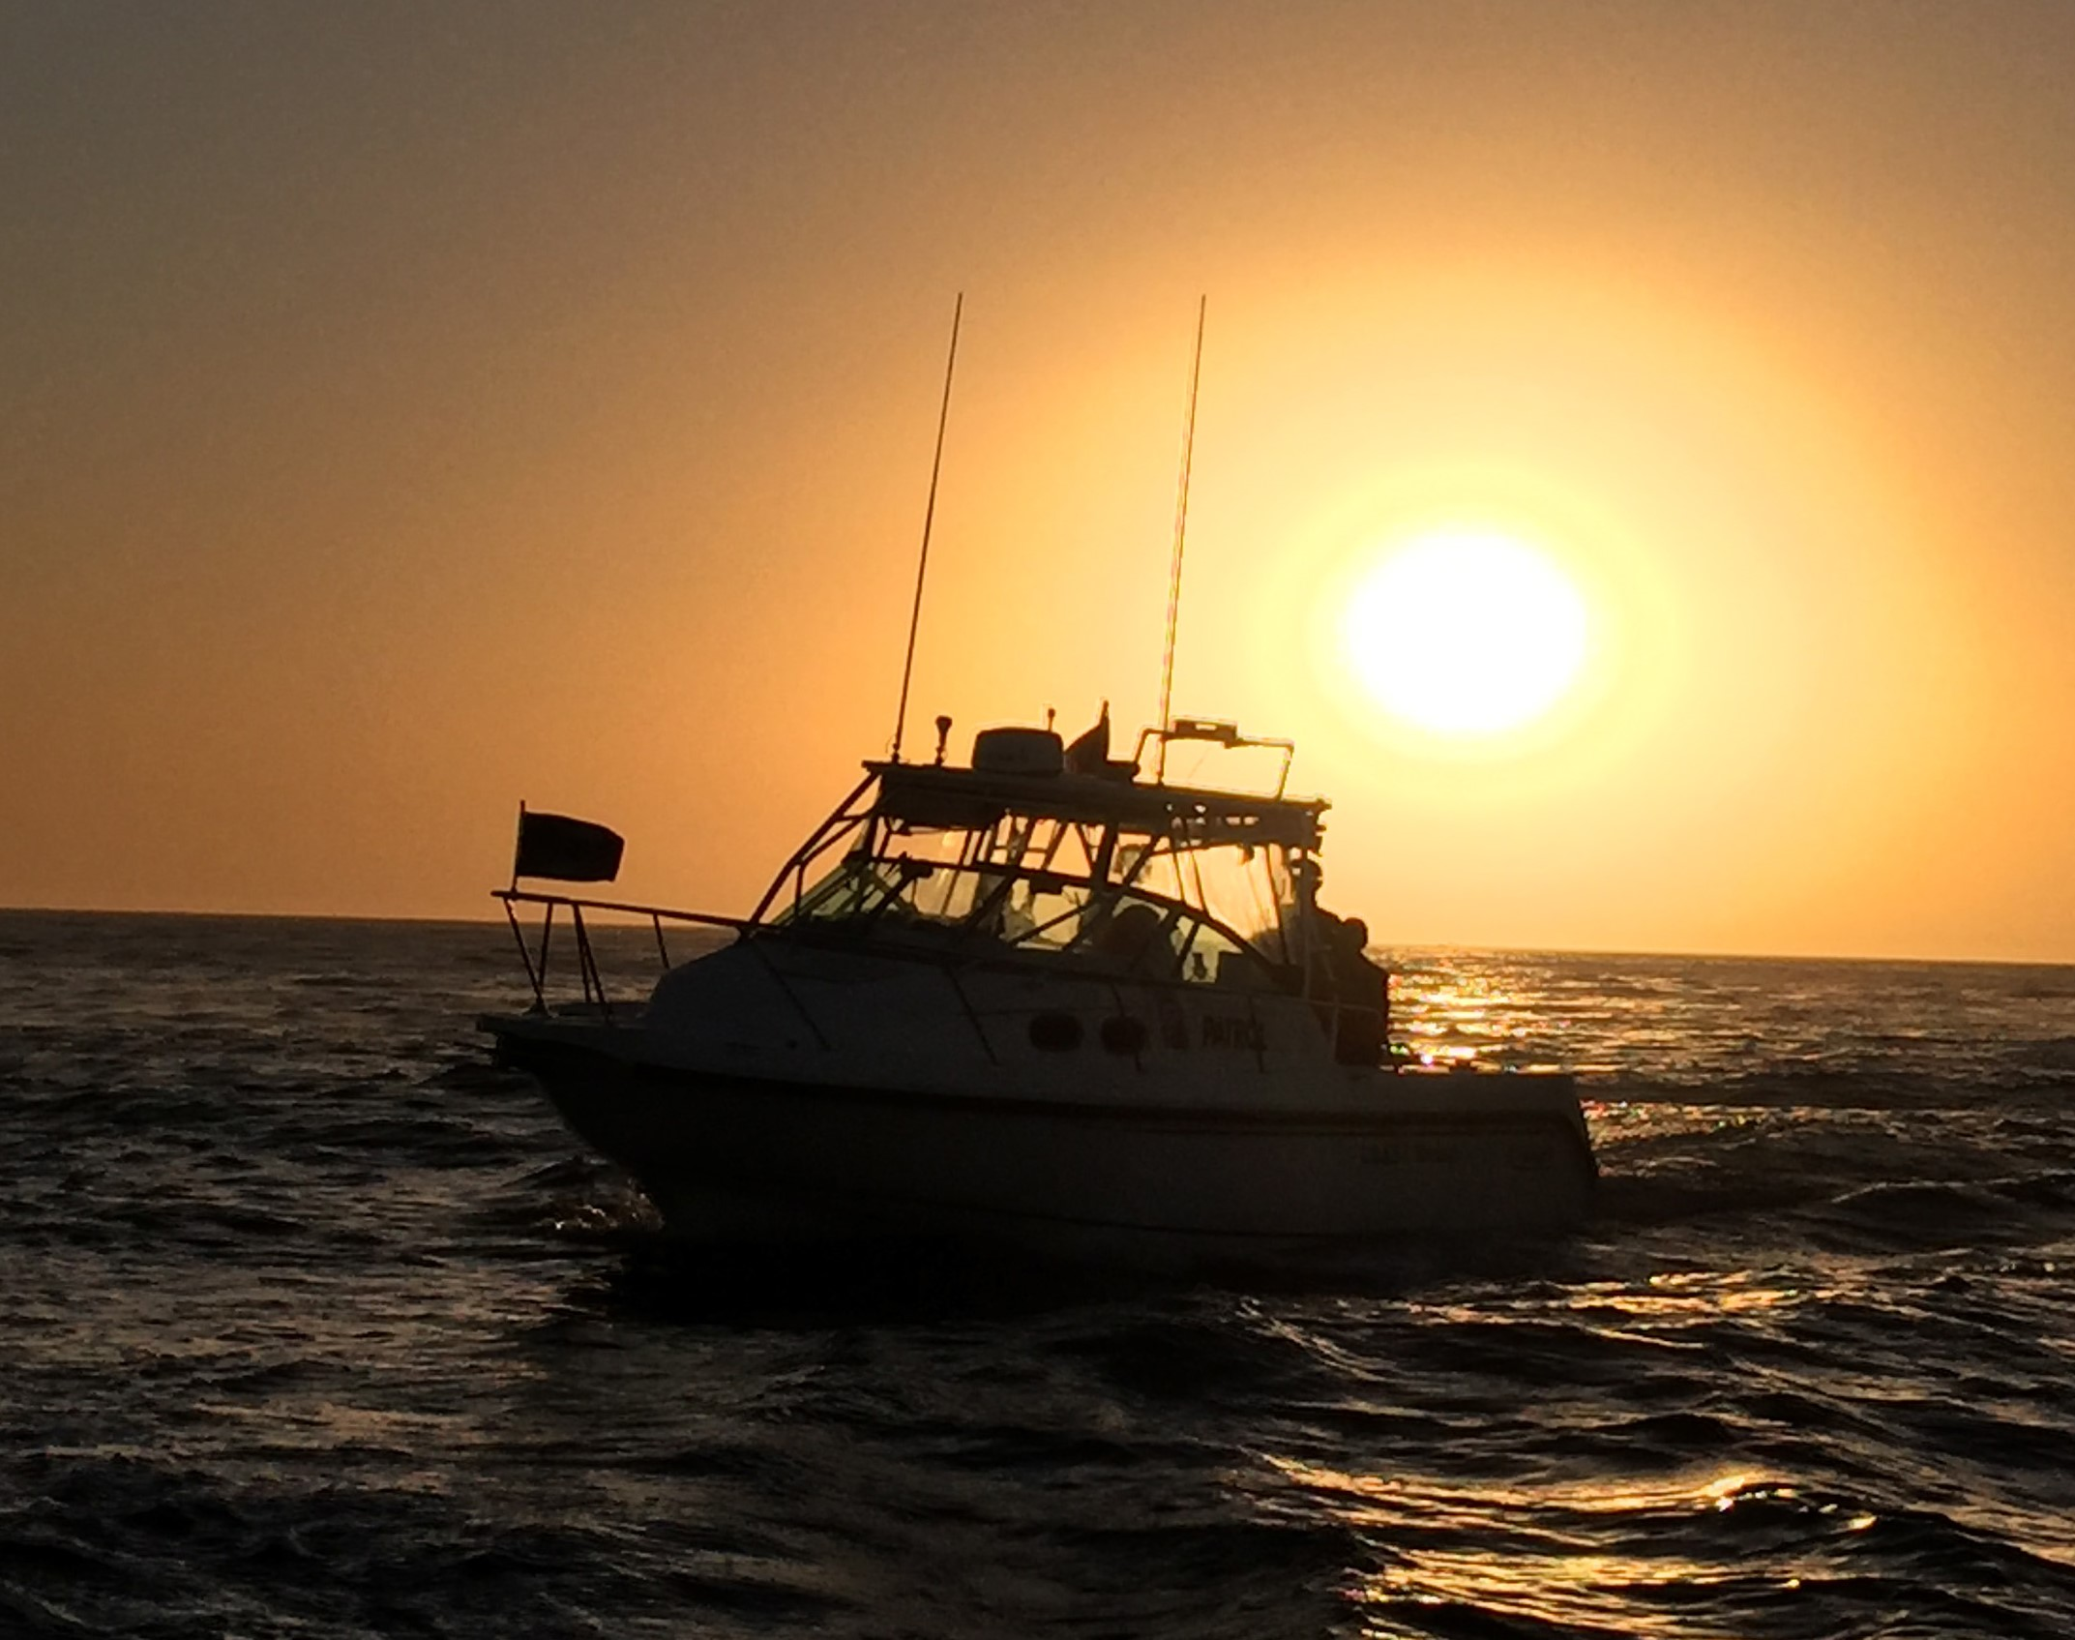
Currency Maintenance Tasks
Additional Coxswain Night Tasks:
Same as Crew:
Navigation & piloting exercise
Man overboard
2 hours underway at night
PWC operators are not authorized to operate during nighttime hours.

Slide 31
Coxswain Hours
Included in the upcoming update to the Auxiliary Training Handbook in early March:
All coxswains onboard get hours whether they are “coxswain of record” or not.
LEAD Coxswain hours are deleted.
This will be reflected in the CY23 hours.
If the member got their 12 hours with 2 of those at night, they will be night certified.
ADII has already been updated to reflect this.
The updated ATH will reflect this.

Slide 32
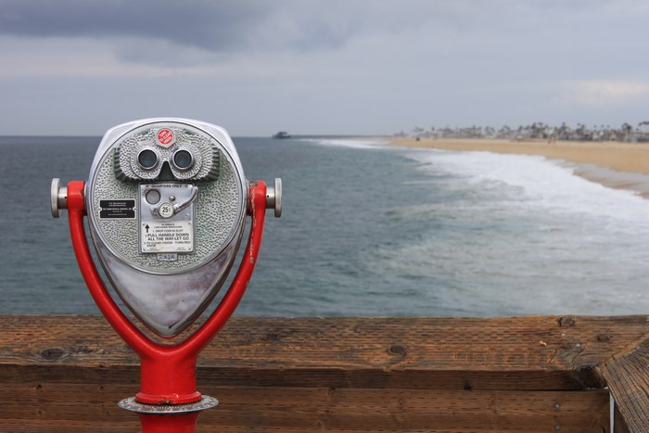
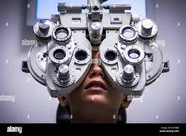
New “Vision” Tasks

Slide 33
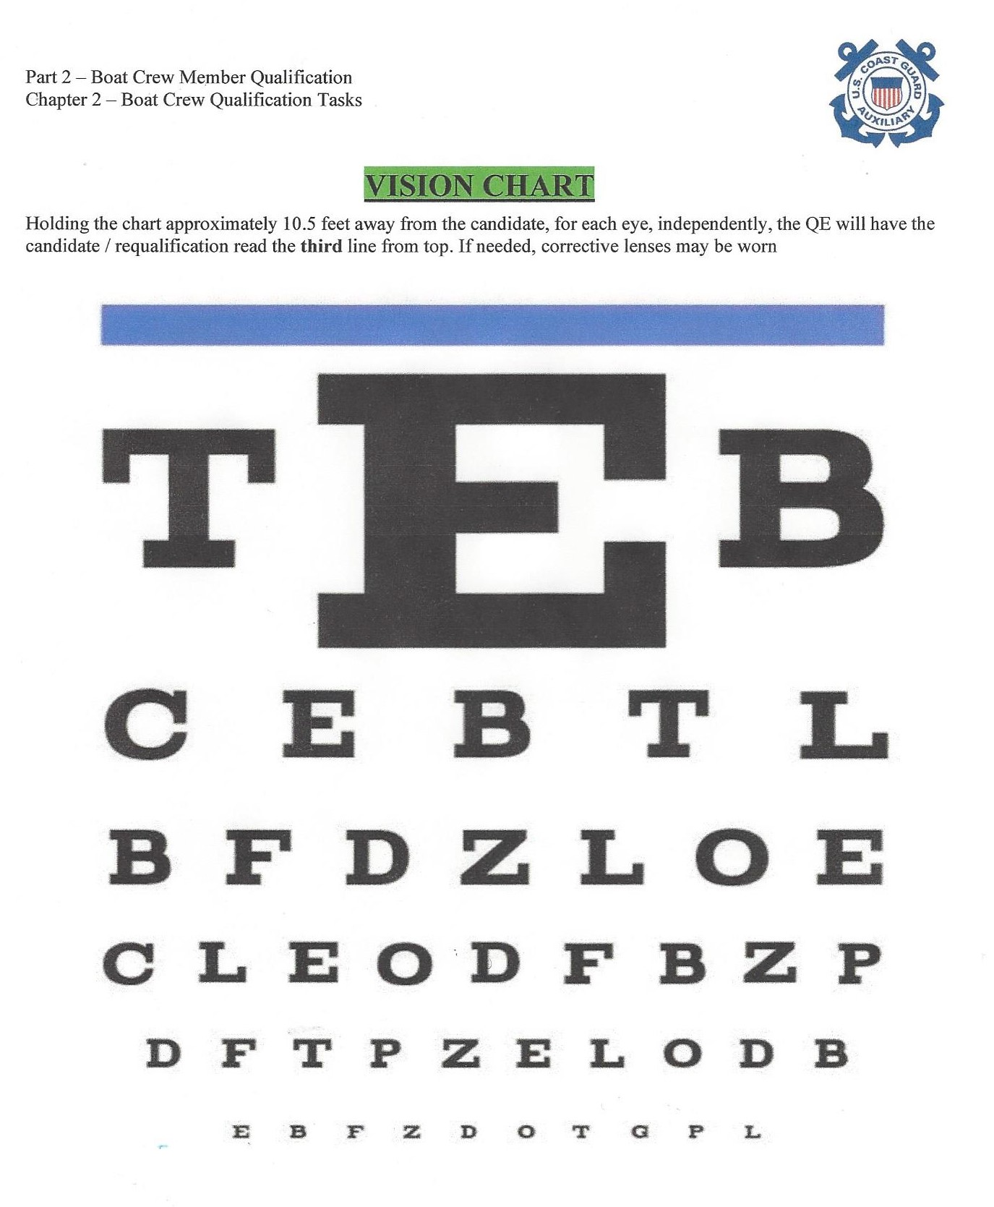
VISION TESTING
Holding the chart approximately 10.5 feet away from the candidate, for each eye, independently, the QE will have the candidate / requalification read the third line from the top. If needed, corrective lenses may be worn.

Slide 34
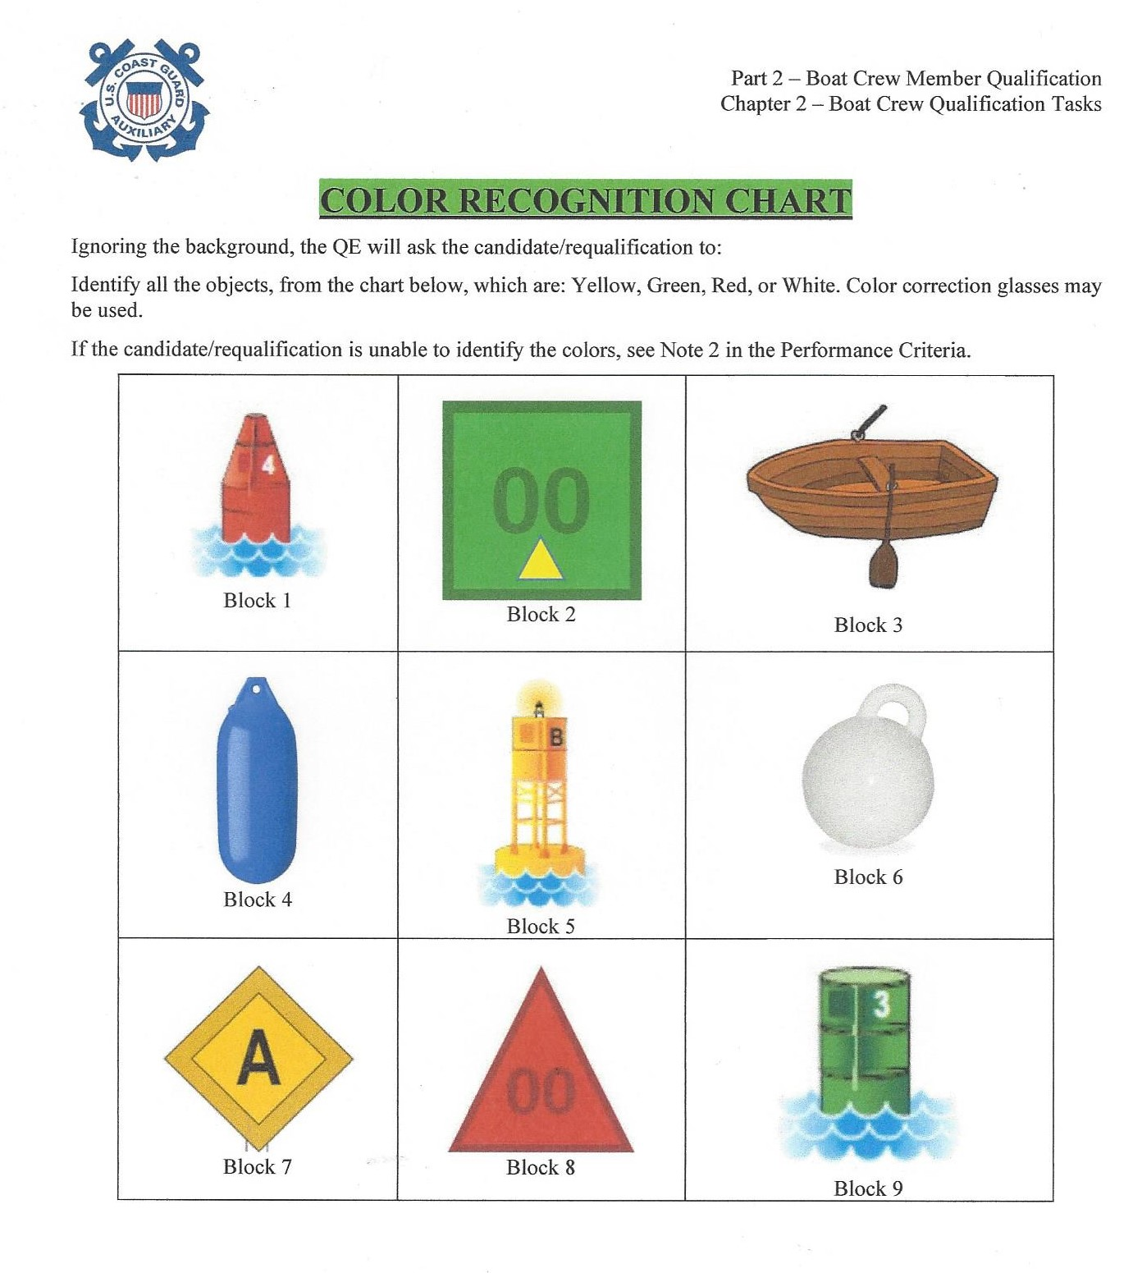
VISION TESTING
Ignoring the background, the QE will ask the candidate/requalification to:
Identify all the objects, from the chart, which are: Yellow, Green, Red, or White. Color correction glasses may be used.

Slide 35
Initial Qualification Tasks - Crew
TASK BCM-08-02-AUX: Perform as a Crewmember During a Navigation and Piloting Exercise (Day and Night)
Note 1: Candidates/requalifications who cannot distinguish objects or shapes are prohibited from participating in operations until the member is further evaluated by a licensed ophthalmologist (MD or DO) or optometrist (OD).
If a member is determined to be legally blind by a certified eye doctor, then the member is prohibited from participating as Crewmember, Coxswain, or PWC operator.

Slide 36
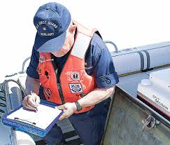
Requesting a Qualification Examiner (QE)
&
REYR

Slide 37
Requesting a QE
When the candidate has completed the training process:
The FC or FSO-MT must request the services of a QE
The request should be made at least 30 days in advance
If for an initial certification, member must advise if nighttime will be part of the qualification process.
Each member must perform all required tasks as outlined in the Handbook.
Ref: Appendix F of the ATH & the Pre QE Requirement 2023 Rev B.

Slide 38
REYR = Required Yearly Not Met
What can trigger REYR status:
Failure to complete Annual Currency Maintenance Tasks
Failure to complete required annual workshops e.g. RM/TCT Refresher & Operations Workshop
Failure to remain current with Core Value courses
Failure to requalify when due (3 years)
Insufficient hours underway in the prior year
Ref: ATH Chapter 4. Section C.

Slide 39
FAILS TO MEET ANNUAL CURRENCY REQUIREMENTS
A member whose certification has lapsed may participate as a designated trainee on an ordered patrol.
A member who fails to meet annual currency requirements for the year shall make up the missing hours and/or currency maintenance tasks as a trainee the following calendar year.
Coxswain shall document the completion of all missing hours and/or annual currency requirements.

Slide 40
REYR = Required Yearly Not Met
Members qualified as coxswain, but placed in REYR, do not automatically downgrade to Crewmember and cannot be part of the minimum qualified crew.
The decision to downgrade is up to the Directors office.
Members who have been in REYR status for a period of five years or more must re-qualify by completing all required tasks for the desired position.

Slide 41
REYR = Required Yearly Not Met
Members in REYR status do not automatically revert to certified status in AUXDATA II upon completion of the missing tasks or hours.
A formal letter must be submitted to the OTO from the FSO-OP, MT (at any level), or FC stating:
(1) That the member has completed the missing requirement
(2) Request that the member be re-instated.

Slide 42
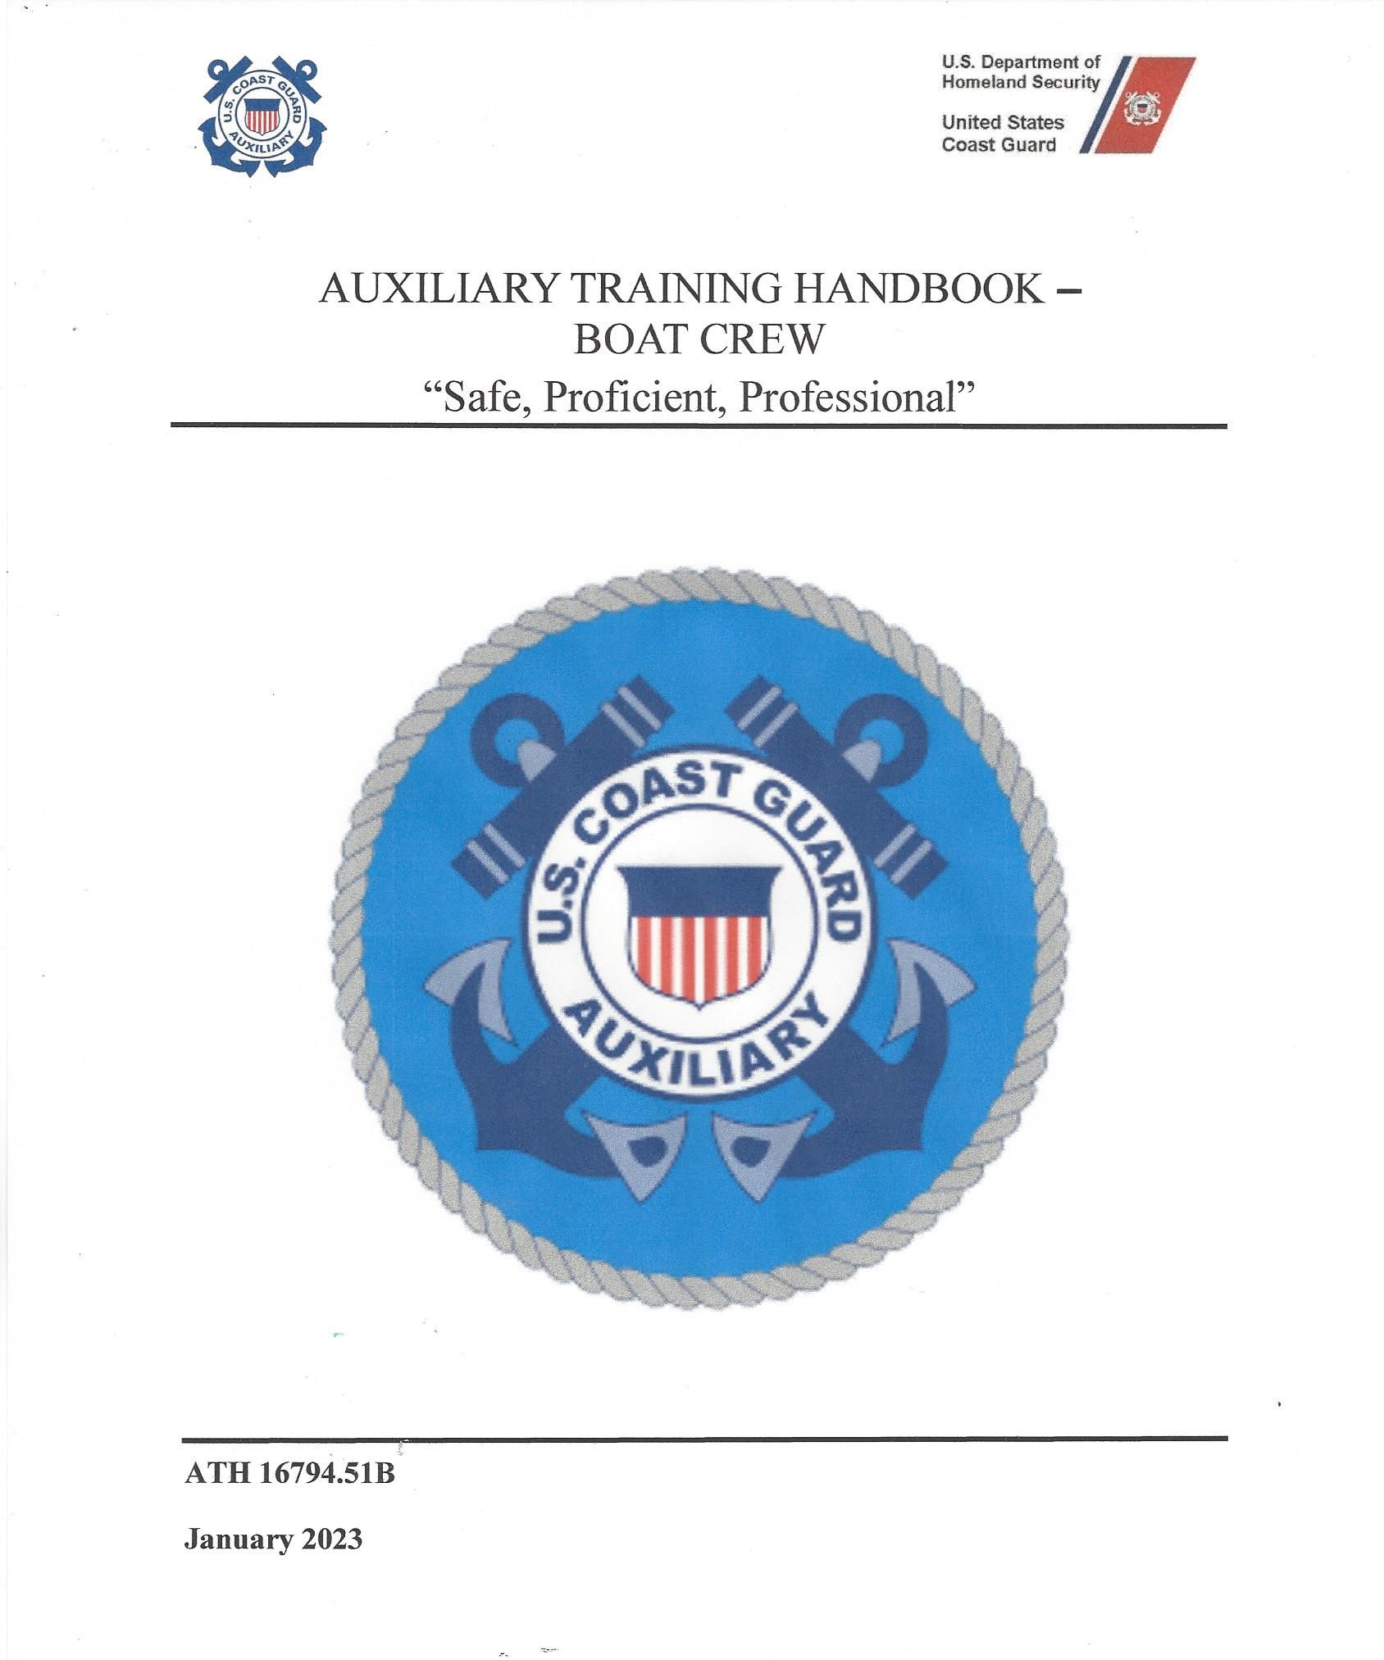
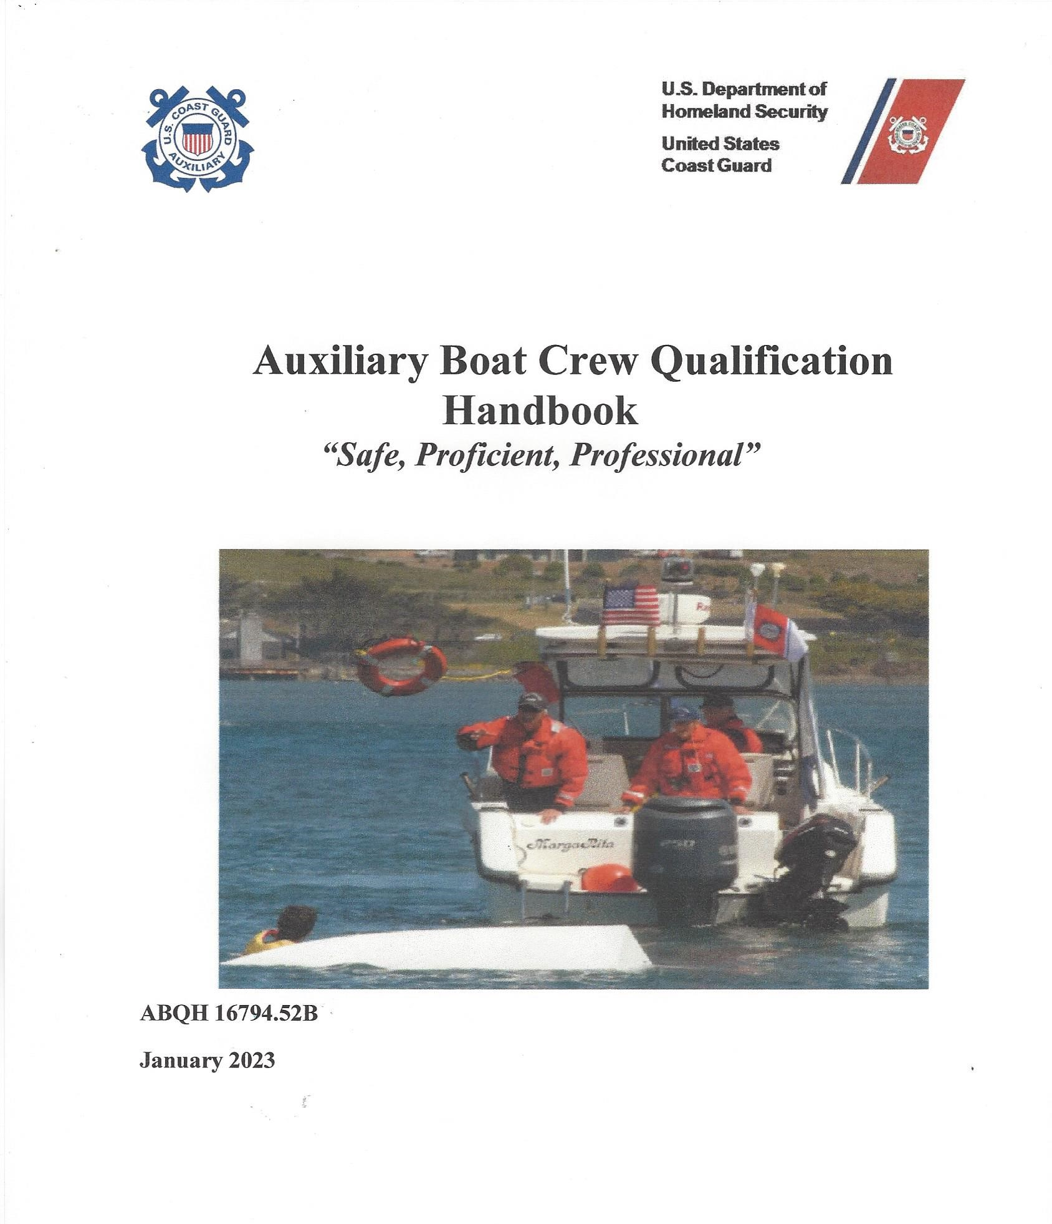
Where are the “Handbooks”?

Slide 43
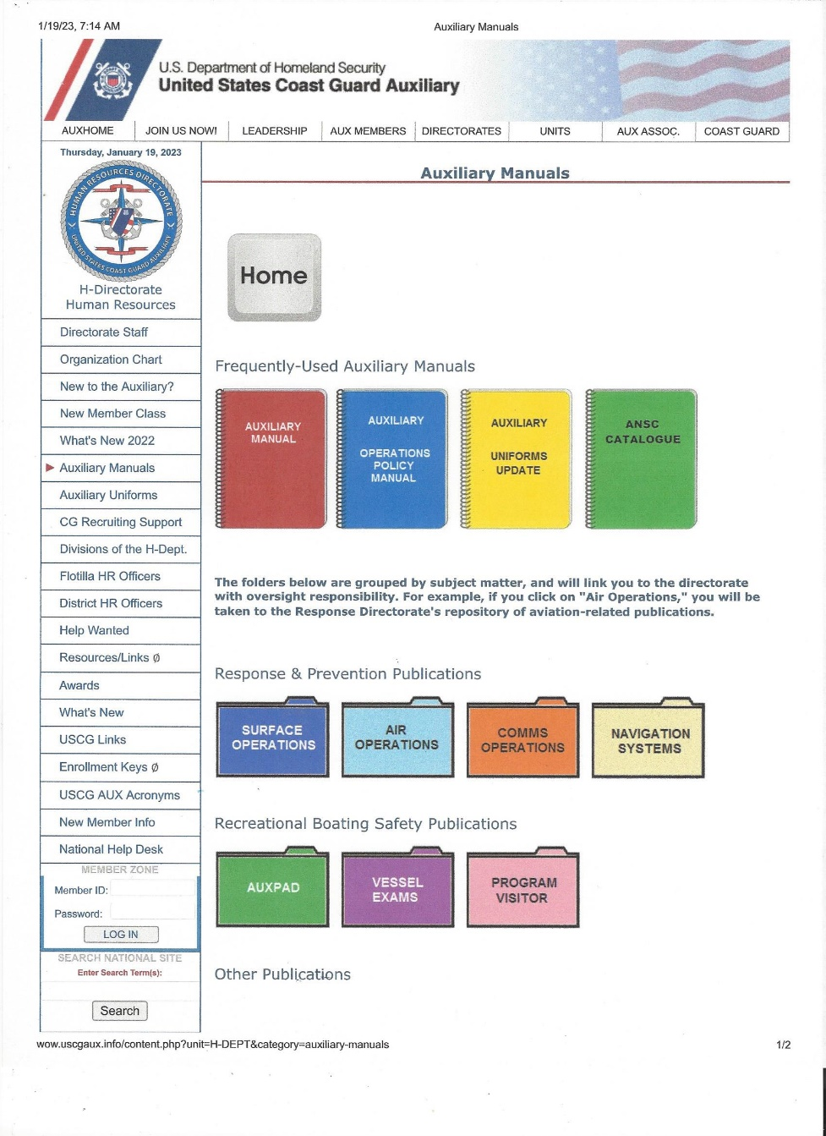
New Surface Ops Qualification & Training Handbooks
How to find them:
Go to AUXDATA
Go to “Aux Manuals – Quick Links (right side on Home Page)
Go to “Surface Operations”

Slide 44
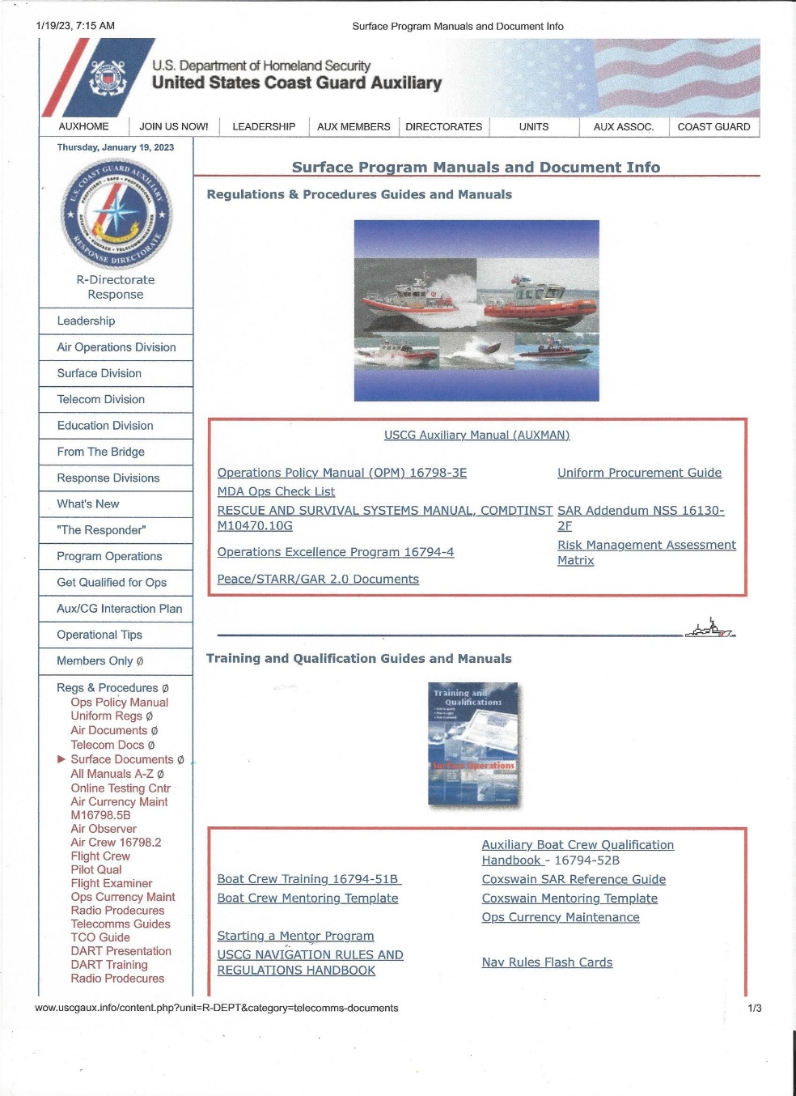
New Surface Ops Qualification & Training Handbooks
How to find them:
Boat Crew Training - 16794-51B
Auxiliary Boat Crew Qualification Handbook – 16794-52B

Slide 45
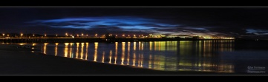
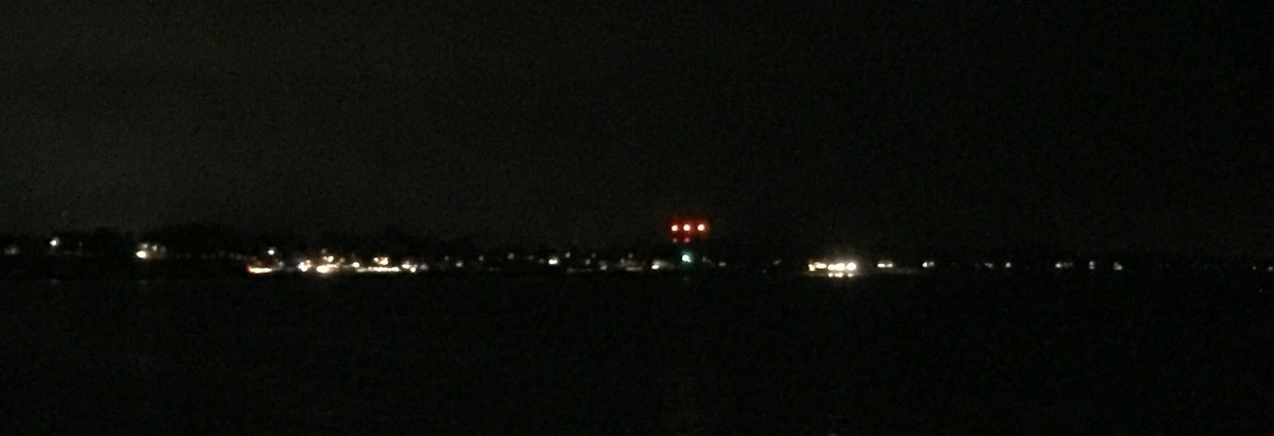
Night Operations … A Brief Primer

Slide 46
Night Operations
Alertness levels may drop off at night.
More frequent helm and lookout changes may be required to maintain an alert crew.
The most difficult period to maintain alertness and awareness is between 2100-0700 hours.
Ref: BOAT Manual Vol 1: Part 4 CH.2 Section C.7 Critical Mission Hours from 2300-0500.

Slide 47
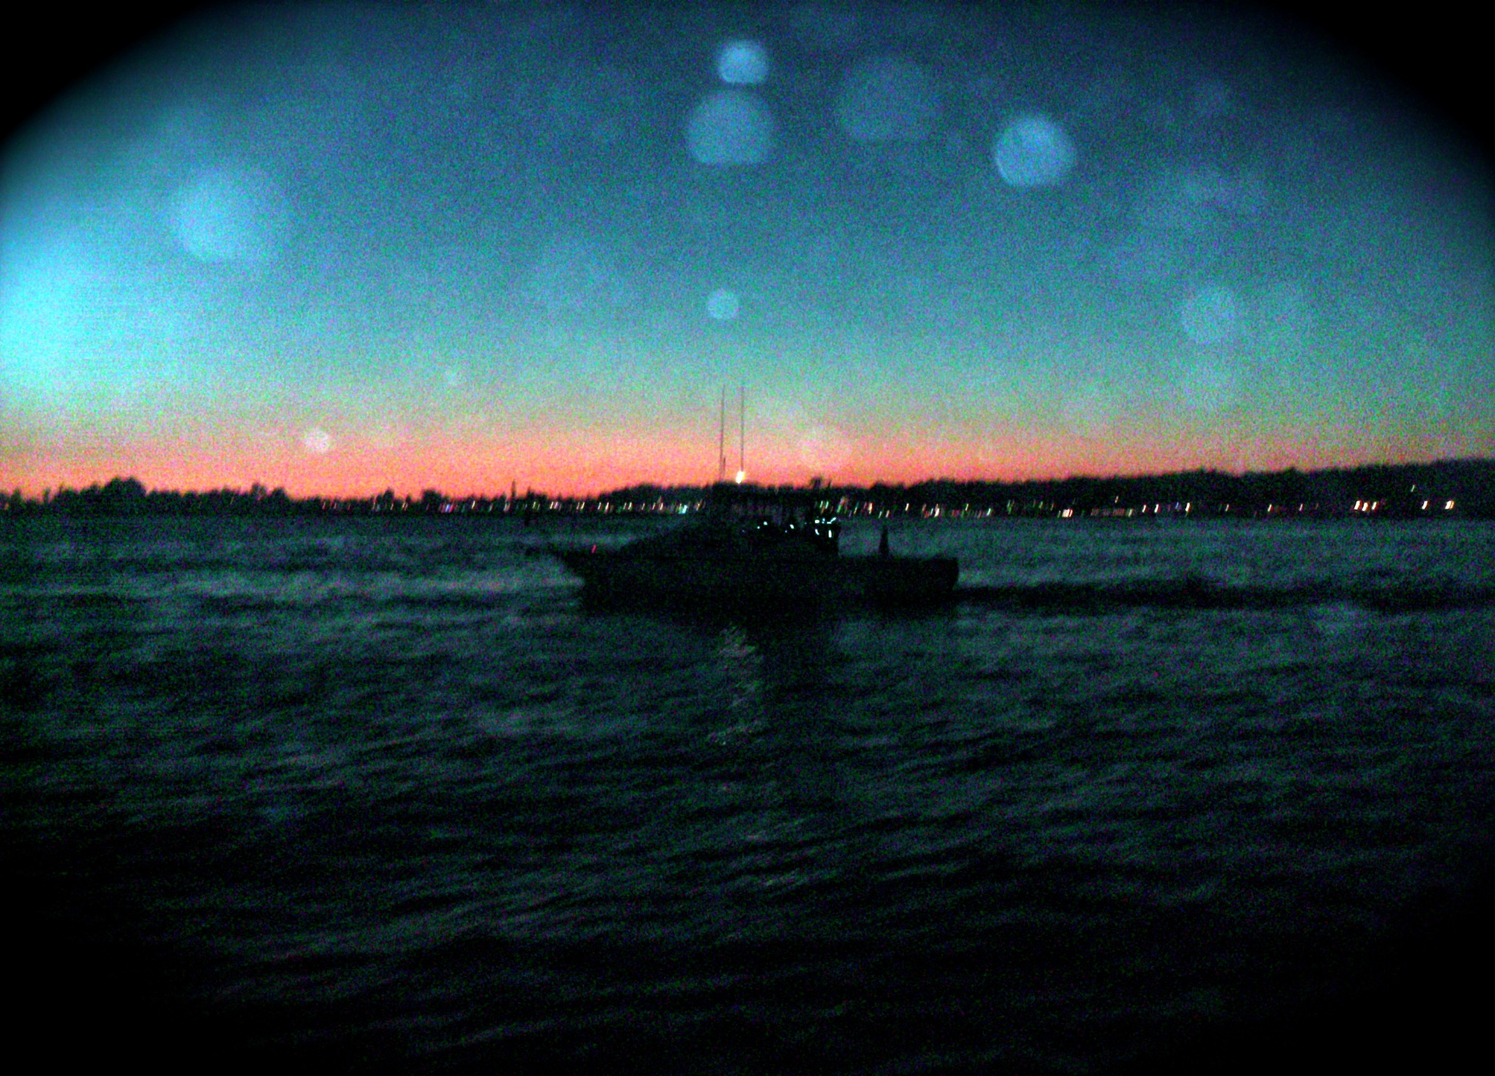
Night Operations
Notes:
Set up the vessel lights so they are not seen by the lookouts or helmsman
One crew should be assigned to the radar. If only 2 members are on board, the helmsman will handle the radar.
When searching at night, charts must be used at all times. Confirm your position with visual aids when ever possible.
Vessel used at night should have red lighting in the helm area.

Slide 48
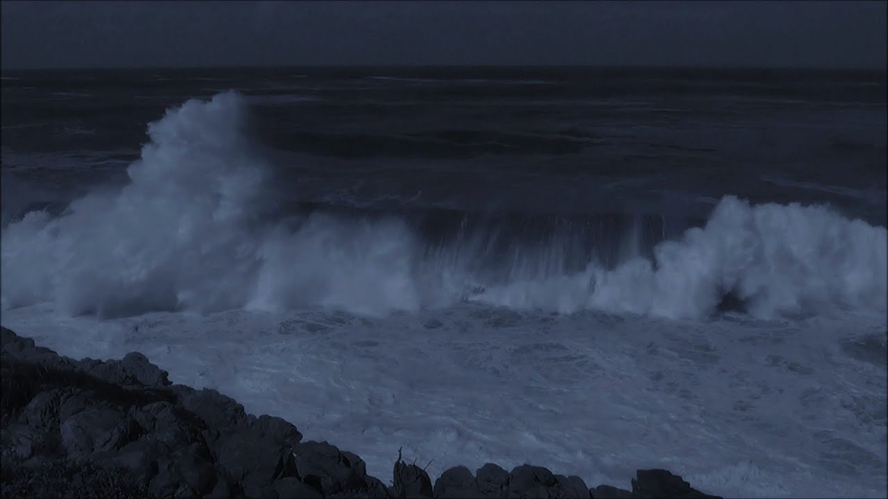
Night Operations
Use your hearing
  Sound carries very well over the water

Slide 49
Night Operations
Rule 5 - Every Vessel shall at all times maintain a proper look-out by sight and hearing as well as by all means available.
Maintain a proper watch and extra lookouts.
Consider attaching Chem-Lights to tow lines so you can actually see the line and stand a proper tow watch.

Slide 50
Night Operations
Speeds should be limited so as not to exceed “safe speed” (Rule 6).
6 factors to determine safe speed.
State of visibility
Traffic Density
Maneuverability of the vessel w/reference to stopping distance and turning ability
Background light, shore lights, or backscatter from own lights.
Wind, sea, & current, and close proximity to hazards
Draft in relation to available depth of water.

Slide 51
Night Operations
The Coxswain should assign one crew member to constantly monitor the Radar screen in addition to the helmsman.
This crew person must be competent with radar, keep a watchful eye on the screen and communicate conditions clearly with the coxswain and helmsman.

Slide 52
Night Operations
Vessels with Operational Radar:
Characteristics, efficiency, and limitations
Radar Range and scale.
Sea state, weather, and other sources of interference.
Small vessels, and other floating objects that may not be detected
Number, location, and movement of vessels detected.
A more exact assessment of the visibility.

Slide 53
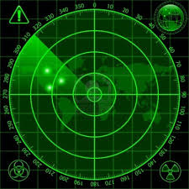

Slide 54
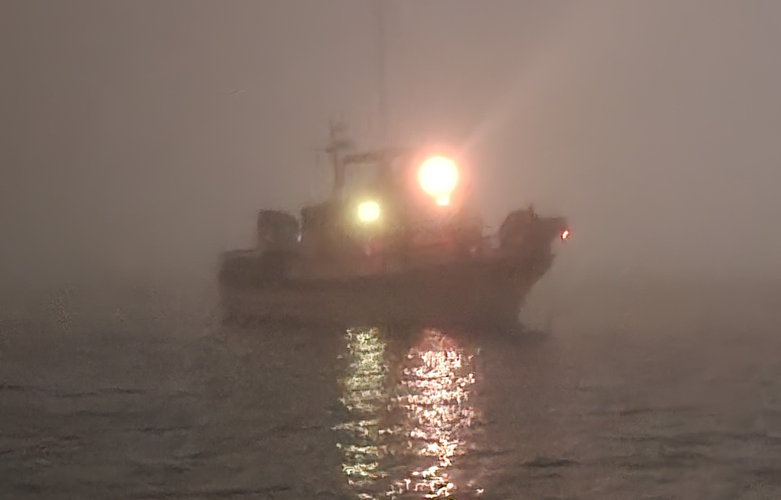
Night Operations

Slide 55
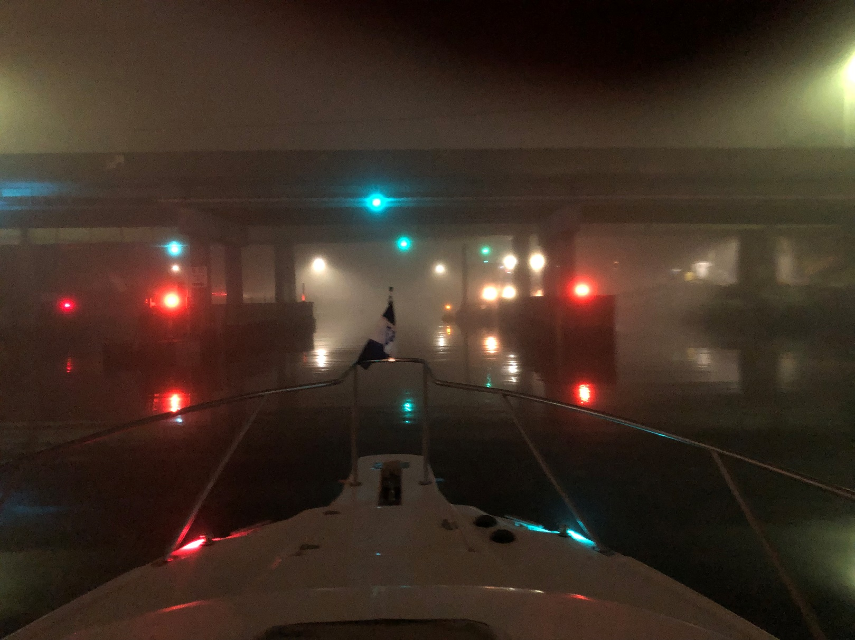
Night Operations

Slide 56
Questions / Comments?

Slide 57
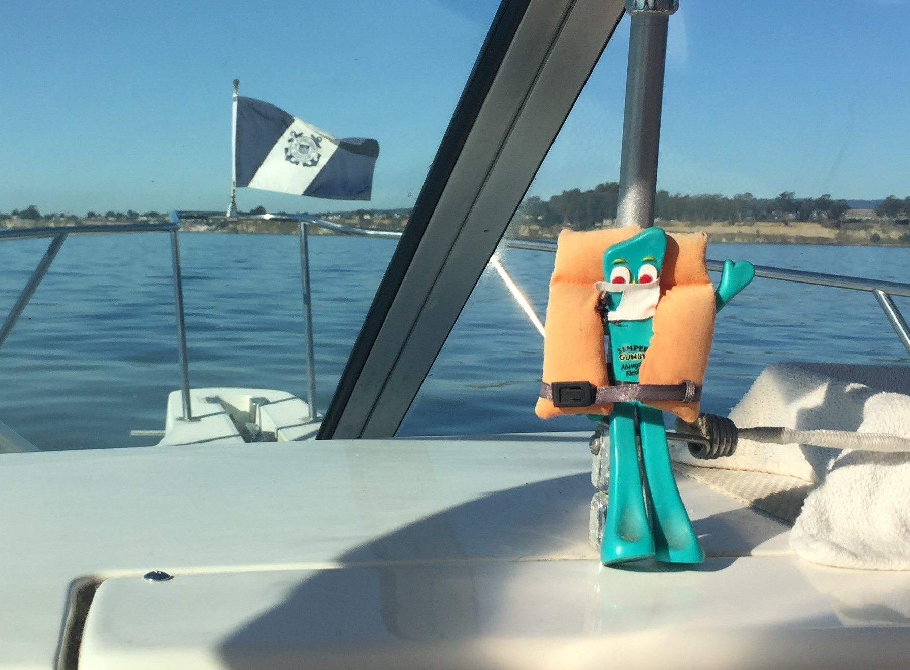
SEMPER GUMBY!

