Slide 1
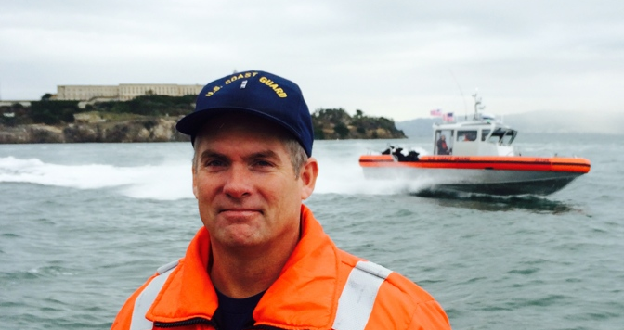

2017 D-11 N Operations Workshop

Slide 2
MANDATORY
Required for all Boat Crew
Reported on the 7039 Workshop form
Deadline: 01 June
  If not complete, member goes into REWK
If not complete by 31 December, REYR
Notes:
Boat crew includes all crew, coxswains and PWOs
The 01 June date comes from the OPM manual [Auxiliary Operations Policy Manual 2.B.7 ] specifically:
B.7. Operations Workshops
Operations workshops may be mandated on an annual basis by Commandant (G-OCX) or by the Director. When operations workshops are mandated, the requirements apply to all personnel participating in surface operations and programs requiring them to be aboard surface facilities. Auxiliarists must complete such workshops prior to June 1 of the year in question in order to participate in operational missions. workshop attendance credit remains valid through May 31 of the year following.

Slide 3
Personal Protective Equipment
(PPE)
DIRAUX/OTO issue regional guidance
PFDs can no longer be shared. (11N will issue “trainee” bag for facilities at request.
PPE inspection-Biannual Requirement
PLBs-Monthly Testing
Maintenance Procedure Cards (MPCs)
  Posted on Response website. Controlled items do not share.
Notes:
Remind members of testing PLB in the first 5 minutes of any hour monthly but NOT more frequently that once per month
Inspections must be done by Auxiliary members who have been trained to do so. If you need PPE inspectors speak to your SO/DSO-MT or your OTO in the Directors office.
If the PFD is issued to you, you are responsible for it and should not loan it out. The Ready Locker concept has been in place for a while so that in cases where trainees, or others need a PFD, or a PFD is damaged & a temporary replacement is needed, the Unit can provide it for temporary use from the ready Locker.
Detailed instructions for PPE inspectors are in the Maintenance Procedures Cards posted in the members only section of the Response Directorate web site. These cards are updated regularly so be sure inspectors are using the most current version.

Slide 4
PPE (Continued)
R&SS Officer
  FC recommended, designated staff officer to manage PPE issuance, training, maintenance
Inflatable PFDs
  ONLY PFDs listed in R&SS Manual are authorized
PLBs
  Monthly Test
  ONLY test on monthly basis. Doing otherwise will harm the PLB battery

Slide 5
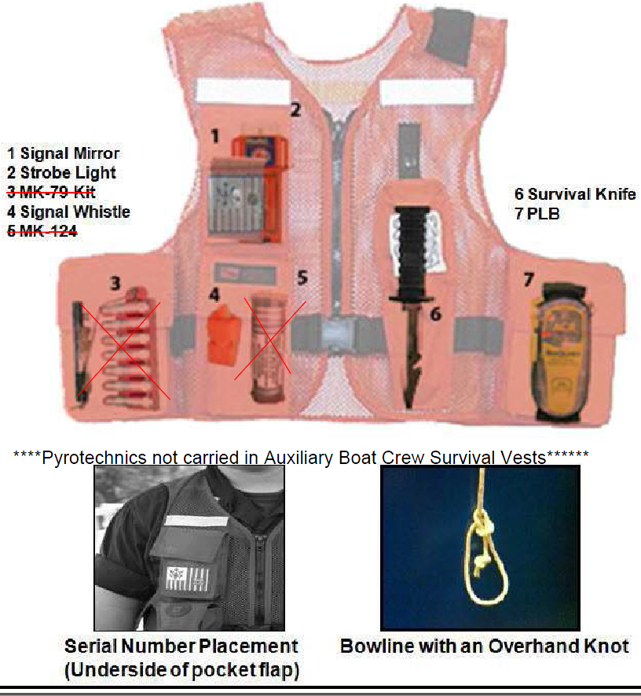
PPE – Survival Vest Carriage

Slide 6
PPE Reminders
PFDs required for all crew
  PPE must be stowed either in SAR vest, or in pockets of PFD
PPE must be secured with 36” lanyard with bowline and overhand knot
Compliance date: 01 June 2016
Notes:
Not all crew will have SAR vests & it is permitted to use the PFD as long as all PPE is properly attached.
If you have been issues a SAR vest you MUST wear it with PPE properly attached

Slide 7
PPE Reminders
Auxiliary PPE is for Auxiliary use only
DO NOT wear Coast Guard PPE
Use only inflatable PFDs that are listed in the R&SS Manual
  NO MANUAL INFLATION PFDs
Notes:
PFDs with Coast Guard Auxiliary name on the back must NOT be worn on private vessels/facilities when you are not in uniform and under orders
PFDs with Coast Guard on the back must NEVER be worn even if you are under orders.

Slide 8
NavRules
Latest revision: August 2014
Required for surface facilities
Hard copies are available commercially

Slide 9
NavRules (continued)
Download link on Response website:
DIRAUX/OTO/OIA may have specific navigation requirements for your region
Periodically updated, stay alert for changes

Slide 10
Training and Safety
Keys to Achieving Safety
Training
Procedures
TCT
Crew Qualifications
Don’t just be a member of the “12 Hour Club”
  Always strive to exceed minimum training hours
Notes:
Train to proficiency, not just to meet minimum qualifications
Know and follow ALL standard procedures
Remind crew about TCT during crew briefing
Know your crews qualifications, abilities, and restrictions BEFORE your leave the dock and make crew assignments accordingly
All crew must be current on their TCT (from last year or current year). Taking the 4 hour TCT in any year qualifies in place of the 1 Hour but the 1 hour does NOT qualify for the 4 hour requirement.

Slide 11
Mishap Reporting
ALL mishaps must be reported to the Order Issuing Authority (OIA)
  With or without injuries
  Even if there is no damage
Mishap does not equal punishment
  Accidents happen. Reporting them does not always result in punitive action
  Not reporting a mishap DOES lead to punitive action

Slide 12
Mishap Reporting
Auxiliary Operations Policy Manual requires “any individual or unit with 1st hand knowledge of a mishap” to report these incidents
Reports must be submitted to the OIA, DIRAUX within 48 hours.
Notes:
Mishap reporting is not just policy and a good idea, it is MANDATORY
The reference to reporting mishaps to the AUX COLM, as well as your OIA is consistent with well established requirements that we must report any occurrence or incident to our AUX leadership, whether it be a surface mishap, as in this case, or any information that our leadership should be aware of as a general good practice

Slide 13
Mishap Reporting
We ask that all crews report mishaps religiously and without fear of criticism through their Chain of Leadership up to District & their OIA
We also ask that all Districts report summaries (no names) of damage & injury mishaps to:
James McCarty – Division Chief Surface
james.mccarty@cgauxnet.us
Surface Operations Division
National Response Directorate

Slide 14
Navigation Standards
Every OIA has a set of Nav Standards for their AOR
Contain vital information on the AOR
To be provided to every Coxswain/Owner
Notes:
Each CG command from small boat station to Sector has navigation standards for their crews- local hazards, problems or issues that must be known to crews. AUX crews should also have that information from the OIA or OTO.

Slide 15
Coxswain Responsibilities
Obtain orders from OIA
Ensure currency:
  Of Facility Inspection
  Of Crew certifications
Responsible for ENTIRE crew
  From pre-mission brief to debrief
  Ensuring each member knows their role AND is capable of filling that role

Slide 16
Coxswain Responsibilities
Designate primary lookout(s)
Exercise DIRECT supervision when facility is being operated by crewmember
May NOT leave the helm station
Ensure kill switches are used (when applicable)
Ensure crew follows fatigue standards in Aux Ops Policy Manual
Notes:
Crew fatigue is critical to the GAR score and cause to shorten or cancel the patrol entirely. The Cox should endeavor to stay at or near the helm in order to be alert and in good position to respond to issues. Common sense applies when it is advisable for the Cox to change his/her position.

Slide 17
Crew Responsibilities
Safety is paramount
If you see something, say something
Use your TCT
Ensure you are well rested prior to getting underway

Slide 18
Important Reminders
Mobile Devices
  Use of Mobile Devices (phones, tablets, etc.) is PROHIBITED without permission from Coxswain
  Proper lookout must be maintained at all times
  If necessary, come to dead stop to use mobile device
Notes:
If a facility is manned by a Coxswain and one crew, the facility must come to a full stop before the use of a cell phone or mobile device.

Slide 19
Important Reminders
Forms – Use the most current forms
  SAR Incident Report – Current form dated 01 APR 10
  Offer For Use Forms
    7003 (Vessel Offer For Use) – Current form dated 06/11
    7008 (PWC Offer for Use) - Current form dated 06/11

Slide 20
Patrol Reminders
Maritime Domain Awareness on all patrols
Proper Signage
Uniforms
  Consistency
  Well Maintained
  Properly Fitted
  Represent the Coast Guard
Notes:
Re-enforce that everything you say and do as well as how you look represents and reflects upon the US Coast Guard and the US Coast Guard Auxiliary
Consistency of uniforms means that all crew are dressed in the uniform of the day, no exceptions. Sleeves are rolled up Apr 1 and down Nov 1, same as for the active duty (gold) side. Clearly, common sense may require a change depending on the weather, etc. The spirit here is to avoid free lancing and maintaining military bearing with respect to uniformity of dress.

Slide 21
“Happen Upon Policy”
Reminder
If you discover a vessel during routine patrol that requests assistance and that vessel has not been in contact with the Coast Guard or a salvage company:
  You may render assistance including tow if capable
  Notify the Operational Commander, identity and location of vessel and where you will be towing them
  If vessel is in danger and you are unable to safely tow, you may endeavor to safely remove persons from the vessel until additional help can arrive on scene

Slide 22
Review of “Happen Upon Policy”
Notes:
  Coxswain has ultimate decision on whether or not to assist vessel
    Based on consultation with crew and GAR assessment
  Inform CG SMC (SAR Mission Coordinator) of your intentions, not “ask for permission to tow”
  The CG SMC may override your decision if warranted by an evaluation of the circumstances or if your facility is needed on a higher priority task
Notes:
If the boater called for help you may also pickup a tow in some instances if a commercial tower is not available in a “Reasonable” amount of time.
From the CG Addendum 4.11
When specific alternate assistance is not requested or available, mariners will be informed that a broadcast can be made to determine if someone in the area can come to their assistance.
Coast Guard resources or Auxiliary vessels may also be directed to respond if no alternate responder can do so within a reasonable period of elapsed time. Factors governing the elapse of a reasonable period of time for assistance to arrive on scene are discussed below, but such a period should not normally exceed one hour from first awareness of the case.

Slide 23
Assistance to Auxiliary Facilities
Coast Guard resources or Auxiliary facilities may be used to help Auxiliary facilities in need of assistance at any time
An Auxiliary Facility is defined as an Operational Facility having a current accepted offer of use whether under orders or not
It is NOT just any boat owned by an Auxiliary member

Slide 24
Safety is Always Priority 1
Remember safety of the crew, the public, and the vessel are more important than the mission
PLB (Personal Locator Beacon)
  Have it on your person at all times when underway
  Check the battery expiration date
  Keep it registered (11 North will continue this for you)
  As of 1 June 2016, all crew and coxswain on board must have and wear a PLB
HAZMAT
  Remember to steer well clear of ANY HAZMAT situation unless you have a certified HAZMAT responder on your crew
Notes:
Please emphasize that safety is the top priority, and if the environment or other factors increase the risk…the GAR must be reviewed to determine what should be done to reduce the risk to an appropriate level. This includes aborting the mission if necessary.

Slide 25
Provide SAR Response
Do only what you & your facility/crew are capable of - Safety of Crew Always Comes First
Operate at safe speed for the sea conditions and local environment
Observe all NO WAKE zones

Slide 26
Responsibilities of Facility Owners
Facility properly equipped/maintained
Notify the DIRAUX of significant changes
Facility Inspection and Offer for Use valid for 1 year plus 45 days. Orders are no longer valid when offer for use expires
Authorized operators when owner not onboard must be designated by name and member # on offer for use and entered in AUXDATA

Slide 27
Offer for Use Forms
Electronic notices are sent to the facility owner(s), FC and SO-OP 45 days prior to the end of the one year date of inspection
Owner have 90 days to get their facility inspected and turned into their DIRAUX office
If not done prior to the 1 year 45 day expiration, AUXDATA automatically removes the facility from operation status
Any patrols approved after that date are not authorized and must not be conducted
Notes:
The last bullet means that even if the orders make it through the system, if the OPFAC inspection is out of date, the patrol cannot proceed.

Slide 28
I’M SAFE
Are you fit for your mission?
I = Illness, Do I have an illness or symptoms of illness
M = Medication, Am I taking prescription or over-counter drugs
S = Stress - Am I under psychological pressure from the job? Worried about financial matters, health problems or family discord?
A = Alcohol, Have I been drinking within eight hours? Within 24 hours?
F = Fatigue, Am I tired and not adequately rested?
E = Eating, Am I adequately nourished?
Notes:
This is essentially part of the GAR form process, and also consistent with TCT principles.

Slide 29
Operating in Reduced Visibility
Follow all requirements in the NavRules
Maintain that lookout as far forward on the vessel as possible (remember - safety first)
Reduce speed
Proper Horn Signals
Nav lights on
Radar on and monitored, if equipped
Follow all district or OIA special requirements
Notes:
If there is any chance of fog or other visibility problems before the patrol, the GAR should reflect that condition and in most cases, the patrol postponed or canceled.
If you have radar, be sure to brief ALL crew on how to us it.
All of these actions are specified in the Rules of the Road, that is, they are the Law, not just good seamanship practices

Slide 30
NIGHT OPS
Radar not required but recommended if installed
Crew properly trained on radar use?
Increased lookout responsibilities
Reduce speed
Ops/Position reporting requirements (different from daylight ops)
Night Vision (check local OIA for any specific requirements)
Notes:
Check the Response web site, “Safety Best Practices” button to access the “Night Operations Guide” for more detail.
Common sense dictates that conditions at night or reduced visibility are problematic. Although the Night Ops guide does not mention this issue, it any prudent mariner will agree that enhanced communication during night ops is a good practice.

Slide 31
Operational Parameters -
Communications
External:
  VHF Radio (25 Watt ) is ALWAYS primary, cell phone secondary (Cell Phone MUST NOT be used by the helmsman)
  Must have 2 way communications at all times, if not return to base
  Maintain a radio guard. Use intervals as required by your OIA
  If communications are lost, your orders may be voided
Notes:
The 25 watt reference is a standard regulation designed to ensure that no transmitter exceeds this limit. Please check with your FSO-CM for more detail.

Slide 32
Radio Communications
In all radio communications, we are to act as professionals
At no time shall we make reference to ethnicity, race, gender, sexual orientation or religious affiliations in radio transmissions
This is a zero tolerance policy and must be strictly adhered to

Slide 33
Radio Communications
It is often not what you say but how you say it, that demonstrates your professionalism
Brevity and accuracy supports mission success and safety
Remember that during a patrol, the boating public “hears” you as the voice of the US Coast Guard
Practice and use proper radio procedures to achieve success, safety and professionalism
Notes:
Re-enforce that the we are seen and heard as representing the United States Coast Guard when we are out on patrol. Your radio transmissions can be heard by all within a range of 25 miles.

Slide 34
Radio Communications
Proper Comms
Example: “Coast Guard Station Nassau Point, Coast Guard Station Nassau Point, this is Auxiliary Vessel 2159637 on 21A, Over.”
“Auxiliary Vessel 9637, this is Station Nassau Point, Over.”
“Station, 9637: (State you message to the station with clarity, using proper radio protocol and brevity) Over.”
“9637, Station, Roger, Out.”
Note: Practice Script (Radio procedures may be reviewed at this link: http://rdept.cgaux.org/documents/Comms/AuxRadioPatrol1.3.pdf
Notes:
Please be sure that all understand the restrictions on using cell technology on OPFACS…especially the policy that prohibits using cell phones alone to maintain radio guard.

Slide 35
Towing
Requires a high degree of awareness
Many potential hazards
Know limitations of facility, crew and towing components
How the vessels are loaded will affect maneuverability
Brief your crew and the disabled vessels owner
Always plan an escape route in case things go wrong – because they will and at the worst possible time
Notes:
Most facilities do not have many opportunities to tow a distressed vessel other than in training an crew/coxswain currency signoffs. Briefing the crew on what will happen and in what sequence is a critical task for the Coxswain BEFORE attempting to connect the tow.

Slide 36
Towing (continued)
Ensure a knife is always immediately available in case the towline needs to be cut in an emergency
Ensure Aux crew has removed all jewelry prior to beginning the towing evolution (this should already have been done at/before the briefing)
Ensure you ascertain whether there are any known hazards on the vessel to be towed prior to beginning the towing evolution (e.g. flooding, lines in the water, steering inoperable) and take steps to mitigate the risks imposed by them
Notes:
Sailboats often present special problems for towing make sure you know how to do it safely

Slide 37
AOM Reminders
All patrols should start and end with some standby time for pre and post u/w activities (Gar, briefing, de-briefing, etc.)
Pre and post standby time is coded based on instructions issued by OIA/OTO
Patrol orders are good for a 24 hour period from the first itinerary entry (but orders expire at midnight)
Request multiple orders for multiple days – do not combine
Time in the itinerary must be consecutive with no gaps. One category ends at 1200, the next begins at 1200, Not 1201 or later
Notes:
The operational issues related to the reporting of pre and post u/w activities are well reported and noted. We recognize that a long term solution is required and that solution is in the pipeline.
Until a separate code can be created in the AOM software to account for stand-by time, the local OIA will designate a temporary work around code for this purpose.
Orders may overlap calendar days, when the 24 hour period is calculated past midnight. One set for one mission.

Slide 38
AOM (continued)
Training missions (22A) do not require a QE to be on-board
If on a QE check ride mission, use 22A and list the QE as required by your district and note in comments box the QE’s name and actual time doing QE activity
If a mid-patrol crew change, list all crew members and note times for each in the comments box. The coxswain and/or facility cannot be changed
The IS officer will adjust the entries in AUXDATA

Slide 39
AOM (continued)
When requesting orders, always check the last Facility Inspection Date
If the patrol date will be 1 year & 45 days from the last inspection, a new offer for use must be submitted before the patrol. AOM will not allow order completion with an out of date inspection
If the date you try to complete orders is over 13-1/2 months from the last inspection, AOM will not allow completion of the orders, even if the patrol date was within the 13-1/2 month range

Slide 40
AOM (continued)
Meals are no longer automatically selected - must be selected manually for each member
Select only the meals that were actually consumed during the underway portion of the patrol, not before and after
Meals are not paid for standby time
FINCEN does not pay for water, soda, snacks, etc.
If you receive fuel or meals at no cost from the Coast Guard, check “Government Provided” box

Slide 41
AOM (continued)
Do not claim make-up engine oil; it is included in your SAMA payment
Fuel additives are 2-cycle oil and octane enhancer
Include receipts and include any and all claimed expenses
Submit claims ASAP…within a week unless unable to do so with good reason.

Slide 42
Subsistence
Payment Reminders
Subsistence (meal) payments go to the Owner or Operator as selected on the order request
The member receiving the subsistence payment is obligated to either
  Turn the payment over to each crew member or
  Provide a meal(s) to each crew member commensurate with at least the subsistence amount paid
Subsistence payments are not to be kept by the owner or operator or put in a boat maintenance fund. This is what SAMA is for

Slide 43
Additional Reminders
Any other special requirements from your local DIRAUX?
How about your OIA?

Slide 44
Bravo Zulu!
Great Job!
Thank you for your participation in the 2017 Surface Operations Workshop. All good content came from BOSN Doug Leavell and your D-11 Northern Operations Staff.
For any complaints, Please
Send your comments to:
Chief, Operations Projects and Educational Outreach Division Bruce.Pugh@cgauxnet.us
Davida Kellogg BC-REI
Bruce Pugh, DVC-RE
James McCarty, DVC-RS
John J Slattery, DIR-R
Don Zinner, DIR-Rd

