Slide 1

CGAUX
Member Training
UNIFORMS

Slide 2
From the Dictionary
Uniform [yoo-nuh-fawrm]
Identical or consistent, as from example to example, place to place, or moment to moment
Without variations in detail
Constant, unvarying, undeviating
An identifying outfit or style of dress worn by members of a given profession, organization, or rank

Slide 3
From the Manual
Pride
“In keeping with the true spirit of an organization of volunteers, the possession and wear of the Auxiliary uniform by Auxiliarists should be a matter of personal pride.”
Representative
“When in uniform, the Auxiliarist is a representative of DHS, the Coast Guard, Auxiliary, and the U.S. Government.”
Appearance
“Appearance, uniform fit, and grooming shall reflect the pride of that representation.”

Slide 4
From the Manual
Example
“Elected and appointed leaders are expected to wear the uniform properly to set an example.”
Help
“They should help other Auxiliarists develop proper habits of personal appearance, hygiene, and grooming when wearing the uniform.”

Slide 5
Auxiliary Uniforms
Two Basic Uniforms!!!
Tropical Blue Uniform (“Trops”)
Operational Dress Uniform (“ODUs”)

Slide 6
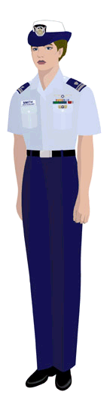
Tropical Blue
Combination or Garrison Cap
Ribbons, Devices, Name Tag (no medals)
AF Light Blue Short Sleeve Dress Shirt
  Open Collar (no tie)
  All but top button buttoned
  White V-Neck T-Shirt
Shoulder Boards – Enhanced
  No collar devices
CG Blue Dress Trousers
Black Web Belt w/Silver Buckle
Plain Black Dress Shoes w/Black Socks
Approved for year-round use

Slide 7
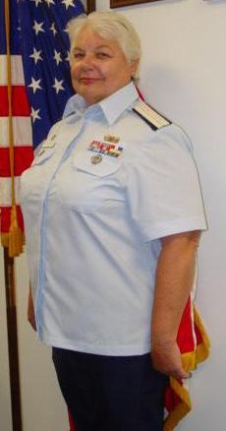
Tropical Blue
For women who will be more comfortable in a size larger than those offered at the UDC.
The shirt does not need to be tucked into the pants when worn.
It can be ordered from the Auxiliary Association (see National web site)
Tunic Over-Blouse

Slide 8
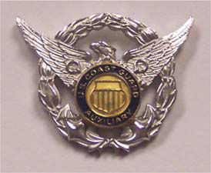
Cover – Tropical Blue
Garrison Cap: Unisex
  Should be worn parallel to ground.
  Squared up on head. No tilt of any kind.
  Crease front lined up with nose vertically.
  Garrison Cap Device worn, 2”back,1 ½” up left side.
  Metal office insignia or member device same spacing right side of face looking forward.

Slide 9
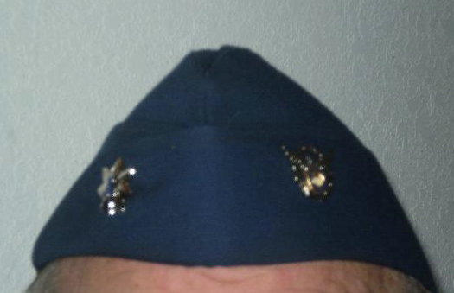
Garrison Cap
Garrison Cap

Slide 10
Trousers / Skirt / Belt – Tropical Blue
Trousers (Male/Female)
    Coast Guard Blue Service Trousers (Service Dress Blue).
    Worn with Black web belt.
Skirt (Female)
    Coast Guard Blue Service Skirt (Service Dress Blue).
    Worn with Black web belt.
    Worn with stockings.
Belt (Male/Female)
    Black web belt with silver tip.
    Worn with Silver belt buckle.
    The right side of the buckle (as viewed by wearer) shall be aligned with the right side of the shirt opening and the right side of the zipper to form a straight line as shown. Known in the military as a “GIG” line.

Slide 11
Shoes & Socks – Tropical Blue
Black Dress Shoes (UDC-issue).
Black Dress Pumps (UDC-issue).
  Females only.
Socks: Black plain undecorated.
Stockings: Flesh tone, plain material, seamless, undecorated.

Slide 12
Necessary Accessories
Tropical Blue
All new members must obtain the following accessories to complete the basic version of the Tropical Blue uniform:
  Garrison Cap Device.
  One pair of Enhanced shoulder boards.
  One U. S. Coast Guard Auxiliary plastic name tag (Last Name only or First & Last Name)

Slide 13
Additional Items
- Tropical Blue
Note: These items are not necessary for a complete uniform
Accessories
  Wooly Pulley Sweater. Worn indoors or between work stations in immediate area. Not outer wear for extended travel.
  Cardigan Sweater. … Same as above
    Must remain buttoned.
Cover
  Combination Cap: Male/Female
    Should be worn parallel to ground.
    Squared up on head. No tilt of any kind.

Slide 14
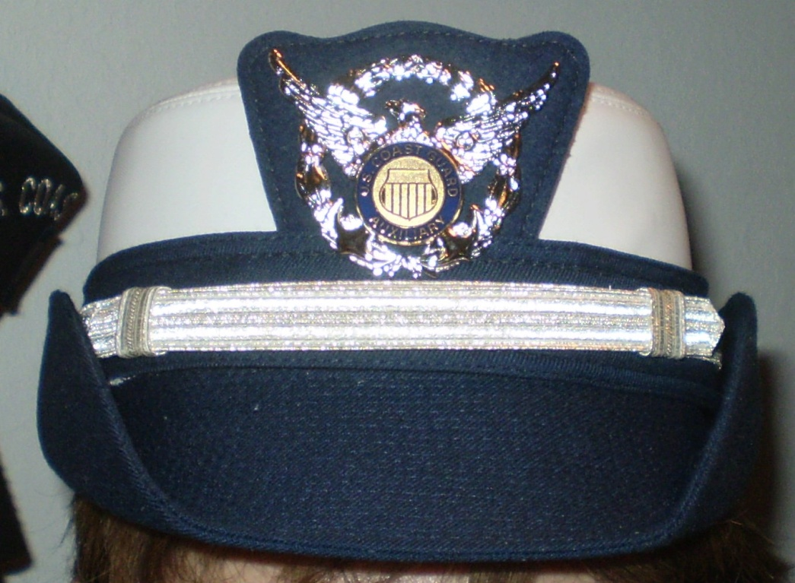
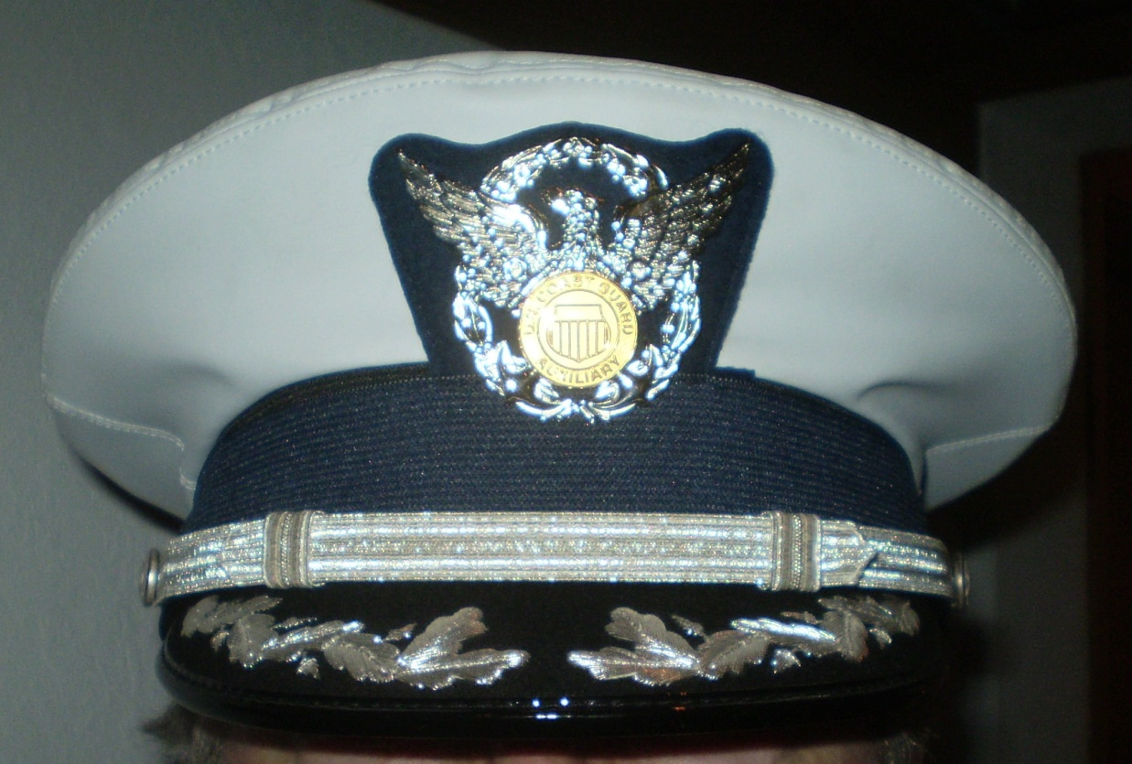
Combination Caps
Combination Cap - Women
Combination Cap - Men

Slide 15
Additional Items
- Tropical Blue (Cont.)
Note: These items are not necessary for a complete uniform
Outerwear
  Windbreaker, with or without liner:
    Insignia: Large Metal, Placed ¾” inboard from epaulet seam.
    Zipped at least 2/3 up when worn
    Zipper pull tucked in
  Trench Coat:
    Insignia: Large Metal, Placed ¾” inboard from epaulet seam.
  All-Weather Parka, Type I (old) or II (new):
    Insignia: only one insignia can be worn on Storm (zipper) Flap on Jacket.
  All Weather Trousers: can be worn in extreme weather conditions.

Slide 16
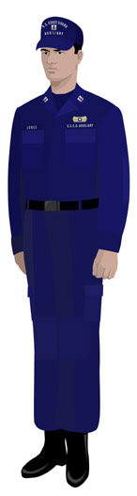
Operational Dress Uniform
Trousers – ODU trousers bloused or tucked in with boots; straight with deck shoes
Belt – Black web belt
Shirt – ODU top with sleeves rolled up accordion style with only the cuff showing - or down
Undershirt – CG Blue T-Shirt, Crew Neck Collar
Socks – Black, undecorated
Shoes – Boot, high top lace up or optional boat shoe
Insignia – Sew-on collar devices
Cloth tape with “USCG AUXILIARY” sewn above left pocket / last name above right pocket.
Breast Insignia / Device sewn above nametape
Hat – Baseball cap with metal collar device

Slide 17
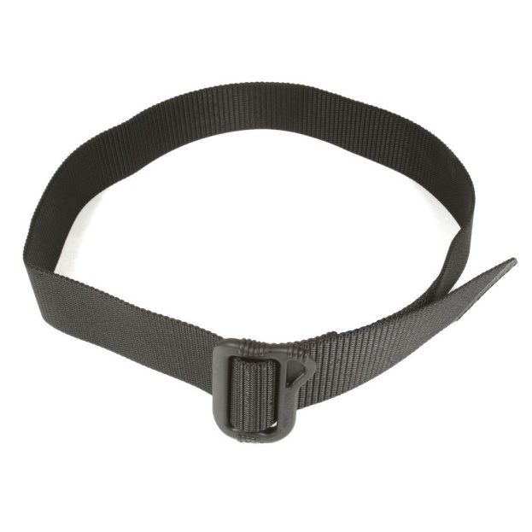
Operational Dress Uniform
Recommend the “Spec-Ops BDU” Belt, 1.75”
Available for under $20 – eBay

Slide 18
Necessary Accessories - ODU
All new members must obtain the following accessories to complete the basic version of the Operational Dress Uniform:
  U. S. Coast Guard Auxiliary Ball Cap.
  One pair of sew-on Office or Member collar insignia.
  One pair Metal Office or Member insignia (one used on cap).

Slide 19
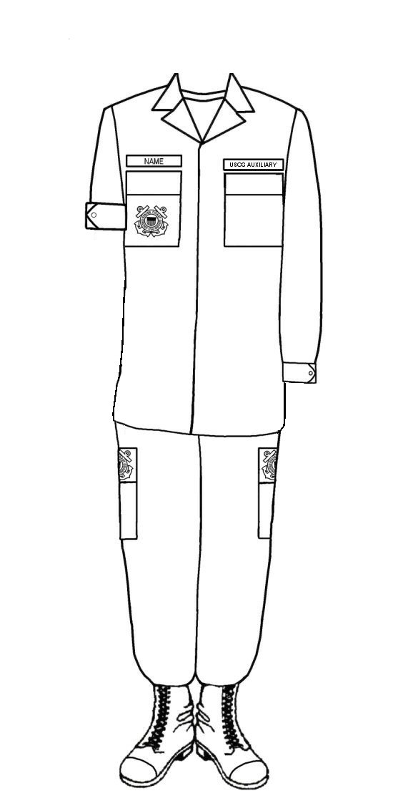
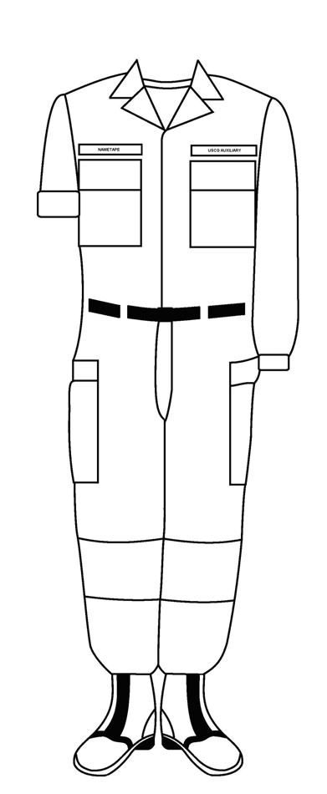
Operational Dress Uniform
‘Tucked’ ODU’s may be worn until “No longer serviceable”
New ‘Untucked’ ODU’s may be ordered from UDC and are available at the CGI Exchange.
Do not mix Tucked & Untucked uniforms!

Slide 20
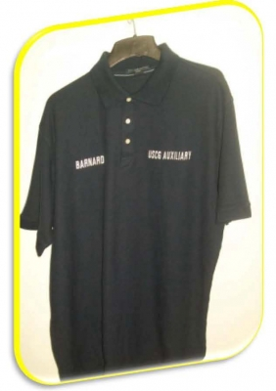
Operations Polo Shirt
For patrol activities, may be worn as an alternative to:
Working Blue shirt
ODU shirt
Hot Weather Uniform shirt
No logos, patches, insignia, name tapes, nor name tags

Slide 21
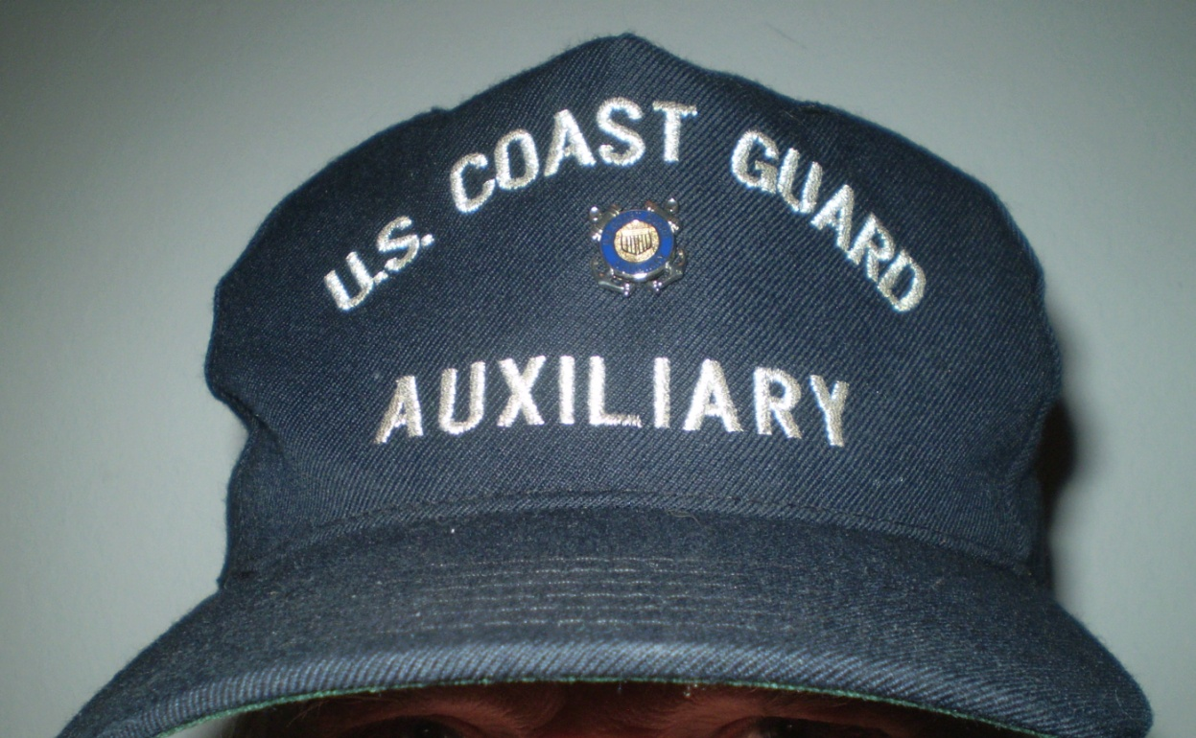
Ball Cap
Full front panel embroidered as shown
May have inscribed, in the same lettering, the number of their Flotilla, Division, and/or District/Region
“Scrambled Eggs” are no longer be authorized
Must wear either the metal office insignia or the metal member collar insignia
  Embroidered/sew-on versions no longer authorized
Mesh backs are no longer be authorized

Slide 22
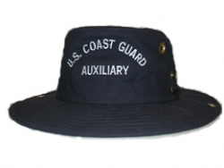
Auxiliary Sun Hat
“Tilley Hat”
May be worn in lieu of a Ball Cap
No insignia may be worn
AUXCEN carries the only hat authorized

Slide 23
Shoes
  8”-10” plain black safety boot (i.e. Super Boot II) if on board a CG vessel.
  Safety boots must have a safety toe that conforms with ANSI standards Z41-1999.
  Boots must be worn if on a Coast Guard base

Slide 24
Boat Shoes
  Boat shoes (brown or dark blue) are authorized ONLY:
  When worn on Auxiliary facilities (boats)
  When doing Vessel Safety Checks
  When transiting to or from the above
  When authorized by a local O.I.A.
  Note: All white or all black, low top, athletic shoes are authorized for the Hot Weather Uniform only.
  (See Aux Manual for full description of Hot Weather Uniform)

Slide 25
Uniform Requirements
CELL PHONE POLICY
From the Manual:
“Use of cell phones and any other hand held devices (e.g., talking, texting, reading) is not authorized while walking in uniform. If unavoidable, for safety and to ensure military protocol is observed, Auxiliarists should stop and step aside to conduct business before proceeding”

Slide 26
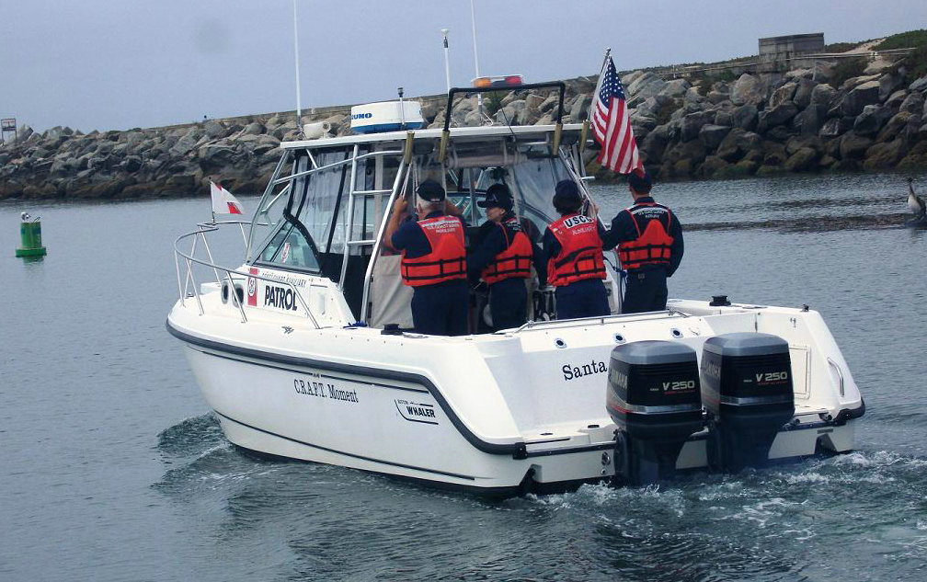
Uniform Requirements
PATROLS OR OTHER OPERATIONAL MISSIONS
Operational Dress Uniform (ODU)

Slide 27
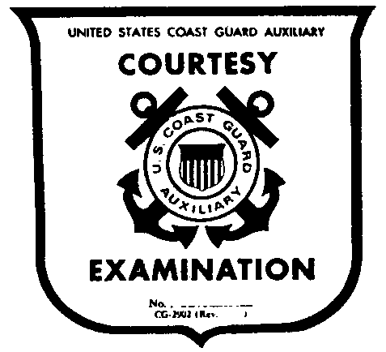
Uniform Requirements
COURTESY MARINE EXAMS
Operational Dress Uniform (ODU)
VE shirt with jeans (or shorts), boat shoes, Auxiliary ball cap
MARINE DEALER VISITS
First visit – in uniform (Trops or ODUs)
Subsequent visits – uniform or proper civilian attire

Slide 28

Uniform Requirements
PUBLIC EDUCATION CLASSES
Tropical Blue Uniform
ODU (Manual states ‘Trops’)
All instructors should be
  in same uniform.

Slide 29
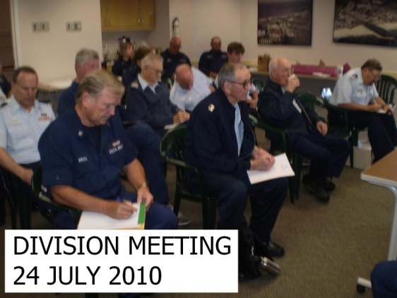
Uniform Requirements
Flotilla & Division Meetings
Tropical Blue Uniform
Operational Dress Uniform

Slide 30
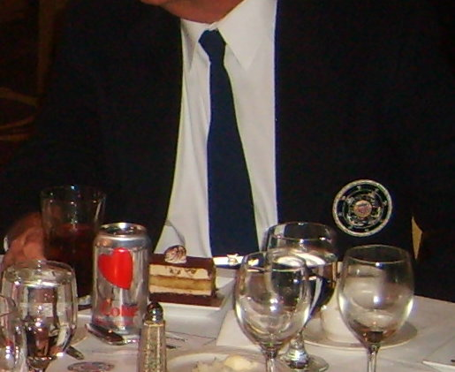
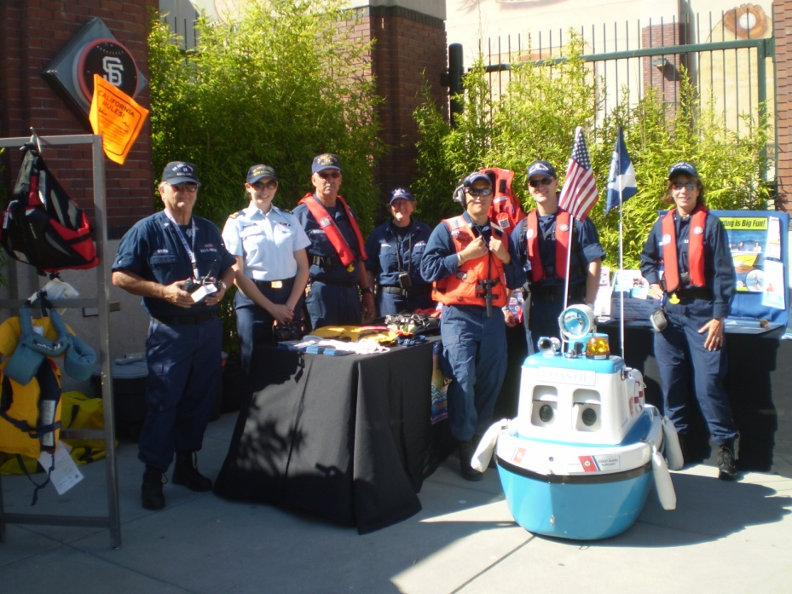
Uniform Requirements
BOATING SAFETY BOOTH & OTHER PA FUNCTIONS
Tropical Blue Uniform
Operational Dress Uniform
Authorized Blue Blazer
w/Appropriate Civilian Attire

Slide 31
Uniform Requirements
OTHER AUTHORIZED ACTIVITIES:
Traveling on Coast Guard or other military facility
  As prescribed by the District Commander or DIRAUX
Performing various other US Coast Guard activities
  As prescribed by the unit CO or OIC
Performing various other CG Auxiliary activities
  As prescribed by the DIRAUX or Auxiliary Officer

Slide 32
When to Wear Which?
The “Uniform of the Day”, or appropriate uniform, will be prescribed by the event or activity organizer.
All personnel participating should be wearing the specified uniform.

Slide 33


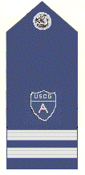
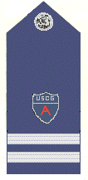




CGAUX Devices
Shoulder Boards
Auxiliary Coxswain
Breast Device
Cap Device
Ribbons
AUXOP Device
Auxiliary Pilot
Breast Device
Collar & Coat Devices

Slide 34
Military Award Recipients
Auxiliarists may wear prescribed prior or current military insignia earned while serving with a U.S. military service on the Auxiliary uniform
All prior military awards, badges and devices will be worn on the left side of the uniform

Slide 35













Devices & Shoulder Boards
Flotilla
Division
District
Member
VFC
SO
ADSO
DCAPT
FSO
FC
VCDR
DSO
DCOS
National
DCDR
NACO
DCO

Slide 36
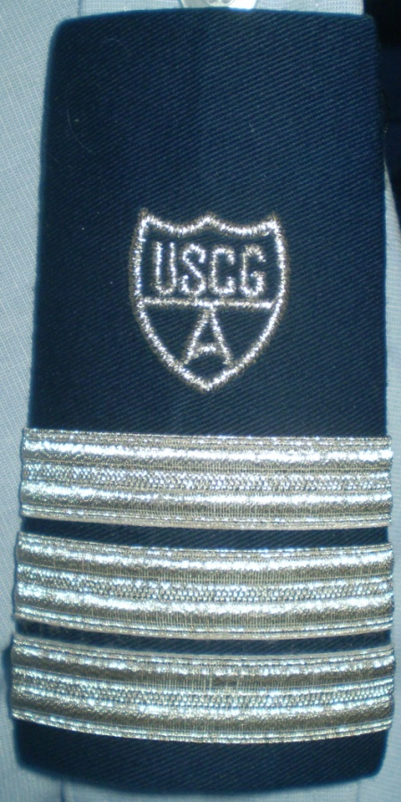
Shoulder Boards
Enhanced shoulder boards shall be worn on all shirts having epaulets when worn as a Dress Uniform
Also worn on the wooly-pully sweater and/or cardigan sweater
“Soft” shoulder boards are no longer authorized

Slide 37
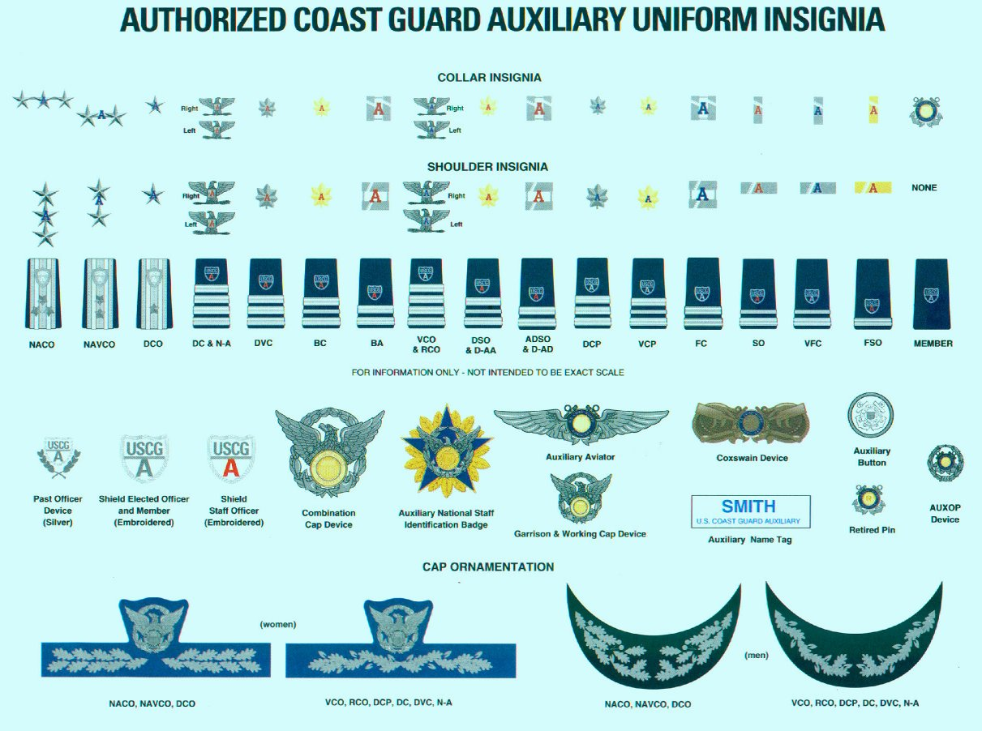
AUXILIARY INSIGNIA

Slide 38
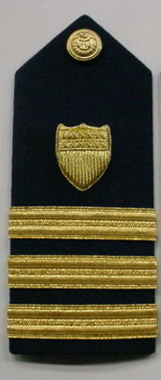
“Gold Side” / “Silver Side”
The regular Coast Guard is known as the “Gold Side”
The Auxiliary is know as the “Silver Side”

Slide 39
Coast Guard Markings
With the exception of authorized Coast Guard unit
ball caps, Auxiliarists should avoid wearing
uniform items that carry Coast Guard markings,
particularly Personal Protective Equipment (PPE),
work clothes, and organizational clothing.

Slide 40
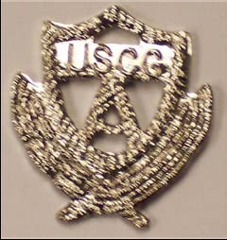
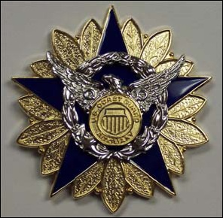

RIGHT SIDE OF AUX UNIFORM
AUXOP Device
Past Officer
Device
National Staff Badge

Slide 41
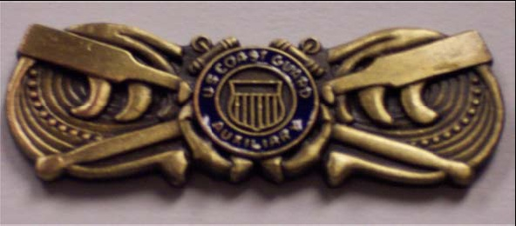
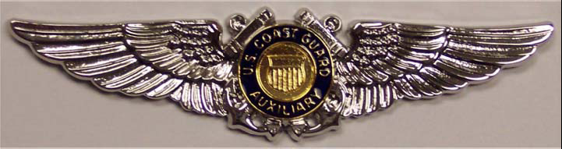
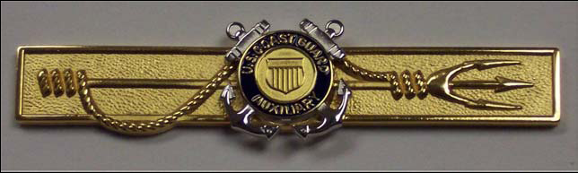
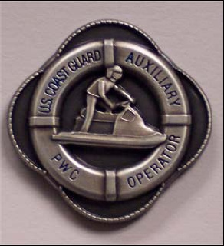
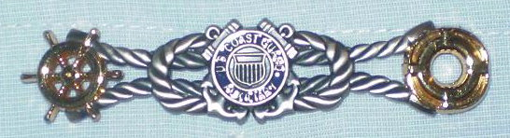
LEFT SIDE OF THE UNIFORM
OVER/UNDER RIBBONS
Coxswain device
Auxiliary Aviator
Marine Safety Insignia
PWC Insignia
RBS Device

Slide 42
Disposing of Uniforms
Uniforms must never be given away or donated to charities.
When no longer needed or no longer serviceable, Uniforms must be DESTROYED so as not to be worn by any unauthorized individuals.

Slide 43
Procurement or “Where do we get it?”
District Store
Only available at PCAs and D-TRAIN
Stocks popular uniform items
D11N Logo items
Lighthouse Uniform
http://catalog.lighthouseuniform.com/coastguard
  Dress Uniforms
  Tropical Blue Uniforms
  Insignias

Slide 44
Procurement or “Where do we get it?”
National Aux Store
http://www.shopauxiliary.com/membershipsignin.php op/uniforms.html
  Logo Items
  Gift Items
  Caps
    Ball Caps
    Garrison Caps
    Combination Caps
  Insignias, Devices, Ribbons
  Name Tags
  Operational Items
  Auxiliary-specific Uniform Items
  Stationery

Slide 45
Procurement or “Where do we get it?”
USCG Uniform Distribution Center
http://www.uscg.mil/hq/cg1/udc/
Need to establish Log-In
Full selection of Coast Guard uniform items
Best pricing
Check here first!
Cloth name tapes available here
VERY LIMITED Aux items!!!

Slide 46
Procurement or “Where do we get it?”
    UNIFORM PROCUREMENT GUIDE
    Link:
    http://www.auxpdept.org/pdf/Uniform%20Procurement%20Guide%204-8-08.pdf
    Best to “GOOGLE” …..
    Coast Guard Auxiliary Uniform Procurement Guide

Slide 47
Additional Uniforms
There are numerous other uniforms available!
The two outlined in this presentation are the most common and are suggested basics for new members.
Check the AUXILIARY MANUAL
CHAPTER 10
For complete uniform information.

Slide 48
Grooming: Hair
Male:
  Trimmed
  Neat
  No square back
  Must not touch shirt collar.

Slide 49
Grooming: Hair
Female:
  Neatly coiffed. 2” at highest point on head.
  Must not touch shirt collar.
  Bangs must not touch eyebrows.
  Ponytail if worn, must be one strand and must not touch collar.
  Must not obstruct proper seating of Cover on head.
  Tuck in if possible or change styling.
  Wear of small unadorned scrunchies is OK.

Slide 50
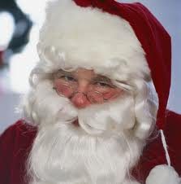

Grooming: Facial Hair
Male:
  Beard: Trimmed neatly. No longer than 1 inch. If longer, must be tucked under chin as to be not so noticeable.
    Beards and mustaches must not interfere with the operation of safety/survival gear. These may prohibit participation in certain operational missions as deemed necessary by DIRAUX.

Slide 51
Self-Presentation
Hair Coloring
  Only natural, basic colors are permitted.
Jewelry
  Watches, rings (basic, avoid the ostentatious).
  No necklaces or chains.
  One pair ¼” round stud earrings (Females only).
Religious Headwear
  Religious headwear is not to interfere with proper Auxiliary Cover. Must not be visible. Must conform with hair color.
Religious Artifacts
  Must not be visible.

Slide 52
Self-Presentation
From the Manual
“It is impossible to provide examples of every appropriate or unacceptable hairstyle or “conservative” or “eccentric” grooming,
therefore, the good judgment of leaders at all levels is key to upholding the Auxiliary grooming policy.”

Slide 53
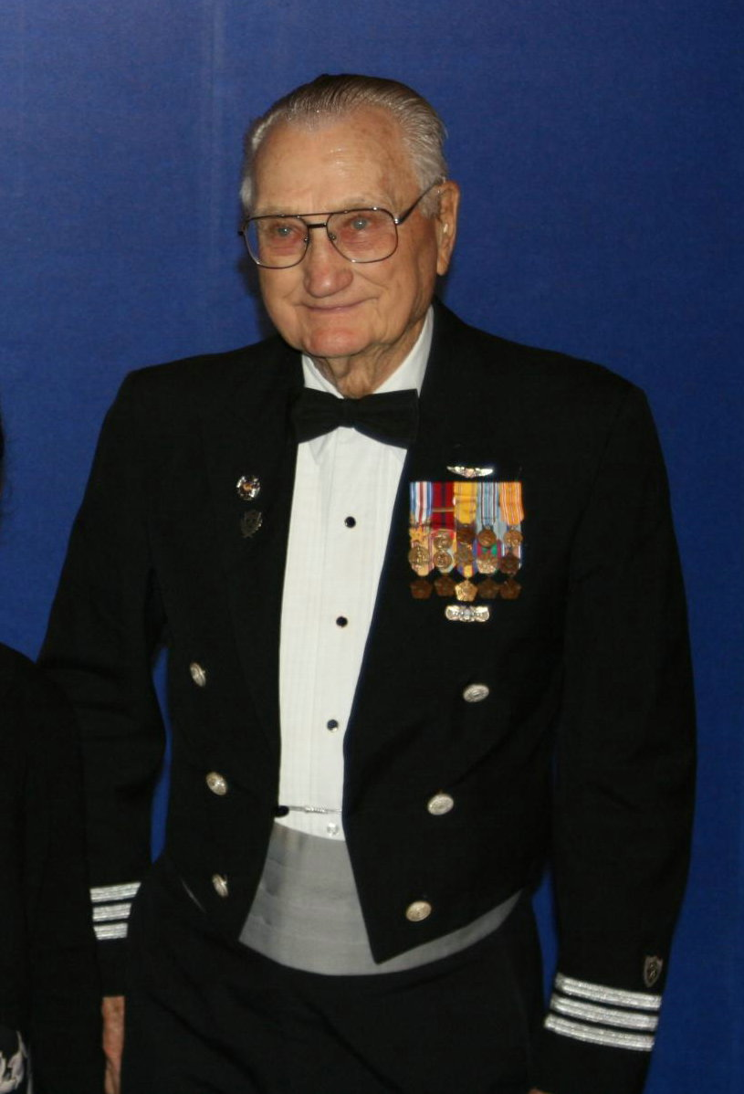
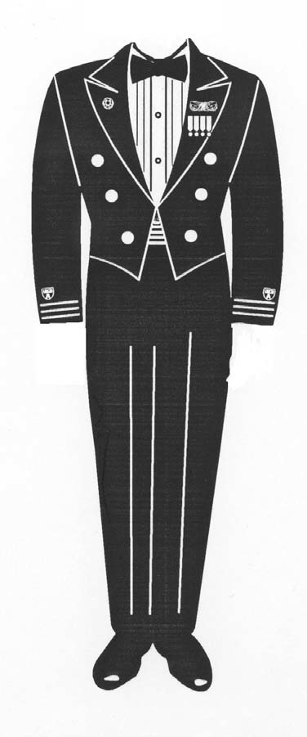
FORMAL WEAR
Dinner Dress Blue Jacket
Formal evening occasions
Dinner Dress
Blue Jacket

Slide 54
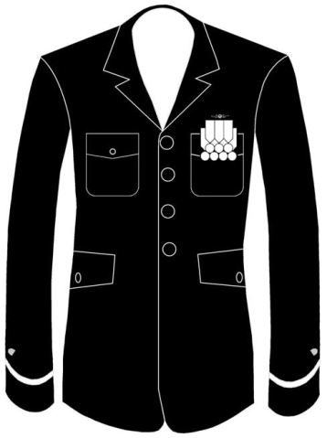
Formal Wear
Dinner Dress Blue
Formal evening occasions when Auxiliarist does not have the Dinner Dress Blue or White Jacket

Slide 55
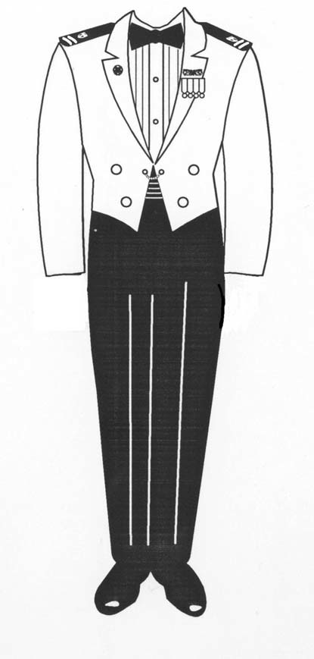
Formal Wear
Dinner Dress White Jacket
Formal evening occasions

Slide 56
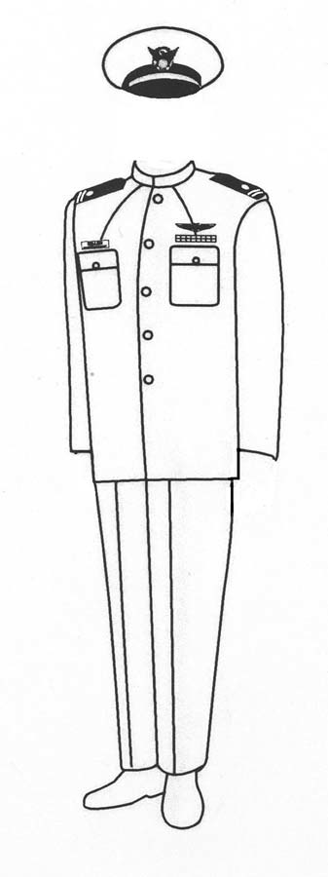
Ceremonial
Service Dress White
Ceremonies
Official functions

Slide 57
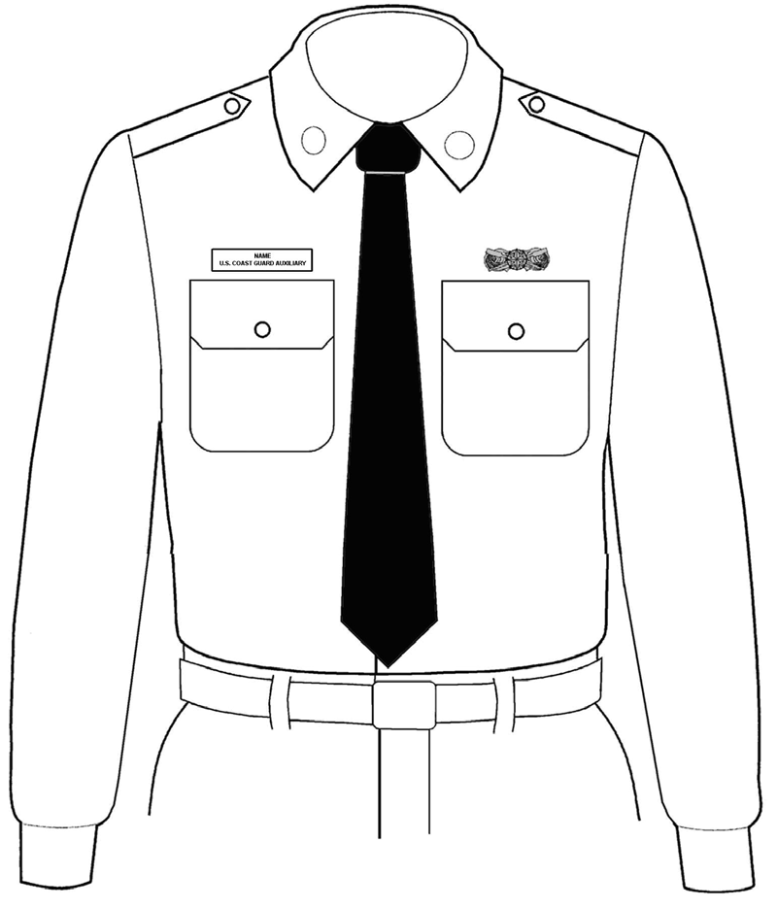
Formal Working Situations
Undress Blue – Winter
Classrooms
Unit meetings
Boating safety booths

Slide 58
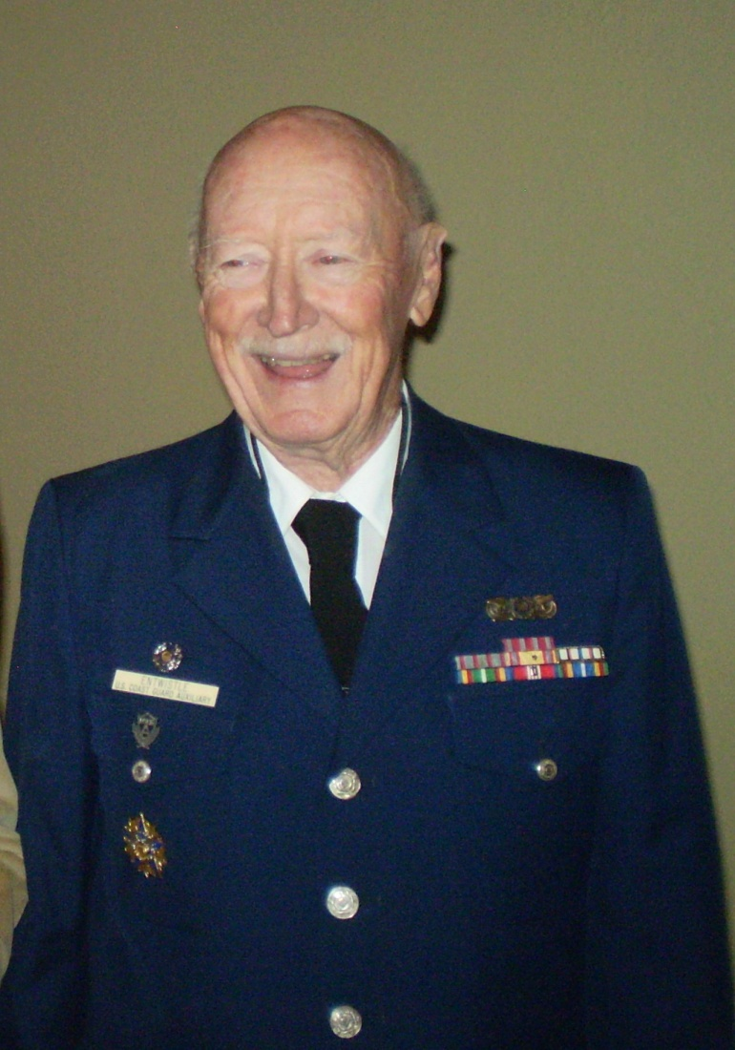
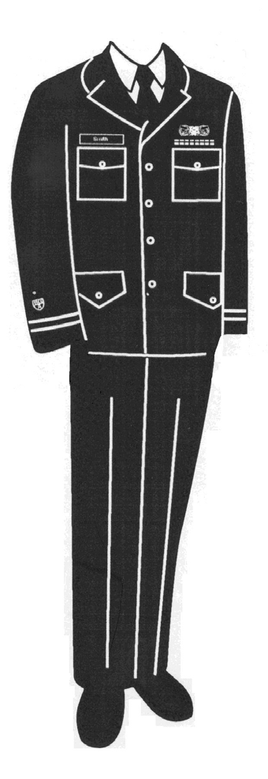
General Purpose
Service Dress Blue Bravo
All meetings
Classrooms
All similar functions
Occasions where civilian equivalent is coat and tie
May be worn year-round
Service
Dress Blue Bravo

Slide 59
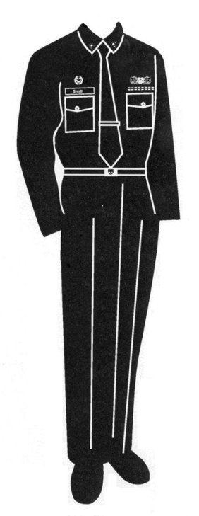
General Purpose
Winter Dress Blue
General office wear
Visits to Coast Guard units
Appropriate assignments to duty
Authorized from 01 November through 31 March

Slide 60
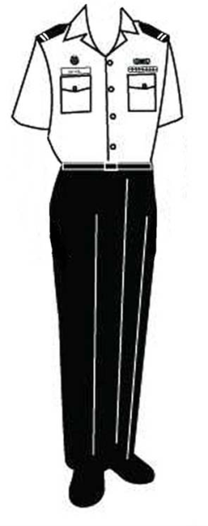
General Purpose
Tropical Blue
Meetings
Classrooms
All other similar functions
Most versatile uniform!
May be worn year-round

Slide 61
General Purpose
Operational Dress Uniform (ODU)
‘Every day’ Coast Guard
Uniform
Anytime a dress uniform
is not required

Slide 62
WEAR THE UNIFORM PROPERLY
OR
DON’T WEAR IT AT ALL!
WE ARE “TEAM COAST GUARD”

Slide 63
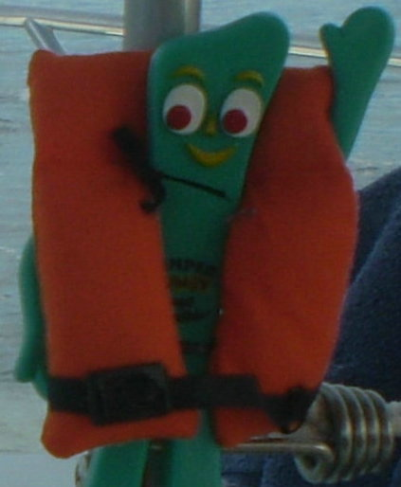
End of Presentation
THANK YOU!
Wally Smith
District 11N Chief of Staff
SEMPER GUMBY!

